Slide 2

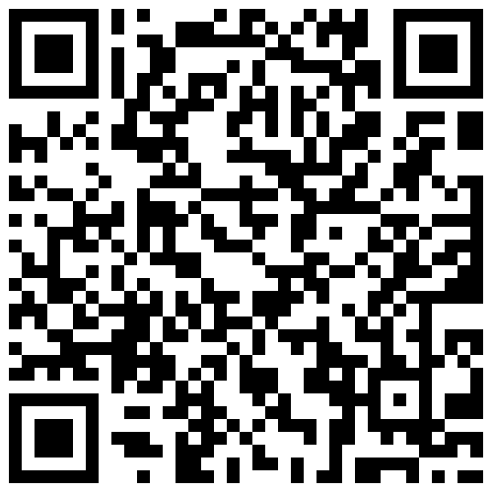

Slide 3
Windows Phone
First Up/ All Up
SESSION CODE: #WPH202
Nick Randolph (Built to Roam)
Dave Glover (Microsoft)

Slide 4
Agenda
Windows Phone Sprint Lap
Windows Phone Session Roadmap
State of the Platform
  Devices, OS, Tools and Marketplace
Let's get fruity with a bit of Mango
  New Tools, New APIs
Sample Application
  File > New …. Design, Debug ... Submit, Certify
Spotlight Finalists

Slide 5
Session Roadmap
 | Wednesday | Thursday | Friday
8:15 |  | Marketplace WPH203 | Cross Platform DEV-WPH314 | Multi-tasking WPH305
9:45 |  | Game Developers WPH305 | Phone to the Cloud COS-WPH208 | Performance WPH307
11:30 | SharePoint OFS202 | What's New WPH201
15:30 | First Up/All Up WPH202 | Application Platform WPH304
17:00 | Peeking at Source WPH308
18:30 | Spotlight SWP001

Slide 6
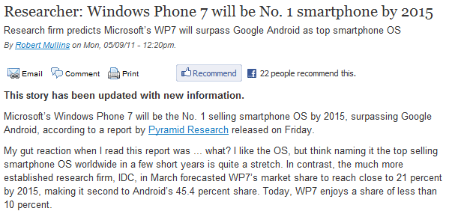
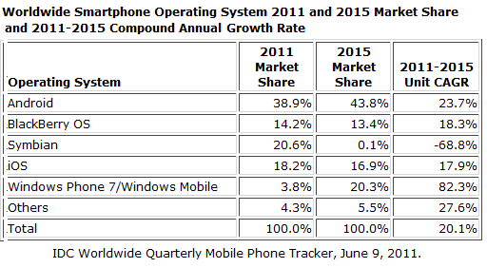
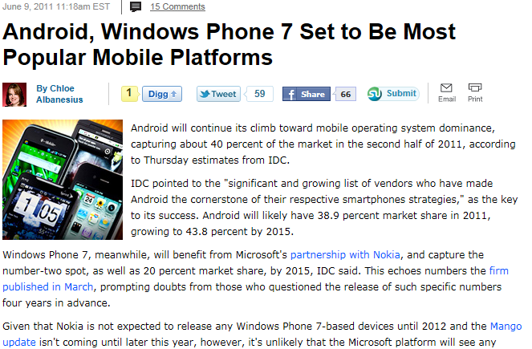
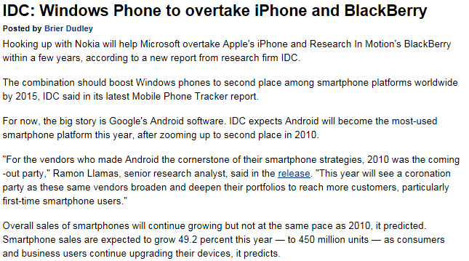
What the market is saying…

Slide 7

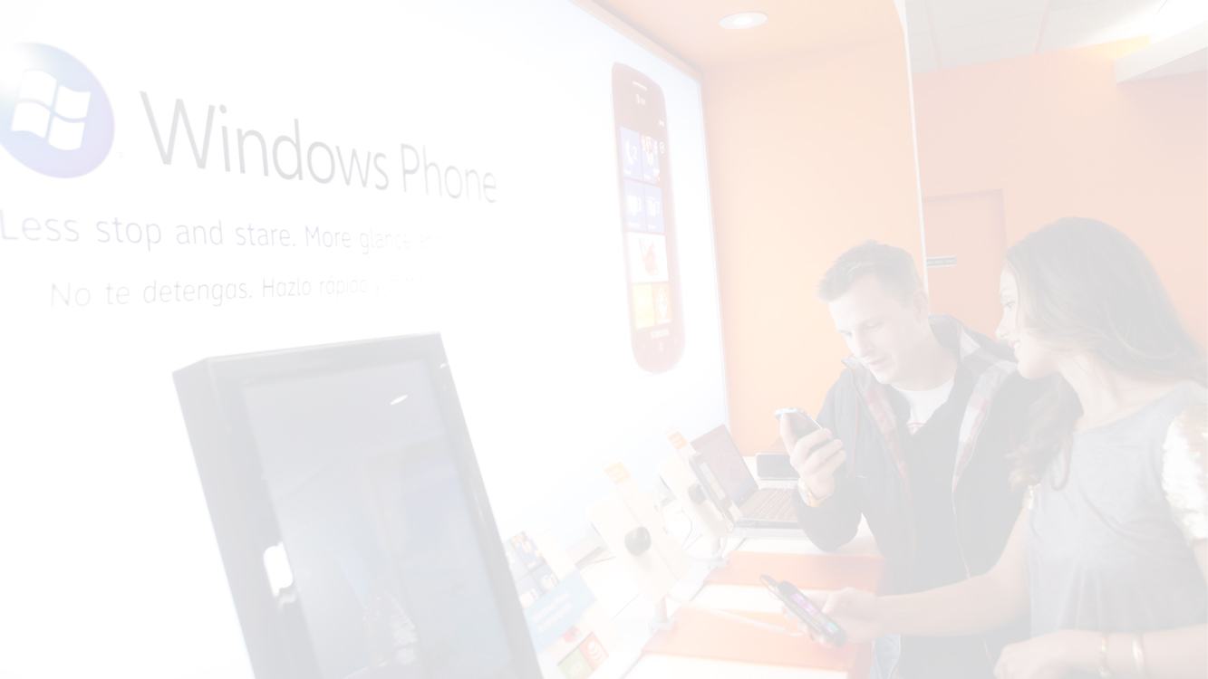

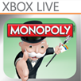





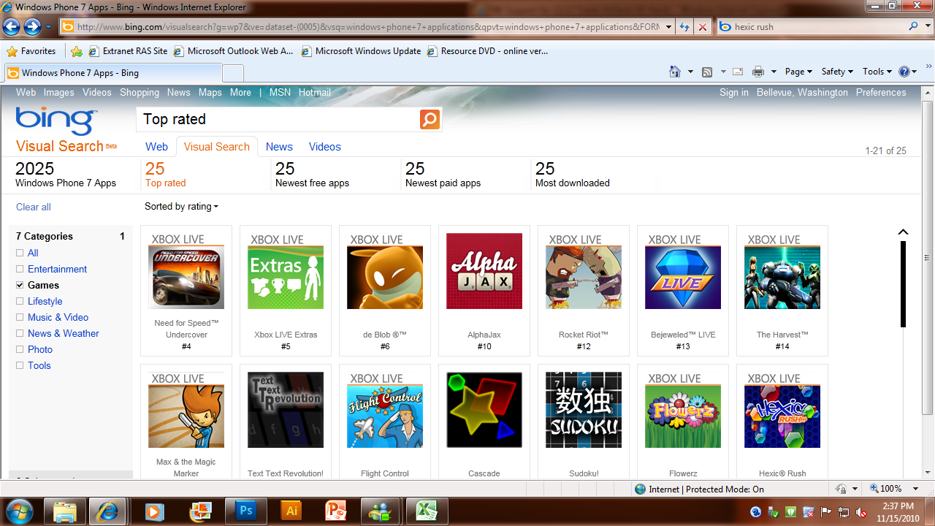
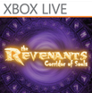










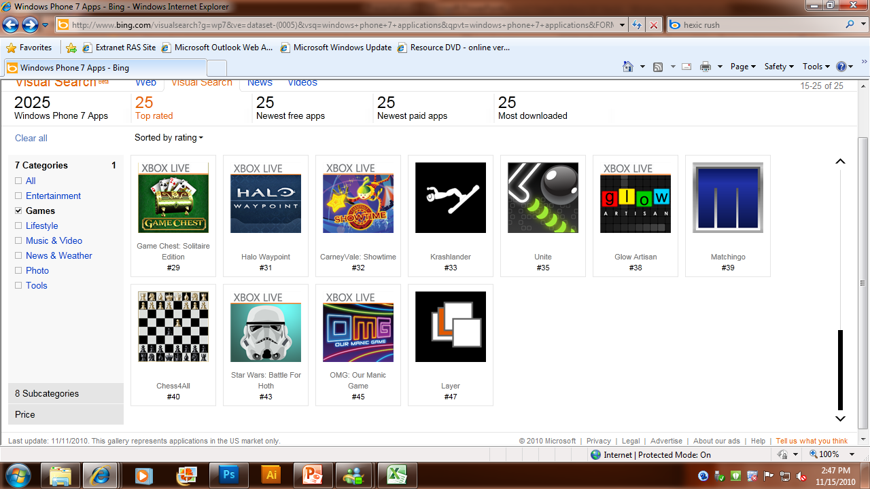












Slide 8





Ratings
UNITED STATES
WORLDWIDE
66%
93%
AWARENESS
SATISFIED
UNITED STATES
WORLDWIDE
66%
90%
VERY SATISFIED
RECOMMEND

Slide 9










Partners

Slide 10









NOKIA SHARE BY REGION CY2010
NORTH AMERICA
Total phone: 6%
Smartphone: 3%
WE
Total phone: 33%
Smartphone: 42%
LATAM
Total phone: 28%
Smartphone: 31%
MEA
Total phone: 63%
Smartphone: 70%
CEE
Total phone: 47%
Smartphone: 65%
APAC
Total phone: 42%
Smartphone: 46%
NOKIA GLOBAL SHARE (2010):
Total Phones: 450M units; 33% share
Smartphones: 100M units; 33% share

Slide 11
Windows Phone Community

Slide 12
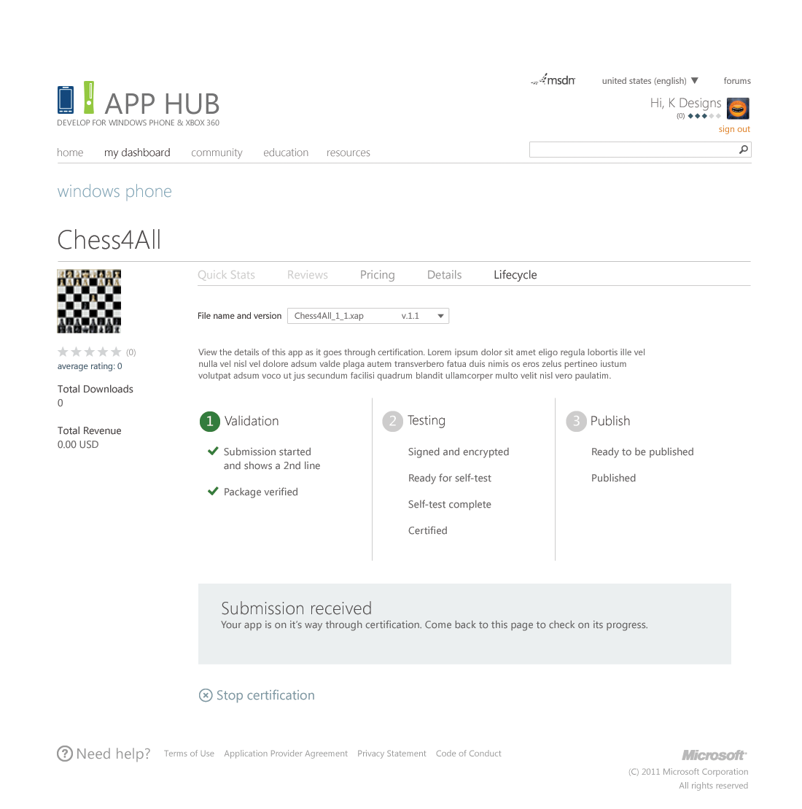
AppHub / Marketplace
AppHub
  New Dashboard
Marketplace
  New Search

Slide 13
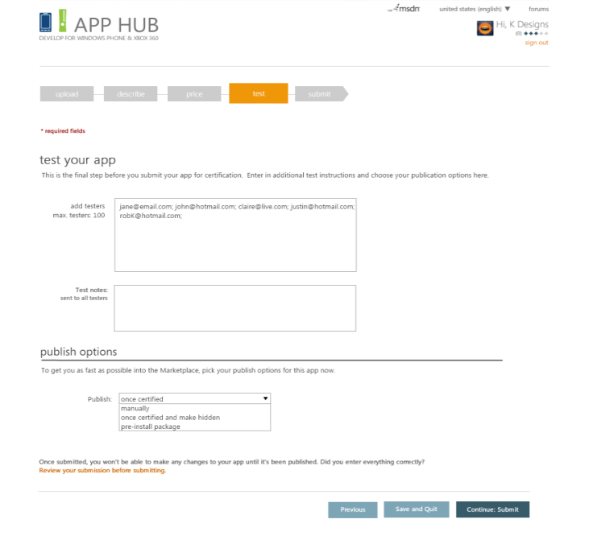
Beta Distribution Service
Capabilities
  List of testers (up to 100)
  Email with a private deeplink
  Provide feedback for 90 days
  No updates
Benefits
  No phone unlock required
  Higher quality apps

Slide 14
Targeted Distribution Service
Capabilities
  Certified before distributing
  App is not discoverable via Search
  No access enforcement
Benefits
  Private deployment

Slide 15
Windows Phone 7.5 (OS 7.1)
Windows Phone 7 Series
Windows Phone 7
Windows Phone
Windows Phone 7.5
Windows Phone OS 7.1

Slide 16

Multitasking
Fast Application Resume
Application resume
Apps stay in memory longer
Every Application!!!
Live Agents
Run code in the background
Audio, timed, or on idle
Notifications
Create alarms and reminders
Consistent UX with platform
Background Transfer Service
Background upload/download for large files

Slide 17
Integrating with the Phone
Camera
Access to the pipeline
No need to capture the image to flash
Sensors
GPS
Accelerometer
Compass
Gyro
Spatial Framework
Networking
Sockets
Connection Manager control
Data
SQL CE
Phone Contacts
Phone Calendar
Launchers and Choosers
Bing Maps
E-mail
Phone Number
Address Chooser
Controls
Frame and Page Navigation improvements
Performance
Open Source on CodePlex

Slide 18
Expanding the Phone Framework
Tiles
Signature user experience for Windows Phone
Complete Framework
Multiple Tiles
Push Notifications
Deep Toast
More control over notifications
Phone Extras
Search
Music
Photos

Slide 19
Tools Investments
Tools
New template for multitasking
Debugging background agents
Isolated Storage Explorer
Profiler
.NET
Performance
Generational GC
Serialization
SIMD – vector
Profiler
Emulator
Sensors and location in Emulator
Multi-touch in Emulator
Screenshot
Ingestion tool

Slide 20
Make My App
Create a New Project
Social View Template
http://socialviewer.codeplex.com
demo

Slide 21
Navigation
Forward navigation
Back Stack

Slide 22
Application Lifecycle
Multi-tasking??
Tombstone v's Dormant
Application events
Page events
Persistent v's Transient state

Slide 23
Make My App Better
Design Time Experience
Expression Blend
demo

Slide 24
Phone Controls
Panorama
Pivot
Map
Toolkit
  LongListSelector
  ListPicker
  DateTimePicker
  WrapPanel

Slide 25
Make My App Faster
Performance Tuning
Visual Studio
demo

Slide 26
Make My App Searchable
Bing Search Integration
Search Extras
demo

Slide 27
Make My App Available
Publish Application
AppHub and Beta Distribution
demo

Slide 28
Spotlight 2011
Finalists
  TransHub
  WasteNot
  QLD Fisheries
  TrafficMate

Slide 30

Enrol in Microsoft Virtual Academy Today
Why Enroll, other than it being free?
The MVA helps improve your IT skill set and advance your career with a free, easy to access training portal that allows you to learn at your own pace, focusing on Microsoft technologies.
What Do I get for enrolment?
Free training to make you become the Cloud-Hero in my Organization
Help mastering your Training Path and get the recognition
Connect with other IT Pros and discuss The Cloud
Where do I Enrol?
www.microsoftvirtualacademy.com
Then tell us what you think. TellTheDean@microsoft.com

Slide 31

© 2010 Microsoft Corporation. All rights reserved. Microsoft, Windows, Windows Vista and other product names are or may be registered trademarks and/or trademarks in the U.S. and/or other countries.
The information herein is for informational purposes only and represents the current view of Microsoft Corporation as of the date of this presentation. Because Microsoft must respond to changing market conditions, it should not be interpreted to be a commitment on the part of Microsoft, and Microsoft cannot guarantee the accuracy of any information provided after the date of this presentation. MICROSOFT MAKES NO WARRANTIES, EXPRESS, IMPLIED OR STATUTORY, AS TO THE INFORMATION IN THIS PRESENTATION.

