Slide 2
Real World Windows Azure WITH GreenButton
SESSION CODE: VOC-COS206
Dave Fellows
CTO
GreenButton

Slide 4
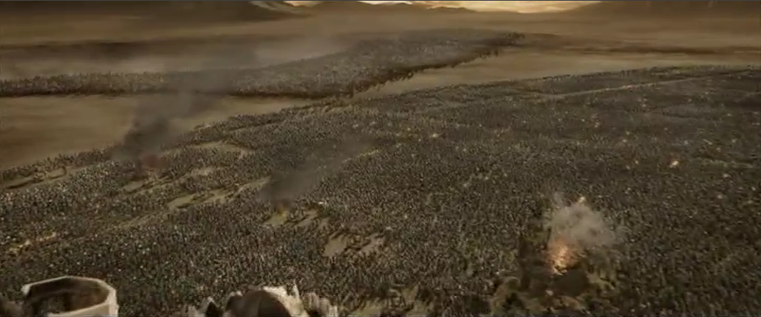

Slide 6


GreenButton allows you to access the power of a Supercomputer from your Desktop

Slide 7
High Performance Computing is…
$$$

Slide 8

High Performance Computing is complex
The stuff just takes too darn long!!

Slide 9




GreenButton allows ISVs to easily use the cloud for HPC
ISV Applications
Digital Media
Engineering
Platform
Oil / Gas
ISV app
ISV app
ISV app
Financial Services
Bio-technology

Slide 10
Using the cloud is more cost effective
1 minute animation
30 frames for every second
= 1800 frames @ 1 hour a frame
= 1800 hours of processing!
Desktop
Datacenter
GreenButton
Time to Process:
75 days
1 hour
1 hour
Cost:
$1500
$3,500,000
$540

Slide 11

demo

Slide 12
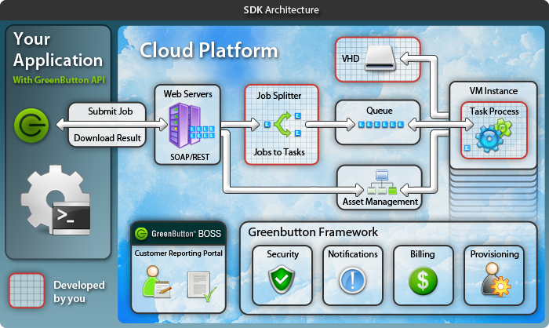
Enable an app in hours

Slide 13

GreenButton SDK
Deep Exploration
demo

Slide 14
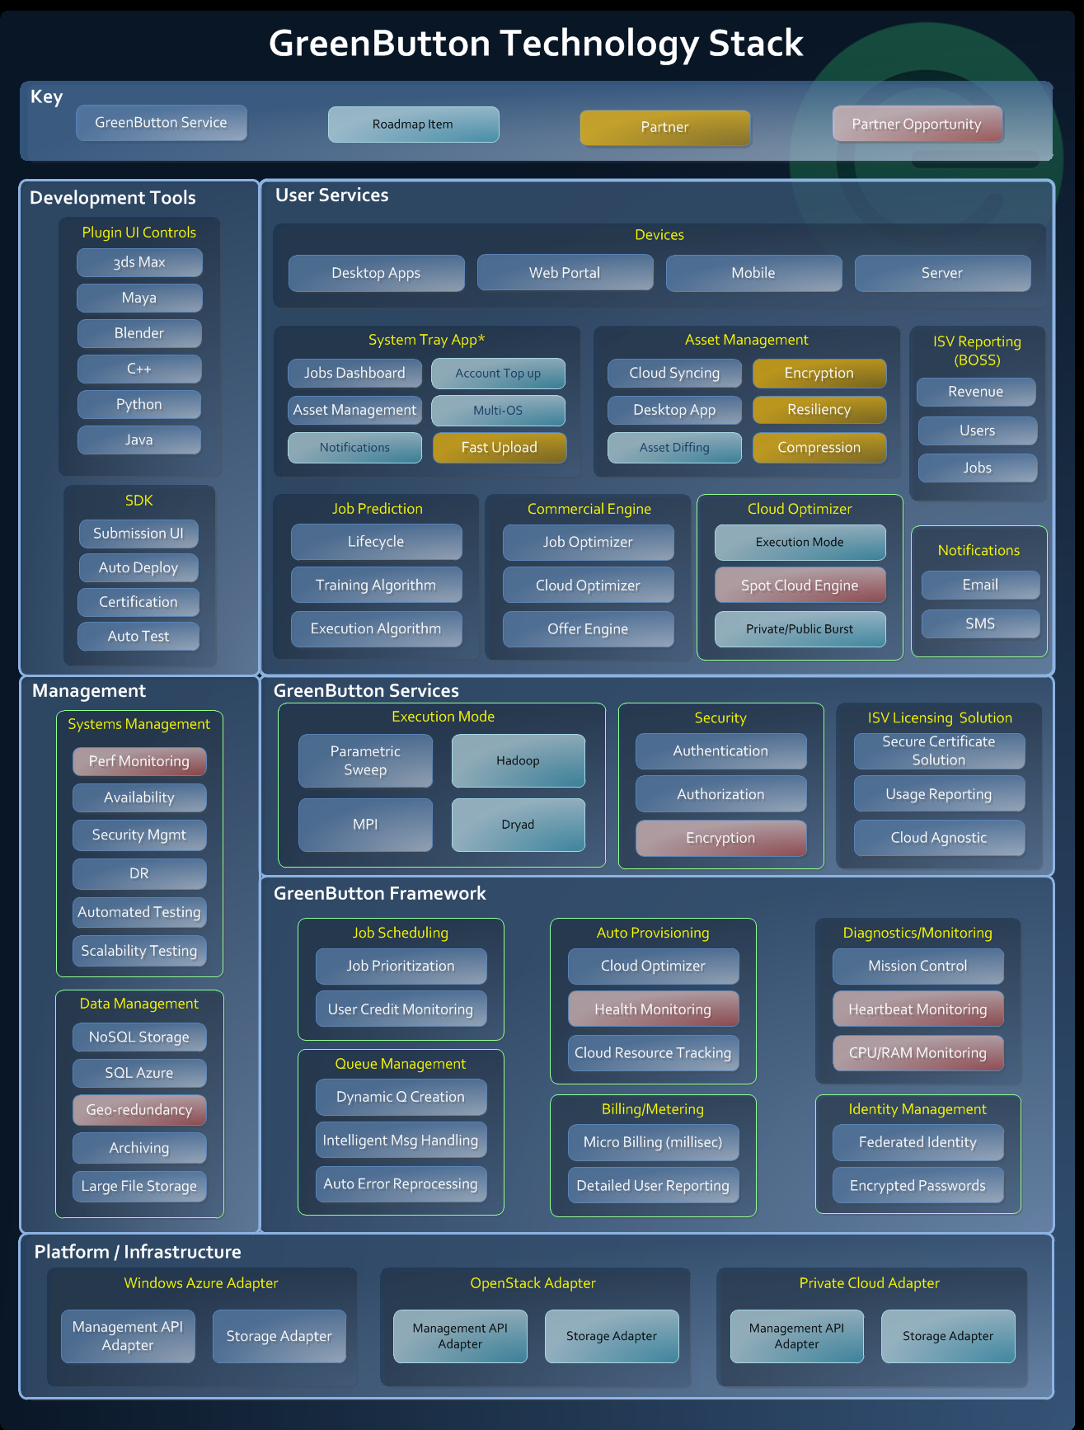
Cloud Agnostic Architecture to support a variety of job requirements (e.g. linux)
Use of Dependency Injection & Inversion of Control to support configurable cloud-specific implementations
Multi-tenant Architecture designed to scale for thousands of ISVs, millions of users

Slide 15

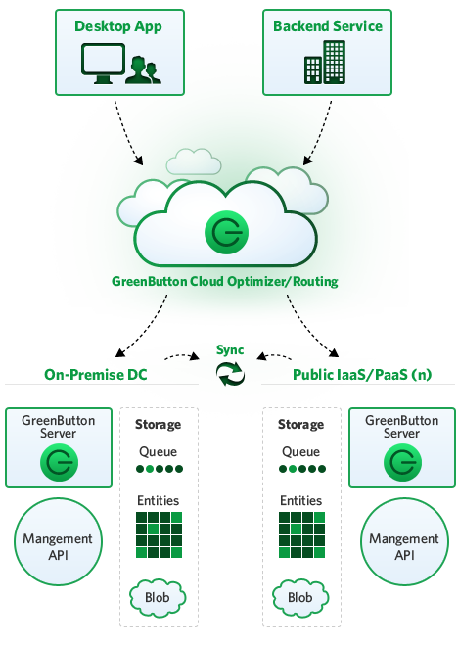
GreenButton Server allows customers to use existing hardware

Slide 16
job
Embarrassingly Parallel
Jobs
Job
Manager
(web role)
Message Passing Interface
Jobs
T
Job Queue
Split
T
Job Queue
J
T
Job Queue
MPI Jobs Queue
Job to Tasks
Virtual Cluster
Head
Node
Worker
Node
Worker
Node
Worker
Node
Job
Scheduler
Resource Controller
(worker role)
Worker
Node
Worker
Node
Worker
Node

Slide 17
Auto Scaling
with the Management API
demo

Slide 18
Azure Connect (VPN)
Connecting the cloud & on-premise
demo

Slide 19
Windows Azure Insights…
Don’t assume instances will be healthy
“Cloud” Virtual Machines are rather volatile

Slide 20
Windows Azure Storage Insights…
NoSQL – Azure Table Storage vs SQL Azure
Identify bottlenecks – Measure everything
  Know the scalability limits of your architecture
Azure Storage scalability limits – sharding over multiple storage accounts
Retry logic is paramount!
  Use the Transient Fault Handling Framework
http://windowsazurecat.com/2011/02/transient-fault-handling-framework/

Slide 21
HPC in the Cloud…
Debate continues on viability
Performance is relative to cost
Cost savings can be massive for spikey loads

Slide 22

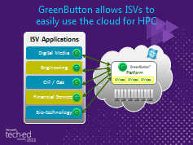
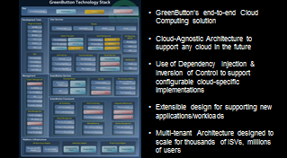
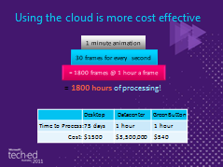
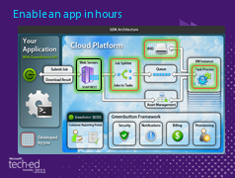
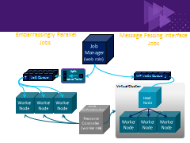
Summary
$$$

Slide 23


Access the power of a Supercomputer from your Desktop

Slide 24

Enrol in Microsoft Virtual Academy Today
Why Enroll, other than it being free?
The MVA helps improve your IT skill set and advance your career with a free, easy to access training portal that allows you to learn at your own pace, focusing on Microsoft technologies.
What Do I get for enrolment?
Free training to make you become the Cloud-Hero in my Organization
Help mastering your Training Path and get the recognition
Connect with other IT Pros and discuss The Cloud
Where do I Enrol?
www.microsoftvirtualacademy.com
Then tell us what you think. TellTheDean@microsoft.com

Slide 25

© 2010 Microsoft Corporation. All rights reserved. Microsoft, Windows, Windows Vista and other product names are or may be registered trademarks and/or trademarks in the U.S. and/or other countries.
The information herein is for informational purposes only and represents the current view of Microsoft Corporation as of the date of this presentation. Because Microsoft must respond to changing market conditions, it should not be interpreted to be a commitment on the part of Microsoft, and Microsoft cannot guarantee the accuracy of any information provided after the date of this presentation. MICROSOFT MAKES NO WARRANTIES, EXPRESS, IMPLIED OR STATUTORY, AS TO THE INFORMATION IN THIS PRESENTATION.

Slide 26




Resources
www.msteched.com/Australia
  Sessions On-Demand & Community
www.microsoft.com/australia/learning
Microsoft Certification & Training Resources
http:// technet.microsoft.com/en-au
  Resources for IT Professionals
http://msdn.microsoft.com/en-au
  Resources for Developers

Slide 27
Agenda
Agenda Subtitle
Agenda item 1
  Agenda subheading
Agenda Item 2
  Agenda subheading
Agenda item 3
  Agenda subheading
Etc…

Slide 28
PowerPoint Template
Subtitle color
Example of a slide with a subhead
  Set the slide header to “Title Case”
  Set subheads in “sentence case”
  Generally set subhead to 36pt or smaller so it will fit on a single line
  The subhead color is defined for this template but must be selected; In PowerPoint 2010, it is the fifth font color from the left

Slide 29
PowerPoint Guidelines
Font, size, and color for text have been formatted for you in the Slide Master
Use the color palette shown below
Hyperlink color: www.microsoft.com
Sample Fill
Sample Fill
Sample Fill
Sample Fill
Sample Fill
Sample Fill

Slide 30
Slide for Showing Software Code
Use this layout to show software code
  The font is Consolas, a monospace font
  The slide doesn’t use bullets but levels can be indented using the “Increase List Level” icon on the Home menu
  To use straight quotes " instead of
  smart quotes ”, do this:
  Click on the Office Button in the upper left corner
  At the bottom of the menu, choose PowerPoint Options
  From the left pane, select Proofing
  Click on the AutoCorrect Options button
  Select the AutoFormat As You Type tab,
  and deselect “Straight quotes” with “smart
  quotes”. Then Click OK.

Slide 31
Table Format
Table Title
Column 1 | Column 2 | Column 3 | Column 4 | Column 5

Slide 32
Bar Chart Example

Slide 33
Pie Chart Example

Slide 34




Tech·Ed Bling
  Email Signature
  Blog Bling
Email Signature
  Blog Bling

Slide 35
Appendix 1: PowerPoint Twitter Tools
In the next few slides you will find Twitter tools which you can use in your session to promote audience interaction.
These twitter tools allow presenters to see and react to tweets in real-time, embedded directly within your presentation, either as a ticker or a refreshable comment page.
To activate these components, simply view this PPT in slide-show mode to install the plug-in, and follow the instructions given.
Note: this is an optional add-in. You may remove these slides if you do not wish to use them.

Slide 36
You can “auto tweet” from presentations using the AutoTweet plugin, available here (Office 2007) or here (Office 2004)
Autotweet (tweet any notes between the tags [twitter] and [/twitter]

Slide 37
Twitter feedback slide
Display a feedback slide with questions and comments from Twitter

Slide 38

Twitter Voter – Real time voting over Twitter
To vote, make the first character of your tweet an option number, and include a unique voting string somewhere in the text, e.g. “1 is the option I choose! myvote” OR “@votebytweet 1 myvote” (your followers won’t see the votes by default)
1. Option 1
2. Option 2
3. Option 3

Slide 39
Twitter voter: Part Two
1. Option 1
2. Option 2
3. Option 3
4. Option 4
1. Option 1
2. Option 2
3. Option 3
4. Option 4
5. Option 5
1. Option 1
2. Option 2
3. Option 3
4. Option 4
5. Option 5
6. Option 6
1. Option 1
2. Option 2
3. Option 3
1. Option 1
2. Option 2

Slide 40
Twitter ticker and mood meter
This tool is a variation on the twitter voting. The audience can tweet either:
  @votebytweet warmer myuniqueid
  @votebytweet colder myuniqueid

Slide 41

PowerPoint noise meter (uses microphone)

