Slide 1
Windows® Centric Singular Information Management for Hyper-V™ and the Microsoft® Enterprise
SESSION CODE: SVR316
Brett Chase
Technical Director APJ
CommVault

Slide 2
Agenda
Agenda Subtitle
Who is CommVault
  Why are we talking to you
Data and Information Management in a Hyper-V Environment
  Best in class solutions for backup, archive and information access
Its not about the data, its all about the information
  Increasing user productivity with access to information

Slide 3
Who is CommVault

Slide 4
Who We Are. What We Do.
Software company solely dedicated to enterprise data and information management.
CommVault is redefining Backup & Recovery by offering a single solution that enables companies to efficiently capture, move, retain, find and recover data from any storage tier. We call this Modern Data Protection.
Our “Solving Forward” philosophy.
The embodiment of our philosophy is found in our singular product, Simpana® software.

Slide 5

Company Stats
Over 14,000 customers
1,900 new customers in the last year alone
97% customer satisfaction
More than 1,300 employees worldwide
Publicly traded on NASDAQ: CVLT
Over $215 million in cash, no debt
FY11 Revenue of $314.8 million
Recognized leader in a $5 billion Backup & Recovery market.

Slide 6

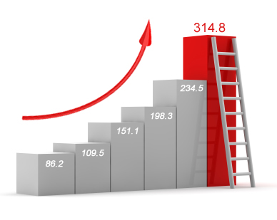
Unprecedented Market Growth
2005 2006 2007 2008 2009 2010

Slide 7

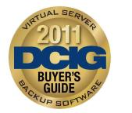

Industry Validation
CommVault and Simpana® software, recognized for excellence
2011 Info-Tech Research Group’s Champion for Enterprise Backup Software
2011 DCIG Best in Class Virtual Server Backup Software
2011 Microsoft Server Platform Partner of the Year

Slide 8
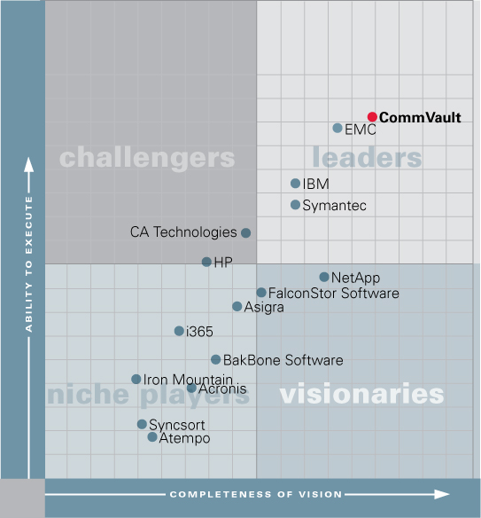
Industry Validation
Gartner Magic Quadrant
CommVault positioned in the “Leaders” quadrant in Gartner’s 2011 Magic Quadrant for Enterprise Disk-Based Backup and Recovery
$5+ Billion Market in Transformation
Source: Magic Quadrant for Enterprise Disk-based Backup/ Recovery ; by David Russell, Sheila Childs, Alan Dayley; January 28, 2011
The Magic Quadrant is copyrighted 2011 by Gartner, Inc. and is reused with permission. For more details visit www.commvault.com

Slide 9


A Massive Transformation is Underway
IT is under fire. More & more demands with fewer resources
Cost Reduction &
Operational Efficiency
Universal
Virtualization
Data Center
Consolidation
Cloud
Computing
eDiscovery &
Records Retention
Information
Analytics and BI

Slide 10
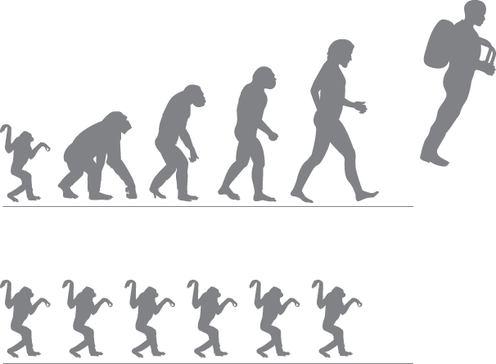
Historic Lack of Investment
Enterprise Backup & Recovery
Evolution of the Data Center
Investment in Data Protection
“The rising frustration with backup implies that the data protection approaches of the past may no longer suffice in meeting current, much less future, recovery requirements.”
-Gartner Magic Quadrant Jan. 2011

Slide 11
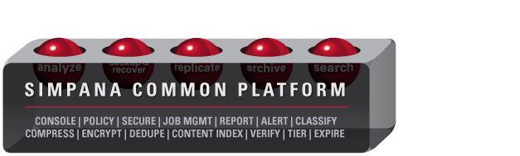
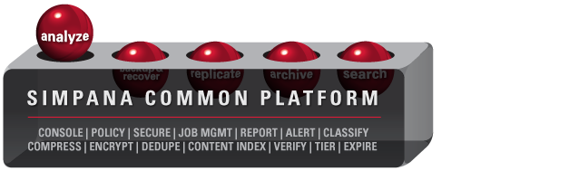
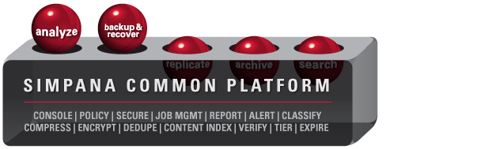
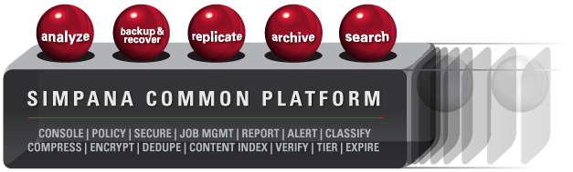
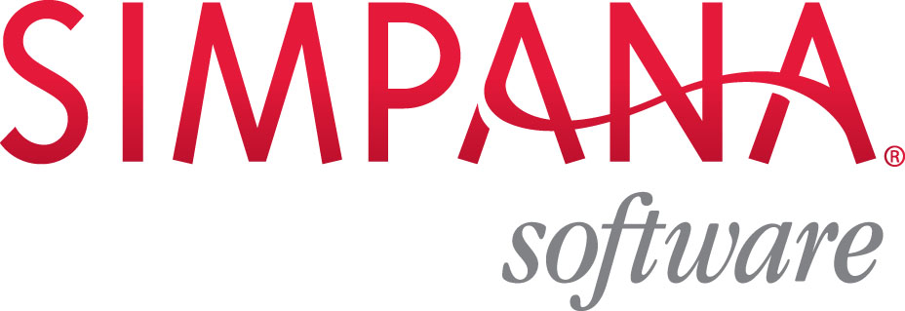
Simpana® software
Plan for the future today with our single-platform

Slide 12


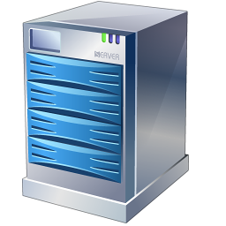
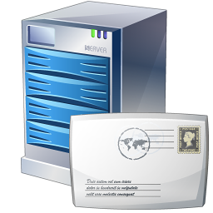
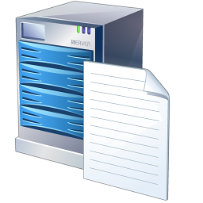
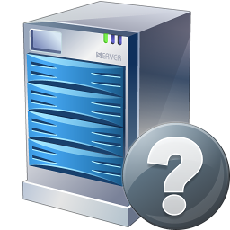
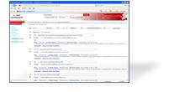
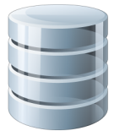





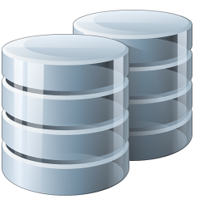
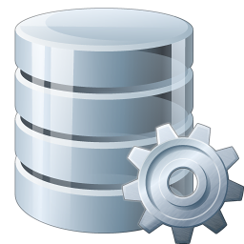

Simpana 9.0 Software Suite
One Platform, One Approach
Extended Search
Legal Discovery Search & Hold
User Self-Serve Search and Restore
Complete search coverage across archive and backup data
Common Infrastructure
Security
Compression
Encryption
De-Duplication (object)
Load Balancing
State Persistence
Intelligent Agents
Application
Databases
Document
Management
Email
File & Print
Deleted
Backup
Content Index
Search
Discover
Retrieve
Analyse
Purge
Audit
Copy
Replicate
Snapshot
Find
Trace
Analyse
Move
Migrate
Archive
Unified Management
Single Unified GUI
Policy automation
Task / role subdivision
Integrated Proactive Reporting
Auditing & Alerting
SNMP Compliant
Index & Search
Content Index (File, File metadata, platform metadata and tags)
401 File Formats, 88 Languages
Web Search & View
Web Folder Structure
Single Consolidated Pool of Managed Data

Slide 13
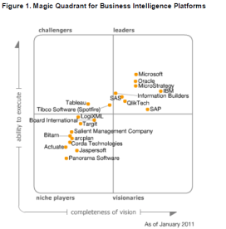
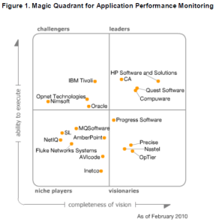
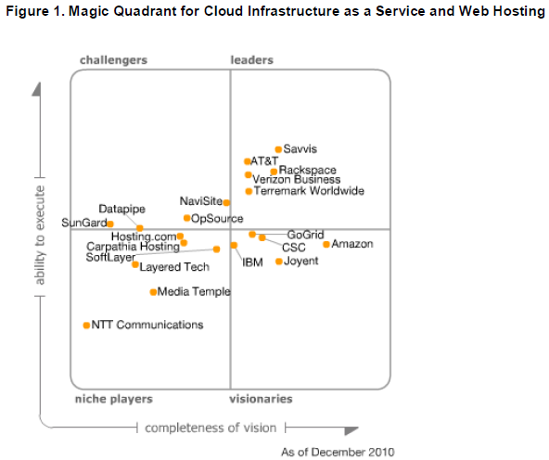
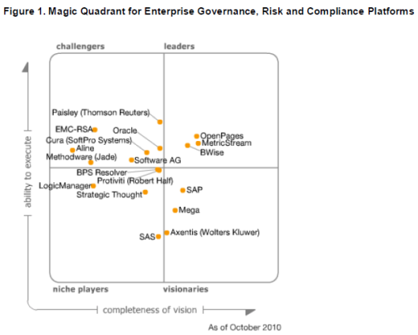
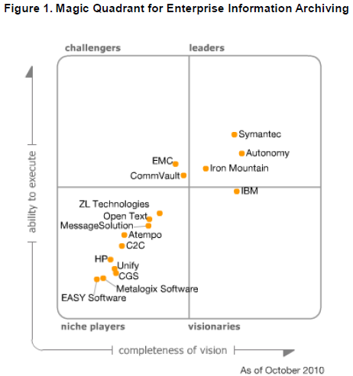
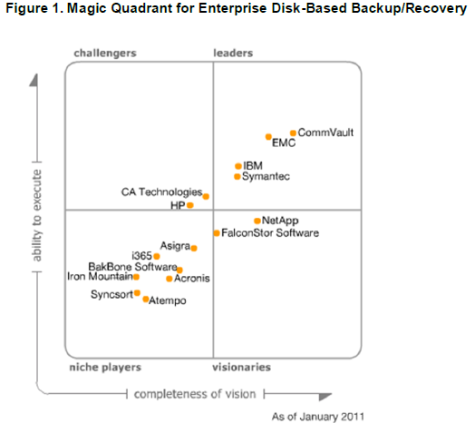
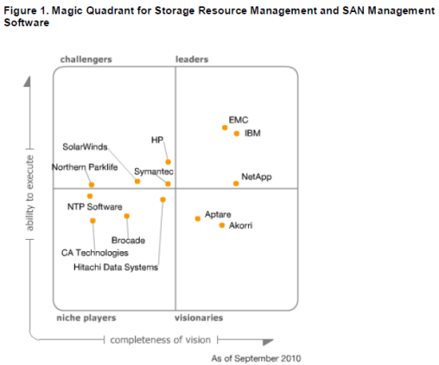
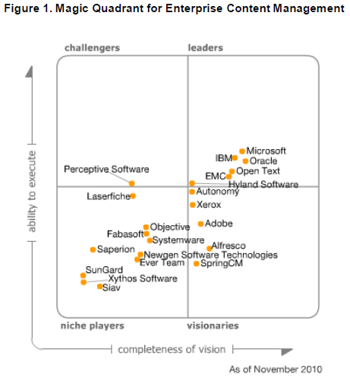
Strategic Expansion of Available Market
Offerings in 8+ Gartner Magic Quadrants
$3.0B
$5.3B
$7.8B
$9.1B
$9.6B
Strategic Archive
10% -15% long term growth
Evolution from e-Mail to Information Archiving for long term retention
Vertical apps – healthcare, Sciences, SPP
Info Governance
8% - 10%% long term growth
E-Discovery & Legal Hold important market drivers
Retention of Info Assets for Business/IT Governance
IT Ops Management
12% - 14% long term growth
Virtualization & Cloud breaks traditional solutions
IT Ops market open to new solutions

Slide 14
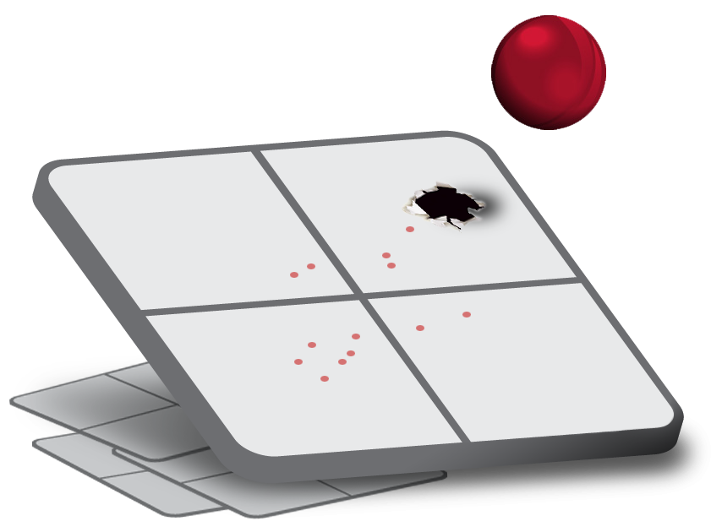
Our Vision
Leadership in a Market of One
Markets and products are combining into a single, comprehensive solution
Commvault will be the leader in this new, combined market

Slide 15
Hyper-V – Data and Information Management

Slide 16
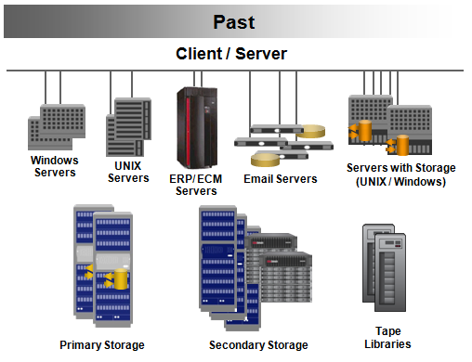
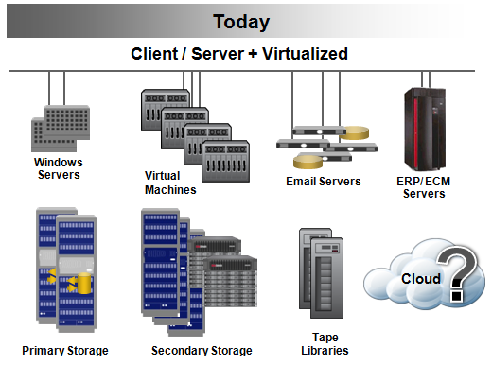
IT Infrastructure Evolution
The modern data center is adding new storage management challenges
High Rates of Data Growth
+
High Density VM Environments
Manageable work loads
Dedicated resources
Dedicated operating window
Highly consolidated & automated
Shared physical resources
24x7 Operations

Slide 17

The Old Way Just Does Not Fit
Legacy data protection techniques often complicate the transition to virtualization
Not enough time to move data
  Too much data per host
Insufficient resources for operation
  Hosts, VMs and Storage systems cannot divert resources for intense IO operations
Agent based operations too cumbersome and time consuming
  No time to maintain and monitor each VM and software within it individually
Legacy Data Protection
Modern Data Center

Slide 18
Data Protection Challenges in VMware environments
Challenge | Details
Operational Overhead caused by VM sprawl | Critical admin time is spent manually discovering and configuring new VMs for data protection VMs created without admin knowledge need automatic protection Unimportant VMs should be backed up less frequently or not at all.
Impact on Virtual Infrastructure | Off load backup load from production systems and servers Distribute backup workload evenly across all available resources for maximum throughput Minimize the impact of snapshots on infrastructure
Balancing short term recovery and DR objectives with long term retention needs | Single pass backup that provides full VM and granular recovery capabilities with no restaging of full VMDK. Create second copy at DR site without impacting production environment Copy data to tier 2 storage for offline storage and long term retention

Slide 19
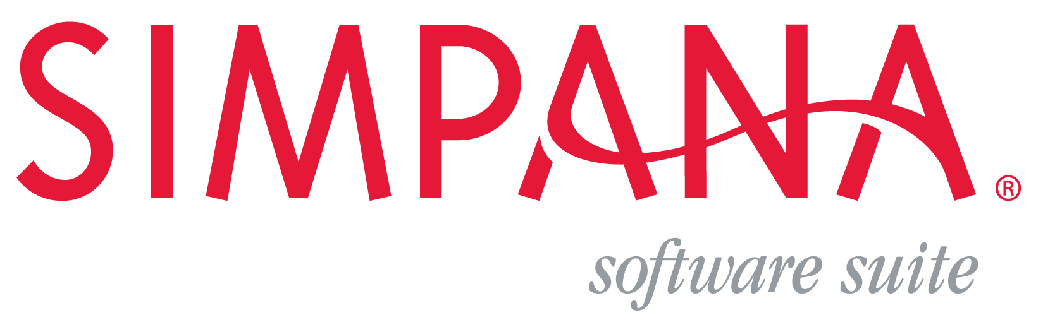
Simpana 9 Enables Rapid Hyper-V Deployments
Easily handles:
Scale
  Immune to VM Sprawl
  No admin intervention
Time to Protect
  Create protection copies in minutes
Infrastructure Impact
  Minimal physical and virtual server load
  Best utilization of expensive resources
# of VMs
Thousands of VMs
Hyper-V Backup API’s
Agent in Guest
500
VMs
Protects in minutes
500
VMs
Time
50
VMs
500
VMs
50
VMs
50
VMs
500
VMs
Minimal Impact
Server Load
50
VMs
500
VMs
50
VMs
500
VMs
50
VMs

Slide 20
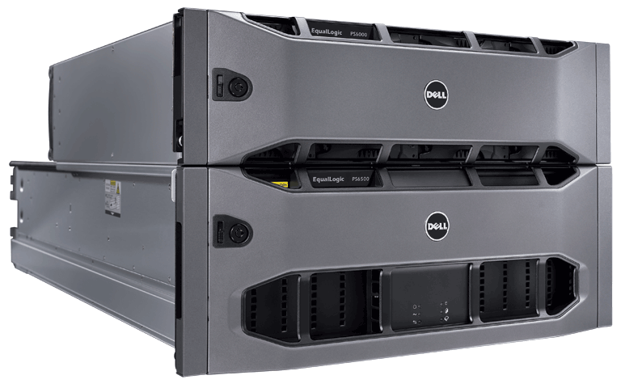
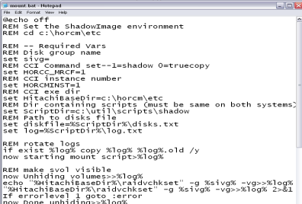
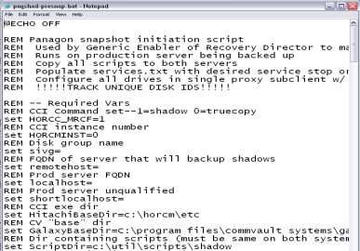
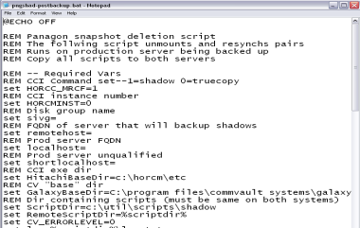
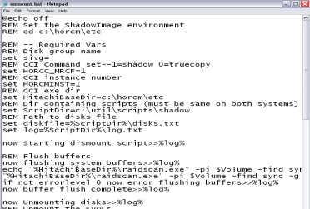
The Snapshot Problem
Snapshots
Data Management
Recovery
Backup/Archive/Replication
Multiple copies across tiered storage
Instant Application-Aware Protection
Integrating these two is NOT EASY
Scripting
No application integration
Multiple user interfaces
Multi-step restore
Notes:
20

Slide 21
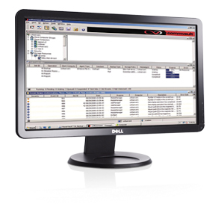



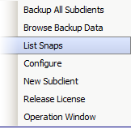


CommVault SnapProtect
Policy
Protection job, quiesce the source, trigger snapshot, catalog contents, enables reporting and alerting
Provides Application and File Level Consistency
Align retention to drive storage economics across ALL tiers
Windows, Linux, Unix
VMware and MS Hyper-V
Exchange, SQL, Oracle, DB2, SAP
Production Volumes
RECOVERY TIER (Tight Array Integration)
Application consistent for rapid recovery
Content-aware /cataloged jobs (offload processing)
Searchable data for granular recovery
EMC (DMX, CX, NAS, VMAX, )
NetApp
HDS (VSP, USP, AMS)
Dell (EqualLogic, Compellent, MD)
HP (EVA, 3PAR, MSA, XP)
IBM (DS, SVC, XIV)
LSI (IBM, Dell, SUN...)
8 AM
12 PM
4 PM
Simplified Restore from Any TIER
4HR SnapCopy – retain for 3 days
Contents
MA
PROTECTION TIER (Any Open Disk Target)
Mount Snap /Extract job relevant contents only to create daily backup retention copy
Deduplicate ,Encrypt, Verification
Any Disk ( DAS, SAN, NAS, JBOD… )
Dedicated or Shared
Dell DL2200 (HW) Appliance (auto disk provisioning/mgmt, 220TB capacity, 3.3 T/H)
SATA
Daily Backup Copy – retain for 60 days
Contents
REST /Service
Amazon
Azure
Rackspace
Iron Mountain
Nirvanix
REST /Platform
EMC (Atmos)
Dell (DX)
HDS (HCP)
Mezeo
CLOUD
COMPLIANCE TIER (Disk, Tape, Cloud)
Selective jobs to lowest-cost storage for long term retention; preserving dedupe, encryption
CommVault was the first to integrate w/ cloud storage (HTTP / service or platform) offerings
DISK
TAPE
Month end Vault Copy – retain for 7 years

Slide 22

Modernized Virtual Protection
Scaling-Up while Collapsing the Backup Window
1
1
Auto-Discovery: Policy discovers new VMs and adds matches, that group is protected as a set in a “job” (control sprawl )
VM Server Pool
SnapProtect Job: Quiesce VM set, ensuring application consistency, trigger snapshot of VM CSV(s) (minutes per store)
2
Hyper-V
Pool
2
3
Recovery Ready: Mount snap/image and catalog each for VM recovery = SnapCopy (offloaded to virtual client on Hyper-V proxy)
Cluster Shared Volume (CSV)
VMDKs on VMFS
Data Store Pool
Persistent HW Snapshots containing Rapid Recovery VM Images
8 hr
Daily Backup Copy: Create backup instance, inline or post-process, mount snap, run Hyper-V backup --chg blks + dedupe + file lvl index-- and write to backup target (zero impact on production tier VMs or Hyper-V hosts)
16 hr
4
SAN Storage
24 hr
Cluster Shared Volume (CSV)
SnapCopy: Images (/8hrs) 3 day retain
Data Blocks/Array + Catalog/Index
Recover whole VM or the Store Vols
Target with App Info Mining
500 VM’s Start to Finish
17 minutes flat
Optional Hyper-V Proxy off-loader running Virtualisation and SnapProtect Client
1
—
2
—
3
3
VSA
SPC
BackupCopy: Jobs (/24hrs) 90 day retain
Deduped Data+Catalog/Granular index
Recovery whole VM, Files or App Mining
4

Slide 23
SnapProtect for Virtual Servers
Leverage Hardware Snapshots for fast recovery copies
Description
Benefits
Rapid fire creation of persistent recovery copies using native snapshot technologies in storage arrays
Protect 100s of VMs in minutes: With minimal impact on production VMs
Multiple RPOs per day: Recover back to a few hours ago.
Hardware Independent: Supports a wide variety of Storage Arrays
Selective Tier 2 Backups for DR: Move selective snapshots to backup copies using VADP
Embedded Deduplication: For secondary copies
Virtual Machine Pool
Hyper-V Server Pool
CSV Pool
Cluster Shared Volume (CSV
8 hr
Fast Recovery Copies
16 hr
24 hr
Hyper-V Proxy
VSA
SPC/VSA on Hyper-V Proxy
MA
Storage
SPC
“Enable rapid switch to the modern data center with confidence”
Backup Copies
Open Disk
Cloud
Tape

Slide 24
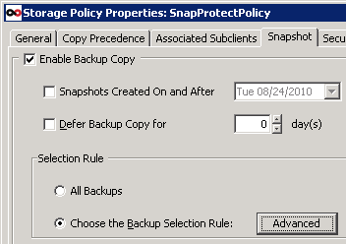
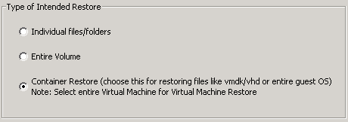
Secondary Copies for DR and Retention
Enable Granular Restores or Full VM Recovery
Description
Benefits
Selectively copy snapshot data to cheaper disk or tape. Full VM or granular file level recovery.
Tiered Data Management copies
Limit number of snaps retained in production storage
Reduce hardware spend by eliminating expensive replication
Full VM or Granular Recovery
“DR and long term retention on commodity disk or tape”

Slide 25
Auto-Discovery Rules
Automated Data Protection with minimal intervention
Description
Benefits
Automatically add new VMs to backup policies based on pre-defined rules. Catch-all policy protects VMs that do not qualify for any protection policy
No more Hunt, Deploy and Configure: Auto-Discover and add to protection policy
Customized SLA: Separate protection policies based on business rules
Equal workload distribution:
Variety of Rules available:
Manual Discovery Override: Manually add VMs for greater control for those critical, must watch VMs.
“Save time and effort hunting down VMs”

Slide 26
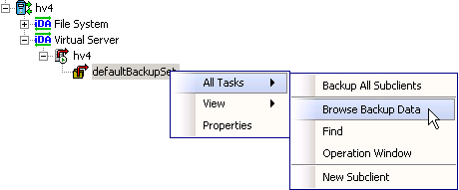
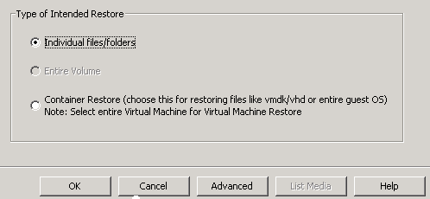
Granular Restores from Image Backups

Slide 27
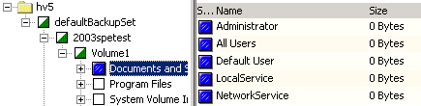
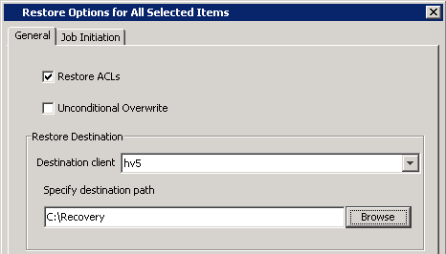
Granular Restores (Cont)

Slide 28
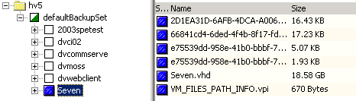
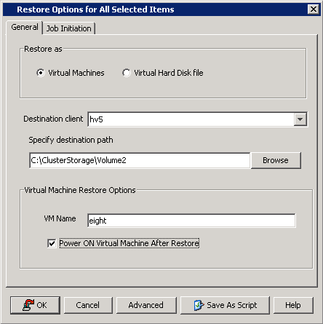
Container Level Restores

Slide 29


Application Integrated Protection
Description
Benefits
Ensure 100% application integrated backup. Include Log Management capabilities using a lightweight agent inside the VM
Protect Apps running inside VMs: 100% application integrated.
Log Management and Log Truncation
No Application Agent License: Lightweight agent in restore only mode
App Restore without restoring entire VM: File Level Restore of App Data files
Information Mining for Granular Recovery and Long Term Retention:
Key App Support: Support Exchange and SQL, with more to follow
Hyper-V Pool
Lightweight agent/VSS Provider
iDA
Queisce App before SPE Job
Truncate Logs after VM is backed up by SPC/VSA
Virtual Machine Pool
App
Win
Mount SPC Snapshots
VSA
SPC/VSA
Queisce VM
Agent in VM queisces App
Snap the Data Store Volume
Agent in VM truncates log
ESXi Proxy
MA
SPC
“App Integrated backups allow critical apps to be hosted in virtual machines”
Backup Copies
Open Disk
Cloud
Tape

Slide 30
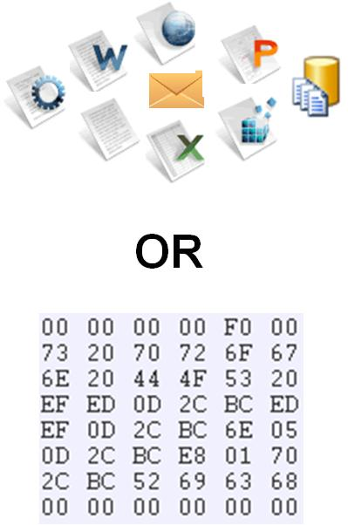
Information Mining Policy
Granular Extraction for Long Term Retention
Description
Benefits
Object Level Protection from 1 – Pass SnapCopy. Provide streaming object level access from SnapCopy generated off host operations
Capture Granular Objects within Databases: Exchange and SharePoint
No impact on App Servers
Granular Retention: Retain data not databases
Searchable Data Sets: End user search, eDiscovery and Legal Hold
Post Stubbing for Archive
ESX Server Pool
iDA
App
Lightweight agent/VSS Provider
Win
Mount SPC Snapshots
VSA
ESXi Proxy
MA
Info-mining policy
SPC
Granular Retention Copy
Backup Copies
Open Disk
Cloud
“App Consistent backups allow critical apps to be hosted in virtual machines”
CI-Aware object format
Search
Hold
Records

Slide 31
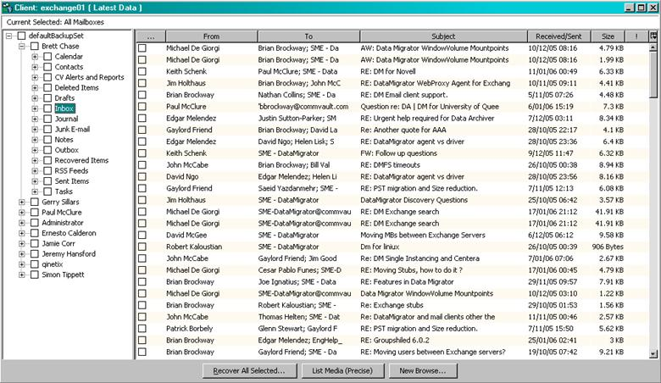
Granular Restore - Exchange

Slide 32
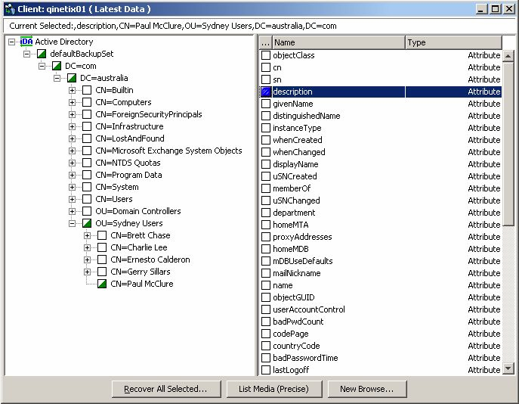
Granular Restore – Active Directory

Slide 33
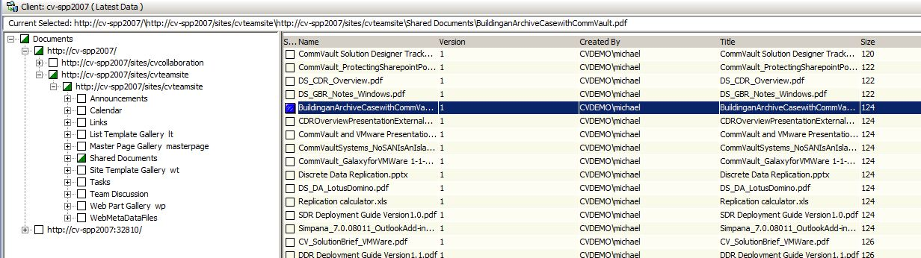
Granular Restore - SharePoint

Slide 34
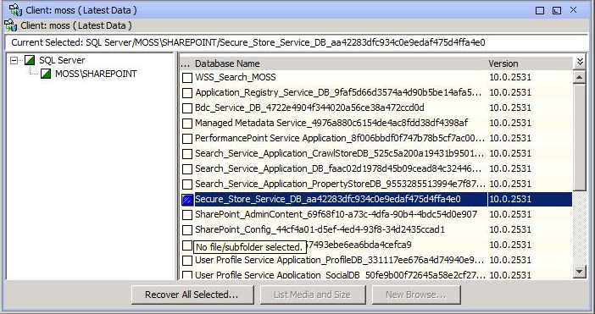
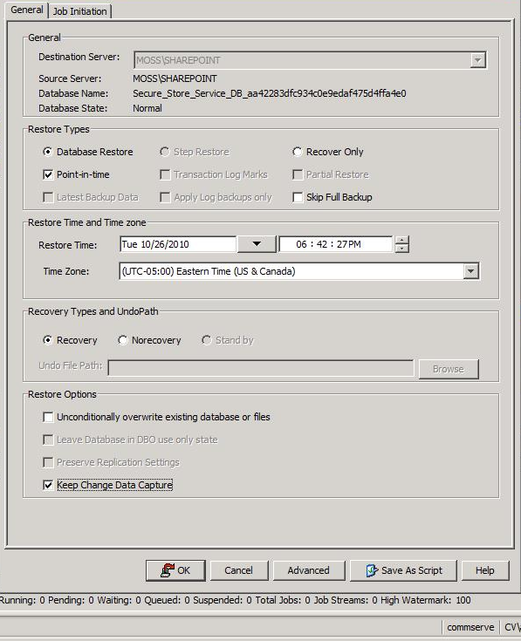


Content Awareness:
Intelligent Recovery Process
Database Integration :
Simplifying Recovery
30 Min Interval
Indexed Contents ...
D:\DB\DB1 - 4pm 7/7/2010
D:\Logs - 4pm 7/7/2010
Managed Log Backups
Indexed Contents ...
D:\DB\DB1 - 6pm 7/7/2010
D:\Logs - 6pm 7/7/2010
Indexed Contents ...
D:\DB\DB1 - 8pm 7/7/2010
D:\Logs - 8pm 7/7/2010
4PM
6PM
8PM
MA
Corruption Occurs at 6:42PM
SnapCopy
Mount
Log Contents ... (on dedupe disk)
\Logfiles-xxx.log - 4:30pm 7/7/2010
\Logfiles-xxx.log - 5:00pm 7/7/2010
\Logfiles-xxx.log - 5:30pm 7/7/2010
\Logfiles-xxx.log - 6:00pm 7/7/2010
\Logfiles-xxx.log - 6:30pm 7/7/2010
\Logfiles-xxx.log - 7:00pm 7/7/2010
\Logfiles-xxx.log - 7:30pm 7/7/2010
\Logfiles-xxx.log - 8:00pm 7/7/2010
\Logfiles-xxx.log - 8:30pm 7/7/2010
Backup Copy
Disk
Cloud
Tape

Slide 35
Data DeDuplication

Slide 36

Client Side DeDupe
Check-in Level 1 (optional)
Optimized for WAN clients
Check-in Level 2
Central Deduplication Database
Mix and match with-in the same infrastructure based on performance requirements and / or bandwidth constraints
90-95% reduction in amount of full data transferred
50% faster backups for subsequent full backups

Slide 37


Source Side DeDupe
DASH Copies
Lightning fast copy of de-duplicated backup for DR
Completely eliminating rehydration and re-deduplication of data between sites
Update reference counts and writes. Only metadata is written to disk.
Only unique blocks are copied to secondary copy
DASH Full
Lightning fast creation of a consolidated full backup
Minimizes the read on disk. Completely eliminating rehydration and re-deduplication
Update reference counts and writes. Only metadata is written to disk.
Synth Full operation reduced from several hours to few minutes

Slide 38

DeDupe In Action
Remote Site 1 Requirement:
Backup data to central site over WAN
No local recovery copy needed
Do not send data already sent by other remote sites
Remote Site 2 Requirement:
Backup data locally for local recovery
Copy all / selective full backups to central site over WAN for longer retention
Do not send data already sent by other remote sites

Slide 39
Information Management v. Data Management

Slide 40

Simpana9 Enterprise Search
Using Microsoft FAST
Extended Scalability & Support
  From 30M to 50M+ per Node, 8 Node Federated Clouds
  Self Upgrading Indexes
Simple & Advanced Search
  Improved UI, Tabbed Organization, Custom Search Builder
Object Mining & Navigation
  Word/Phrase, Date Range, Type, Size, Tag
Sharing & Collaboration
  Saved Searches
  Review Sets
Classification & Tagging
  Manual & Automated Patterns

Slide 41












Simpana 9 Information Governance
Product Architecture
End User
Search
Desktop
/ Laptop
Index & Search
Content Index (File, File metadata, platform metadata and tags)
401 File Formats, 77 Languages
Unified web search, mine, view
Web folder structure
Web Search Portal
File
Systems

Search
SharePoint

Online Index
(Exchange & CIFS)
⬥
De-Dupe
Storage Tiers
Offline Index
(Any Archive
or Backup)
Exchange
Domino
◆
❖
eDiscovery /
Compliance
Corporate
Search
Archive / Backup
(Move/Copy)
Managed Data

Slide 42



Simpana 9 Enterprise Search
Enhanced Search Console View
Simple column listing results presentation
  Tabbed Content Oriented Views (Email/File/Advanced…)
  Column listings (sort/show hide)
Simple Navigation
Key Folders
  Review Sets
  Legal Holds
  Saved Searches
  Sharing
  Downloads
  ...
Preview Reader Pane
  HTML view, in-line based on selected item in the list
  User can scroll through to read – similar to Outlook, but this applies to email, files and docs…
  Allows site customization of what properties you want to show/hide
  Speeds content review/relevancy assignment (right click >)
Right click menu
  Assign items directly off list
Notes:
42
42
42

Slide 43
Simpana 9 Enterprise Search
Object Mining & Navigation
“Bad Weather”
5M records, 1000 Hits
“Incident Report”
400 records
6 Month date range
152 records
Tornado.doc (MS Word)
45 records
“Personal Injury” Classified
25 records
Common Keyword / Phrase
Based on top ‘n’ items by relevance
Ranked by freq
Number Displayed (configurable)
Content Type
By 400 indexed types of file
Date / Time Range
Earliest Date
2 Midrange Dates
Oldest Date
Size Range
Less than 1 KB
1KB & 2KB
2KB & 3KB
Greater than 3KB
User / Automated Tagging
Ranked by frequency per tag

Slide 44

Simpana 9 Enterprise Search
Advanced Query Builder
Advanced Search – more combinations while simplifying query encoding
View/Tab
  Add/Delete criteria quickly
  In-field hints
  Simple to nest criteria chains
  String conditions to meet Boolean rules
  Direct search against selective CI cloud
  Summarize criteria to check, save query definition or share it with group

Slide 45

















Simpana 9 Records Declaration
eDiscovery / Compliance
MS SharePoint Records Centre
SAP
ArchiveConnect
Search
Portal
Taxonomy Placement
API
Corporate Search
Simpana
Unified Data
Acquisition
Intelligent Search & Mining
Cloud / xSP
Copy
Move
Classification & Retention
Authentication & Encryption
Preservation & Export
SDK
REST
Legal Hold
Web Service
Records
Manager
Private &
Public Virtual
Collections
3rd Party

Slide 46

Enrol in Microsoft Virtual Academy Today
Why Enroll, other than it being free?
The MVA helps improve your IT skill set and advance your career with a free, easy to access training portal that allows you to learn at your own pace, focusing on Microsoft technologies.
What Do I get for enrolment?
Free training to make you become the Cloud-Hero in my Organization
Help mastering your Training Path and get the recognition
Connect with other IT Pros and discuss The Cloud
Where do I Enrol?
www.microsoftvirtualacademy.com
Then tell us what you think. TellTheDean@microsoft.com

Slide 47

© 2010 Microsoft Corporation. All rights reserved. Microsoft, Windows, Windows Vista and other product names are or may be registered trademarks and/or trademarks in the U.S. and/or other countries.
The information herein is for informational purposes only and represents the current view of Microsoft Corporation as of the date of this presentation. Because Microsoft must respond to changing market conditions, it should not be interpreted to be a commitment on the part of Microsoft, and Microsoft cannot guarantee the accuracy of any information provided after the date of this presentation. MICROSOFT MAKES NO WARRANTIES, EXPRESS, IMPLIED OR STATUTORY, AS TO THE INFORMATION IN THIS PRESENTATION.

