Slide 2
Configuration manager 2012 infrastructure drilldown
SESSION CODE: SEC414
@OlikkaTech
@MichaelPascoe
blog: bolikka.com
Michael Pascoe
Consultant & Co-founder
Olikka

Slide 3

You are…?

Slide 4
MP
RP
DP
SMS
SMP
BDP
PKG
PSP
SLP
SS
CS
SUP
SHV
OSD
PS
RSP
FSP

Slide 5
About Me

Slide 6
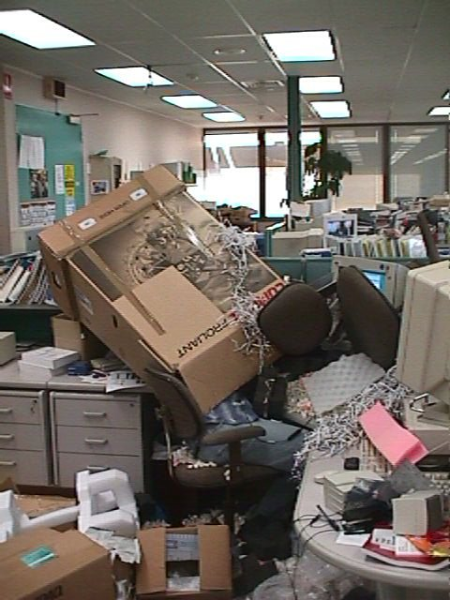
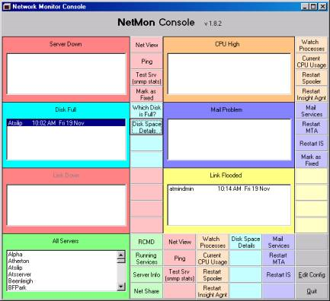
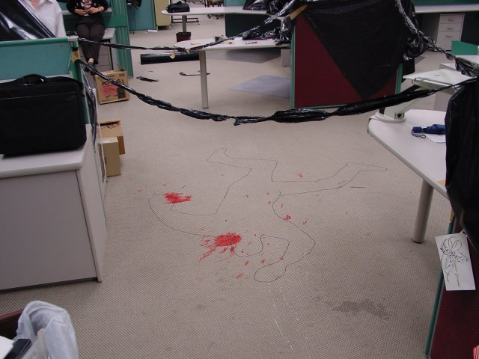

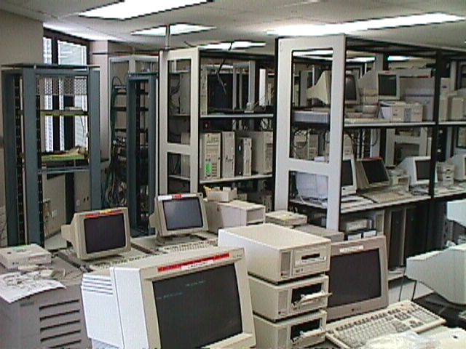
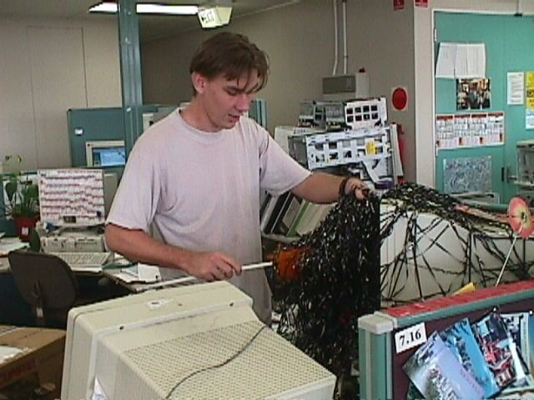
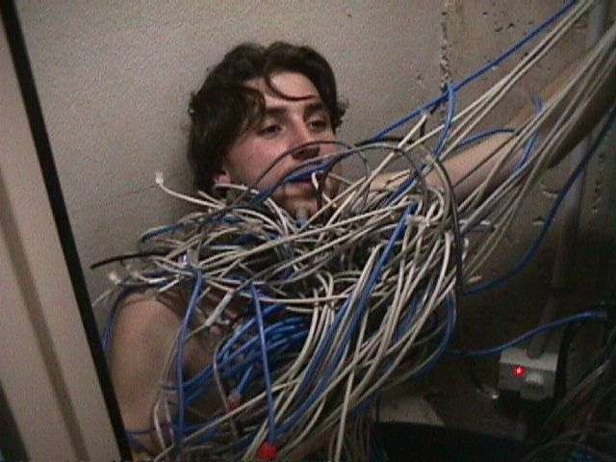
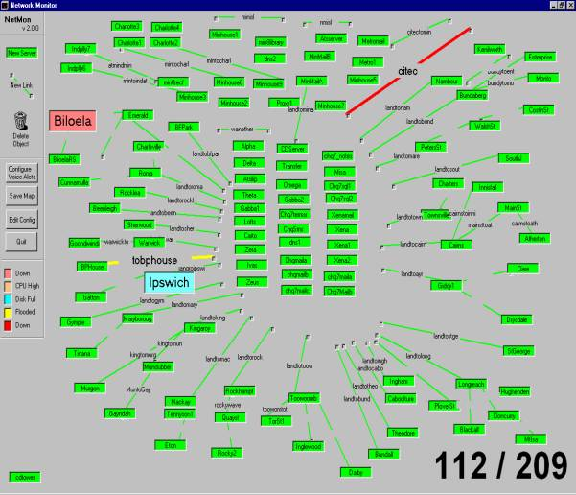
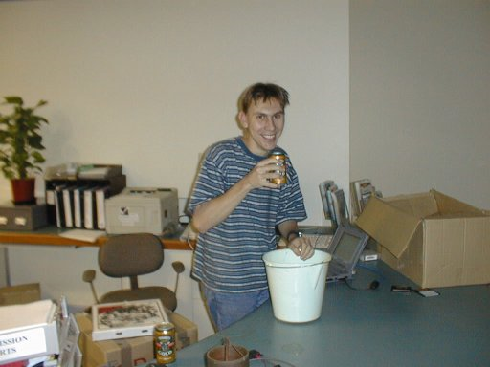
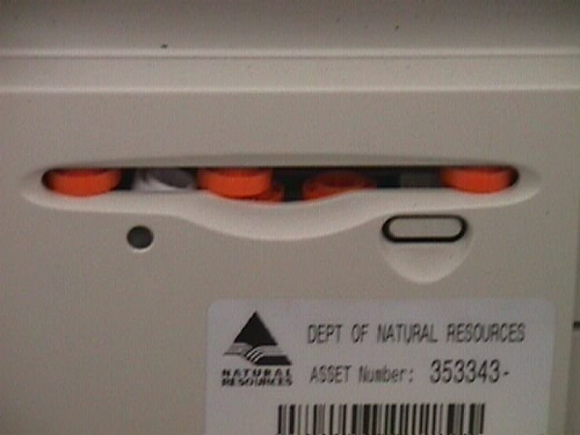
Intro
Michael Pascoe - @olikkaTech
Professional
History

Slide 7


Intro
Michael Pascoe - @michaelpascoe
Personal
Picture of Chloe

Slide 8



Intro
Michael Pascoe - @olikkaTech

Slide 9
Config Manager 2012
Unify Infrastructure
Simplify Administration
Empower
Users
Sell More Product

Slide 10
Agenda
Lots to cover
Role Changes
Hierarchy Changes
Secondary vs. DP
Content Distribution
Discovery & Boundaries
Client Settings & Inventory
Role Based Admin
Installation Tips

Slide 11



Role
Changes

Slide 12
What’s gone in 2012
What’s changed 2012
x
MP
RP
DP
DP
x
SMP
SMS
BDP
PKG
PKG
PSP
PSP
x
SLP
SS
SS
CS
SUP
SHV
OSD
PS
PS
RSP
FSP

Slide 13
letter word
x
___ ___ ___ ___
four

Slide 14
letter word
x
three
___ ___ ___ ___
four

Slide 15

letter word
x
three
_5_ _H_ _T_ ___
four

Slide 16
Site mode
Just one
type
AD schema
Same as 2007

Slide 17
New Roles
ACWSP
Application Catalog Web Site Point
MDAEP
Mobile Device and
AMT Enrollment Point
ACWSP
Application Catalog Web Service Point
MDEPP
Mobile Device Enrollment Proxy Point

Slide 18

New
Hierarchy

Slide 19
Primary Sites

Slide 20
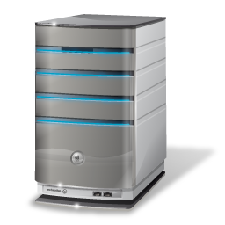



Hierarchy
Primary Sites
No multi -tier primary
sites
Primary
DP
x
Secondary
Secondary
Secondary
Primary
Secondary

Slide 21
Hierarchy
Primary Sites
x
No
central site
Central Site
Primary
Primary
Secondary
Secondary
Secondary
Secondary

Slide 22
Hierarchy
Reduce Primary Sites
Reasons for multiple 2012 primary sites
Scale – More than 100,000 clients
Reduce impact of site failure (engineer for HA)
LOCAL point of connectivity for administration
Political / Commercial reasons
Content regulation
Multiple primary sites NO LONGER needed for:
Client settings
Content routing for deep network hierarchies
Decentralised administration
Languages
Logical data separation

Slide 23
Hierarchy
Primary Sites
How to link
multiple
primary
sites?
Central Administration Site
Central Administration Site (CAS)
Primary
Primary
Secondary
Secondary
Secondary
Secondary

Slide 24
Secondary Sites

Slide 25

Hierarchy
Secondary Sites
Secondary Site replication
now via
SQL
Primary
DP
Secondary
Secondary
Secondary

Slide 26
Hierarchy
Secondary Sites
MP + DP installed by default
Other functions are still
available too (SMP, PXE)

Slide 27

Hierarchy
Secondary Sites
Site communication
is totally
different,
otherwise
not much
changed

Slide 28
Distribution Points

Slide 29

Hierarchy
Distribution Points
Traffic to
DPs
can be
managed
.

Slide 30
Hierarchy
Distribution Points
  DP management
  gets a
  make-
  over
Packages remain assigned
to DP Groups
New "content library" on DPs
GUI improvements
Easy and sensible pre-stage

Slide 31
Hierarchy
Distribution Points
2012
2007
Distribution Point
Server
Client
Standard DP
Server Share DP
PXE Service Point (PSP)
Branch DP

Slide 32
Hierarchy
Distribution Points
2012
Distribution Point
Server
Client
Standard DP
Server Share DP
PXE Service Point (PSP)
Branch DP
2003 SP2
Windows 7
Vista SP2

Slide 33
Hierarchy
Distribution Points
2012
Distribution Point
Server
Client
Standard DP
Server Share DP
PXE Service Point (PSP)
Branch DP
PXE Feature
2003 SP2
Windows 7

Slide 34
Hierarchy
Distribution Points
2012
Distribution Point
Server
Client
Standard DP
Server Share DP
PXE Service Point (PSP)
Branch DP
PXE Feature
WDS
2003 SP2
Windows 7

Slide 35
Hierarchy
Remote Sites
DPs good. Why use Secondaries?

Slide 36
2007 Secondary Site Features
Benefits Split

Slide 37
Hierarchy
Why Secondary Sites?
Local MP (+ DB)
Manage upstream bandwidth
Local client push
Multi-hop networks
(content routing)

Slide 38
Hierarchy
Secondary Site and Content Routing
Primary
Link A
Distribution Point
Distribution Point
Secondary Site X
Link B
Distribution Point
Distribution Point

Slide 39
Hierarchy
Secondary Site and Content Routing
Primary
Link A
Distribution Point
Distribution Point
Secondary Site X
Link B
Distribution Point
Distribution Point

Slide 40
Hierarchy
Secondary Site and Content Routing
Primary
Link A
Distribution Point
Distribution Point
Secondary Site X
Link B
Distribution Point

Slide 41
Hierarchy
Secondary Site and Content Routing
Primary
Link A
Distribution Point
Distribution Point
Secondary Site X
Link B
Secondary Site Z
Distribution Point

Slide 42
Hierarchy
Why Secondary Sites?
Local MP (+ DB)
Manage upstream bandwidth
Local client push
Multi-hop networks (content routing)
Think about:
  PXE
  SMP

Slide 43
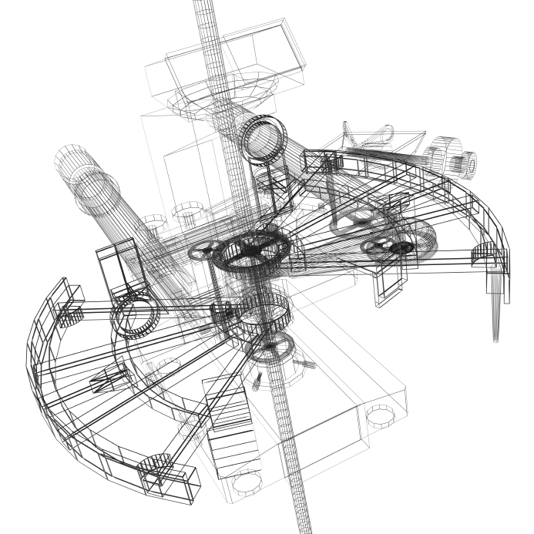
in more
DPs
detail

Slide 44

DPs in Detail
Content Assignment
Dynamic DP Groups
+ good looking
wizards
+good pre-stage
+more!!

Slide 45





DPs in Detail
Content Assignment to DPs
Distribution Points
Distribution Point Groups
Collections
Melbourne Main
Melbourne Users
DP 1
DP 1
DP 2
South Melbourne
Melbourne Computers
DP 2
DP 2
DP 3
DP 3
Stock Warehouse Computers
Geelong
DP 4
DP 4
.
DP 5
DP 5

Slide 46

DPs in Detail
Package Storage
Content Library
single instance storage

Slide 47
DPs in Detail
Content Library
Package Library
Data Library
File Library
PackageID.ini
content includes
pkg version
PackageID.ini
content includes
pkg version
PackageID.ver.ini
First 4 letters of hash
content includes:
hash code
FullHash.ini
content includes:
List of pkgIDs that use this file
PackageID.ver
PackageID.ver
source folder
structure
sourcefile.name.ini
source folder
structure
sourcefile.name
FullHash.sig
File full signature
FullHash (no ext)
content includes:
size of original file
timestamp of original
hash of original
FullHash
Original source file
(with a different name)
hash
.

Slide 48

DPs in Detail
Content Library
Warning: Content Library
Side
Effects

Slide 49
DPs in Detail
Content Library
Download and execute as default (BITS + IIS)
Package share (SMB) by exception
  Duplicates storage so watch out
.

Slide 50
DPs in Detail
Pre-stage
Pre-stage content
Now easy!
.

Slide 51
DPs in Detail
Even More Stuff!!
Distribute content wizard
Package Validation (PKGXFER MGR)
No PXE Distribution share
  Option on boot image to copy
  to RemoteInstall folder
  Single boot image set for entire site
  More PXE than 2007

Slide 52

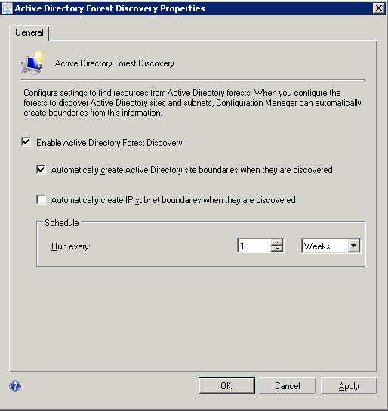
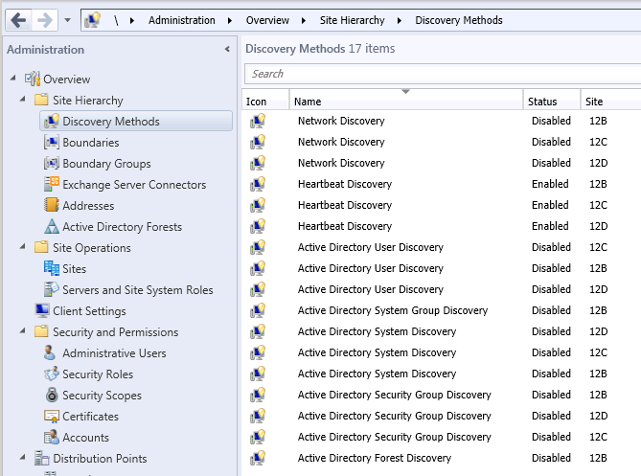
Discovery

Slide 53

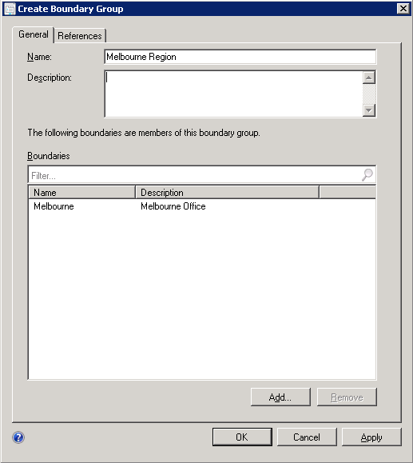
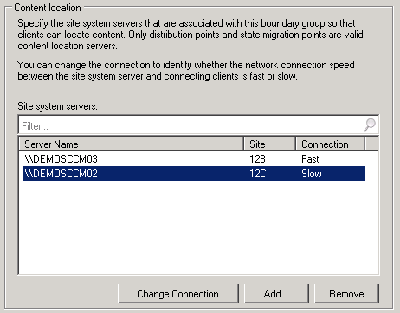
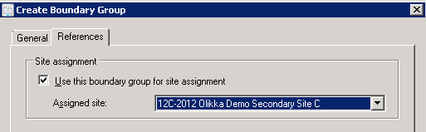
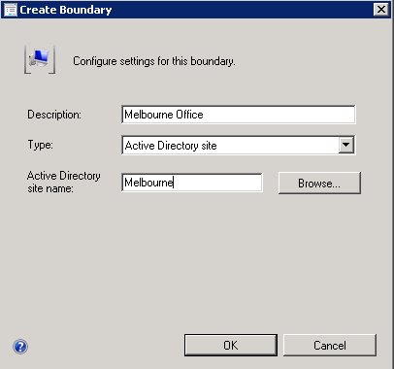
Boundary
Groups

Slide 54

Client Settings & Inventory
.

Slide 55

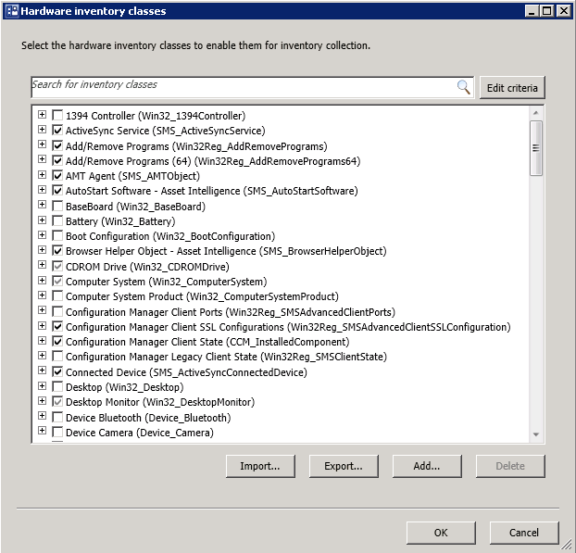
Client Settings and Inventory
WMI Inventory
No
SMS_DEF.MOF
.

Slide 56

Role based
administration

Slide 57
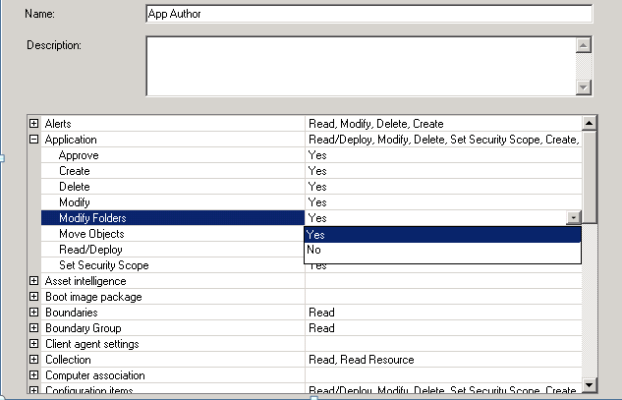
Role Based Administration
1. Roles
1. Create security roles defining the allowed actions on object types

Slide 58
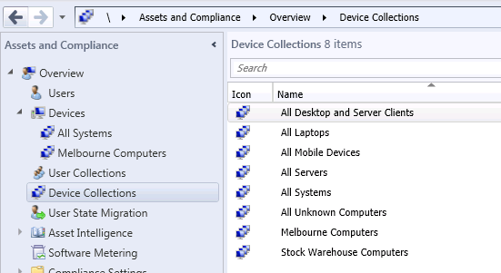
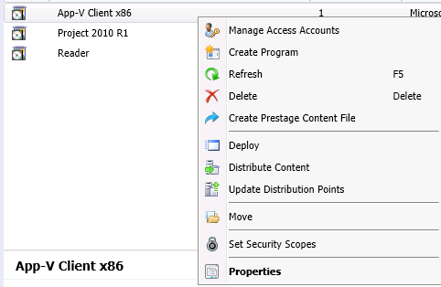
Role Based Administration
2. Scope
2. Define which instances of those objects one should perform the actions on

Slide 59
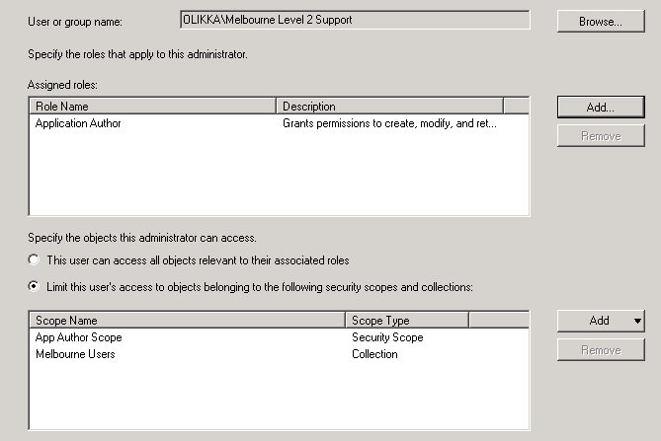
Role Based Administration
2. Assign
3. Assign the role, limited to the defined scope and collections,
to an AD group

Slide 60

Installation

Slide 61
Installation
Tips
Central site first!
AD schema same as 2007
Service accounts for lots of connections
x64 for all roles except DP
.net framework 4 (full) needed
Auto IIS install (BITS?)
WebDav not needed
Remote differential compression (RDC)
WDS for PXE
WSUS for SUP

Slide 62
The important stuff

Slide 63
The important stuff
Sites
Site codes still 3 letter
No native/mixed mode - each role http/s
AD schema same as 2007
No multi-tier primary
No central (as primary)
Some data is "global“
Secondary site data now via SQL

Slide 64
Hierarchy
Today
2007
Central Site
Primary
Primary
Primary
Distribution Point
Secondary
Secondary
Secondary
Secondary
Primary
Secondary

Slide 65
Hierarchy
New
2012
Central Administration Site
Primary
Primary
Secondary Site
Secondary Site
Distribution Point
Distribution Point
Distribution Point
Distribution Point
Distribution Point

Slide 66
Hierarchy
New
2012
Central Administration Site
Primary
Primary
Secondary Site
Secondary Site
Distribution Point
Distribution Point
Distribution Point
Distribution Point
Distribution Point

Slide 67
Hierarchy
New
2012
Central Administration Site
Primary
Secondary Site
Secondary Site
Distribution Point
Distribution Point
Distribution Point
Distribution Point
Distribution Point

Slide 68
Hierarchy
New
2012
Primary
Secondary Site
Secondary Site
Distribution Point
Distribution Point
Distribution Point
Distribution Point
Distribution Point

Slide 69
The important stuff
Roles
No BDP, RP
New roles for application catalog
and mobile device management
Lots of DP changes
  Traffic to remote DP can be managed
  PXE option on DP (if server)
  Content library
  Permanent DP groups
  Pre-stage
  Wizards

Slide 70
The important stuff
Management
Boundary groups used to define
sites and protect systems
Client settings can be assigned
to collections of computers
No sms_def.mof - replaced by GUI
Role based admin allows
granular role definition

Slide 71
Share your opinion…
Tweet your reaction to this presentation
just follow @OlikkaTech and
re-tweet my post
with your reaction

Slide 72

Enrol in Microsoft Virtual Academy Today
Why Enroll, other than it being free?
The MVA helps improve your IT skill set and advance your career with a free, easy to access training portal that allows you to learn at your own pace, focusing on Microsoft technologies.
What Do I get for enrolment?
Free training to make you become the Cloud-Hero in my Organization
Help mastering your Training Path and get the recognition
Connect with other IT Pros and discuss The Cloud
Where do I Enrol?
www.microsoftvirtualacademy.com
Then tell us what you think. TellTheDean@microsoft.com

Slide 73




Resources
www.msteched.com/Australia
  Sessions On-Demand & Community
www.microsoft.com/australia/learning
Microsoft Certification & Training Resources
http:// technet.microsoft.com/en-au
  Resources for IT Professionals
http://msdn.microsoft.com/en-au
  Resources for Developers

Slide 74

© 2010 Microsoft Corporation. All rights reserved. Microsoft, Windows, Windows Vista and other product names are or may be registered trademarks and/or trademarks in the U.S. and/or other countries.
The information herein is for informational purposes only and represents the current view of Microsoft Corporation as of the date of this presentation. Because Microsoft must respond to changing market conditions, it should not be interpreted to be a commitment on the part of Microsoft, and Microsoft cannot guarantee the accuracy of any information provided after the date of this presentation. MICROSOFT MAKES NO WARRANTIES, EXPRESS, IMPLIED OR STATUTORY, AS TO THE INFORMATION IN THIS PRESENTATION.

