Slide 2
Fim r2 deep dive
SESSION CODE: SEC318
Paul Conroy
Technology Specialist
Microsoft

Slide 3
WARNING
This isn’t an introductory to FIM, for that….
BING – technet implementing forefront identity manger

Slide 4
Agenda
Web Based User Self Service Password Reset
Enhanced Reporting
Simplified Reporting and Troubleshooting Tools
Enhanced Performance
Enhanced MA connectivity

Slide 5
Web Based User Self Service Password Reset
End user can register and reset from a web browser on a machine that isn’t domain joined
….even if the browser is not Internet Explorer
Admin can deploy registration and reset portals on extranet-facing host
Admin can configure password reset for external users using the same model as for internal users
Upgrade from FIM 2010 SSPR to FIM 2010 R2 without breaking an existing FIM solution

Slide 6
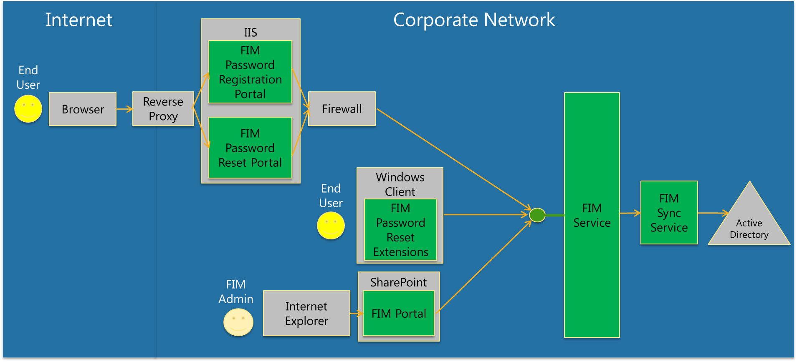
FIM Password Reset Components
Illustrative Topology

Slide 7
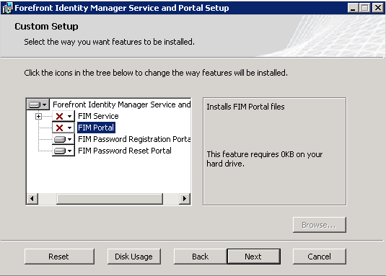
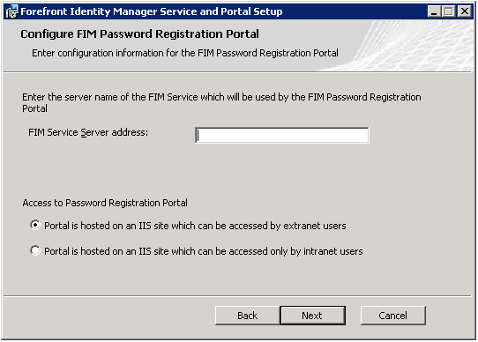
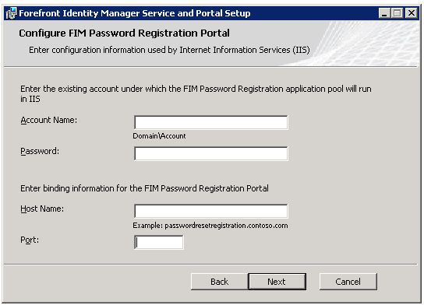
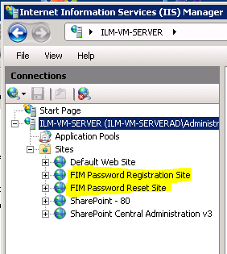
Setup Experience – PW Reset Portals
2
1
Choose to install Password Portals
Specify whether host is extranet accessible
3
4
Specify AD user account for Portal
Password Portals visible in IIS Manager

Slide 8
Distinguishing Requests from Extranet
How this works - Registration
Security context is determined without reliance upon IP addresses
Registration Portal
Makes registration request to the FIM Service in the context of the Registration Portal’s AD identity
FIM Service
Identifies registration requests from the Registration Portal’s identity

Slide 9
Distinguishing Requests from Extranet
How this works - Reset
Reset Portal
Makes password reset request to the FIM Service in the context of the Reset Portal’s AD identity
FIM Service
Identifies reset requests from the reset portal.

Slide 10
Authentication and password reset
Registration is a process of establishing credentials for alternative authentication
Many have a higher bar for authentication from the Internet, than from a domain-joined machine
Extensibility for customer-specific needs

Slide 11
User Self Service Password Reset
demo

Slide 12
Enhanced Reporting
  Integrates with System Center Service Manager, leveraging its data warehouse
Add historical reporting for FIM-managed objects
  Includes frequently-requested reports, e.g.:
    Group membership changes over time
    Request history
    Person and group change history
  Report data store is extensible
    Can be extended to store history of custom FIM Service objects and attributes
    Enable customers and ISVs to build custom reports

Slide 13
How to Answer these Questions
State
Events
Who is in group A?
What groups does a particular person belong to?
Who is person Y’s manager?
Who joined group A today?
What groups had new members today?
How many new people joined the company today?
Current
Source: FIM database via portal
Source: FIM requests via portal
What groups did person A have access to on November 4th, 2009?
What was a group’s membership last July?
Who joined group A on May 1st, 2010?
How did a group’s membership change over time?
Who approved a group join?
How did a set filter definition change over time?
Historic
Source: FIM Portal and Reporting
Source: FIM reporting

Slide 14
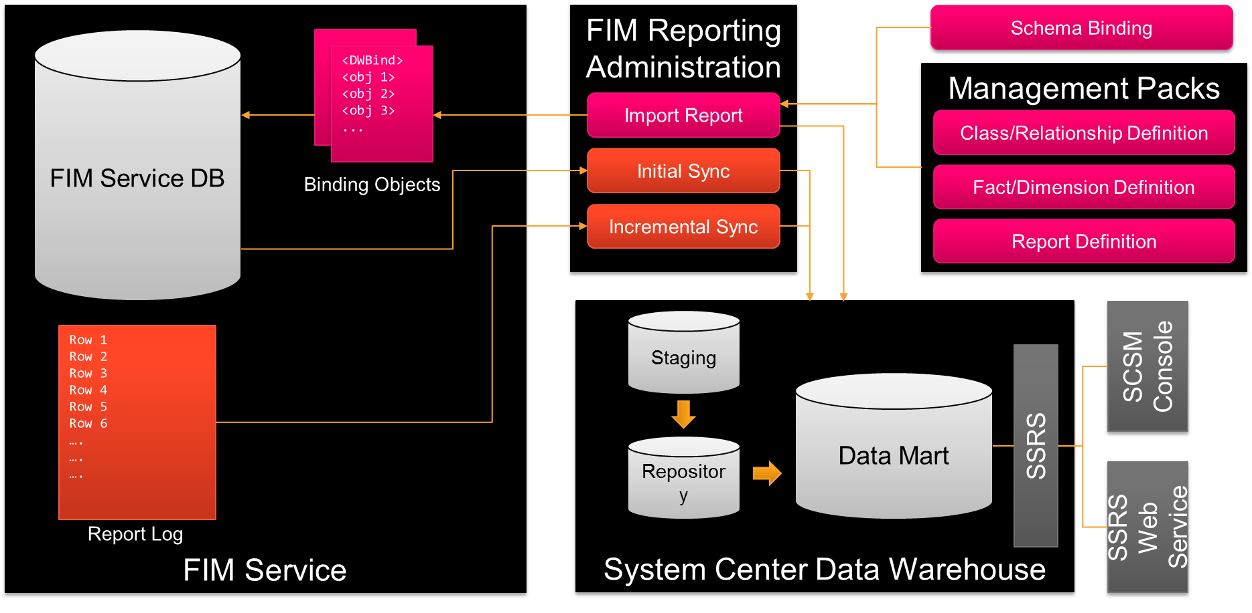
Reporting Architecture

Slide 15
Out of Box Reports
Report Class | Defined Over | Description
Membership Change Reports | Group Membership (SG + DG) Set Membership | Contains membership changes, who approved them, and the associated request which generated the change.
Object History Reports | Users Groups Sets Requests Policy Rules | Contains changes to key attributes over time.

Slide 16
Example Membership Change Report: Group Membership Change
Account Name | Operation Type | Committed Time | Group Name | Request Originator | Request Approver | Request ID | MPR that Triggered the Request
cwilcox | Join Group | 1/7/2011 14:27:02 | Finance | FIM Service |  | {43edf…} | All accountants have access to financial data
kimaber | Join Group | 1/3/2011 16:12:25 | Sales | kimaber | dparker | {81e2b…}
cwilcox | Leave Group | 1/1/2011 08:58:02 | Marketing | samanthas
Samantha removes Colin from the Marketing group
Colin changes roles and is added, automatically, to the Finance group
Kim requests to join the Sales group, Darren approves the request
User Information
User Display Name
User Account Name
User Object ID
User Domain
Group Information
Group Display Name
Group Account Name
Group Domain
Group Type
Group Owner
Request Information
Request Originator
Request Approver
Policy Rule that Triggered the Request
Request ID

Slide 17
Example History Report: User History
User Name | User ID | Operation | Attribute | Value | Requestor | Committed Time | Request
Colin Wilcox | {732d2…} | Remove | User |  | FIM Service | 2/13/2011 01:22:00 | {532aa…}
Colin Wilcox | {732d2…} | Remove | Display Name | Colin Wilcox | FIM Service | 2/13/2011 01:22:00 | {532aa…}
Colin Wilcox | {732d2…} | Remove | First Name | Colin | FIM Service | 2/13/2011 01:22:00 | {532aa…}
Colin Wilcox | {732d2…} | Remove | Last Name | Wilcox | FIM Service | 2/13/2011 01:22:00 | {532aa…}
Colin Wilcox | {732d2…} | Add | Manager | gfort | Garth Fort | 9/22/2006 08:55:28 | {8457b…}
Colin Wilcox | {732d2…} | Remove | Manager | samanthas | Garth Fort | 9/22/2006 08:55:28 | {8457b…}
Colin Wilcox | {732d2…} | Add | Employee Type | FTE | Garth Fort | 9/22/2006 08:55:28 | {8457b…}
Colin Wilcox | {732d2…} | Remove | Employee Type | Contractor | Garth Fort | 9/22/2006 08:55:28 | {8457b…}
Colin Wilcox | {732d2…} | Add | Manager | samanthas | FIM Service | 5/2/2002 08:32:11 | {126da…}
Colin Wilcox | {732d2…} | Add | Employee Type | Contractor | FIM Service | 5/2/2002 08:32:11 | {126da…}
Colin Wilcox | {732d2…} | Add | Display Name | Colin Wilcox | FIM Service | 5/2/2002 08:32:11 | {126da…}
Colin Wilcox | {732d2…} | Add | User |  | FIM Service | 5/2/2002 08:32:11 | {126da…}
Colin is created in FIM in 2002 via a sync through HR, Samantha Smith is his first manager
In 2011, Colin leaves the company, and he is removed from FIM.
In 2006, Colin becomes a full-time employee, and, as a result, gets a new manager, Garth.

Slide 18
Enhanced Reporting
demo

Slide 19
Simplified Deployment and Troubleshooting Tools
Best Practices Analyzer (BPA)
Improvements for troubleshooting
Improvements in the setup process

Slide 20
Enhanced Performance

Slide 21
Enhanced Performance
Improve performance for initial load of customer data from connected system to FIM Service
Improve performance for bulk addition (e.g., of new division) from connected system to an existing FIM deployment
Provide FIM Service database tuning guidance and enhancements

Slide 22
MA Connectivity

Slide 23
Enhanced MA connectivity
Enable extensible Management Agents to support
  Batched call-based import
  Batched call-based export
  Programmatic schema, partition, and hierarchy discovery
  Password management behave as other methods
  Custom anchors and additional dn styles
  Support custom parameters
  Full Export run step
  .NET 4 support
New SAP, Oracle ERP, and Lotus Notes MAs for FIM 2010 R2 developed on top of the new API

Slide 24
Enhanced MA connectivity
demo

Slide 25
There’s More………
But Wait

Slide 26
Platform Investments
FIM add-in supports Outlook 2010 for group management and approvals
FIM portal supports SharePoint Foundation 2010

Slide 27
Conclusion
Credential Management
  Web based password reset
Reporting
  Historical reporting for managed resources
  Service Manager data warehouse integration
Ease of Use
  Enhanced diagnostics
  Enhanced initial load performance
  Simplified deployment for password reset
Advanced MA configuration improvements
  More MAs

Slide 28
Next Steps
Search for “Forefront Team Blog” and be part of the Beta program
Microsoft.com/ida
LinkedIN – ‘Microsoft Forefront Identity Manager’ group

Slide 29

Enrol in Microsoft Virtual Academy Today
Why Enroll, other than it being free?
The MVA helps improve your IT skill set and advance your career with a free, easy to access training portal that allows you to learn at your own pace, focusing on Microsoft technologies.
What Do I get for enrolment?
Free training to make you become the Cloud-Hero in my Organization
Help mastering your Training Path and get the recognition
Connect with other IT Pros and discuss The Cloud
Where do I Enrol?
www.microsoftvirtualacademy.com
Then tell us what you think. TellTheDean@microsoft.com

Slide 30

© 2010 Microsoft Corporation. All rights reserved. Microsoft, Windows, Windows Vista and other product names are or may be registered trademarks and/or trademarks in the U.S. and/or other countries.
The information herein is for informational purposes only and represents the current view of Microsoft Corporation as of the date of this presentation. Because Microsoft must respond to changing market conditions, it should not be interpreted to be a commitment on the part of Microsoft, and Microsoft cannot guarantee the accuracy of any information provided after the date of this presentation. MICROSOFT MAKES NO WARRANTIES, EXPRESS, IMPLIED OR STATUTORY, AS TO THE INFORMATION IN THIS PRESENTATION.

Slide 31




Resources
www.msteched.com/Australia
  Sessions On-Demand & Community
www.microsoft.com/australia/learning
Microsoft Certification & Training Resources
http:// technet.microsoft.com/en-au
  Resources for IT Professionals
http://msdn.microsoft.com/en-au
  Resources for Developers

