Slide 2
Server Fabric Lifecycle – Configuring Networking and Storage
SESSION CODE: SEC311
Alessandro Cardoso
Dell Senior Technical Consultant
Microsoft MVP

Slide 3
Session Objectives and Takeaways
Session Objective(s)
  Explain storage and network management approach
  Understand the infrastructure requirements
Key Takeaway
  Network management feature offers a new abstraction
  Static IP management integrated with VM management
  Storage automation feature simplifies common tasks
  VMM is not a SRM tool

Slide 4
SCVMM 2012
Deployment
Fabric
Cloud
Services
Infrastructure Enhancements
HA VMM Server
Upgrade
Custom properties
Powershell
Cloud Management
Application Owner Usage
Delegation and Quota
Capacity and Capability
Service Management
Application Deployment
Image Based Servicing
Custom Command Execution
Service Templates
Fabric Management
Hyper-V Bare Metal Provisioning
Update Management
Hyper-V,
VMware, Citrix XenServer
Dynamic Optimization
Network Management
Power Management
Storage Management
Monitoring Integration

Slide 5
Value Proposition
  Standards-base Approach : e.g.Load Balancers settings, SMI-S for storaged
Deep integration of fabric into SCVMM, making ease to deploy Load Balancers
Backwards compatibility ( VDS for SAN Mgmts., PowerShell )

Slide 6
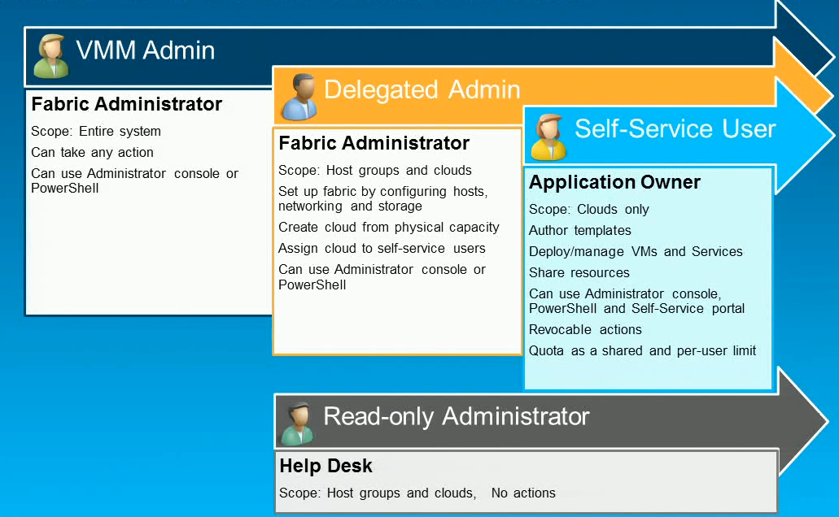
Fabric Management and User Roles

Slide 7


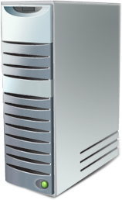


Fabric Management
Network
Define network using Logical Networks
Assign IP, VIP, and MAC from pools
Integrate with load balancers
Physical Server
Manage multiple hypervisors
Integration with remote management
Bare metal provisioning
Cluster creation with storage provisioning
Storage
Discover storage device to VM relationship
Classify storage according to capabilities
Assign new storage to Hyper-V cluster
Provision new storage with VM deployment
Fabric Management
Bare Metal Provisioning
Network Management
Storage Management
Hyper-V, ESX , XenServer

Slide 8
Networking : Overview
Define Logical Networks using VLAN’s and Subnets per Datacenter location
Address management for static IP’s, Load Balance VIP’s and MAC address: Assign IP, VIP, and MAC from pools
Automate provisioning of load balancers

Slide 9
Logical Network
Abstraction for server admins when modeling services
Model networks for various types of usage scenarios
Location | Logical Network | Logical Network Definition
 |  | Subnet | VLAN
Sydney | FRONTEND | 10.1.1.0/24 | 5
 | BACKEND | 172.10.1.1/20 | 7
Melbourne | FRONTEND | 10.1.2.0/24 | 10
 | BACKEND | 172.10.2.0/24 | 12

Slide 10
Network elements affinity
Logical network
Host group
IP subnets/
VLANS
IP pools
Frontend
Sydney
10.1.1.0/24
VLAN 5
Pool 01
Pool 02
DHCP
VLAN 7
Melbourne
DHCP
VLAN 12
12.1.1.0/24
VLAN 10
Pool 03
Pool 04

Slide 11
IP Address Pool Management
IP Range: 10.70.23.1/24 (254 addresses)
Static IPs
Reserved IPs
VIPs
(Virtual IPs)
Define Pool
Set IP range
IP check-out
IP check-in
Static, reserve, VIP
New VM creation
VM deletion, migration

Slide 12
MAC Address Pool Management
MAC Range: 00:1D:D8:B7:1C:00 - 00:1D:D8:F4:1F:FF
(3,998,720 addresses)
Static MACs
Define Pool
Set MAC range
MAC check-out
MAC check-in
Associate to host group
New VM creation
VM deletion
Allocate Pool

Slide 13
Network Management- part1
demo

Slide 14
VIP Address Pool Management
IP Range: 10.70.23.1/24 (254 addresses)
Static IPs
Reserved IPs
VIPs
(Virtual IPs)
Add Load Balancer Provider
VIP check-in
New VM creation
VM deletion, migration
Define VIP Template
PowerShell provider
VIP check-out
Protocol
LB method
Persistence
Health Monitors

Slide 15
VMM uses the Citrix NetScaler provider to create VIP in the load balancer
VMM
Placement picks same IP pool that’s used to allocate IPs for DIPs
Sydney
NetScaler
BigIP
Pool 01
Pool 02
Citrix Netscaler
F5 BigIP
Library
NetS_HTTPS
User chooses VIP template to use when creating service instance

Slide 16



Multiple vendor Load Balancer support in VMM 2012 RTM
Standard interface for all load balancers
Opportunity for load balancer vendors to write their own providers
Support for MS Load Balance ( Software ) in RTM

Slide 17
Network Management- part2
demo

Slide 18
Storage
End-to-End Storage device mapping
Allocation and assignment of Storage
Provisioning of a new VM using the SAN
Migration of SAN based VM

Slide 19
Storage Automation
Storage Automation for the Virtualized Private Cloud
  Seamless in box experience for common tasks
  Deep integration into UI/CLI
  Help keep administrators productive
    Storage admins worry about the designing
    Virtualization admins worry about consuming
  Leverage functionality across many arrays
  Extensive use of standards : SMI-S Provider

Slide 20
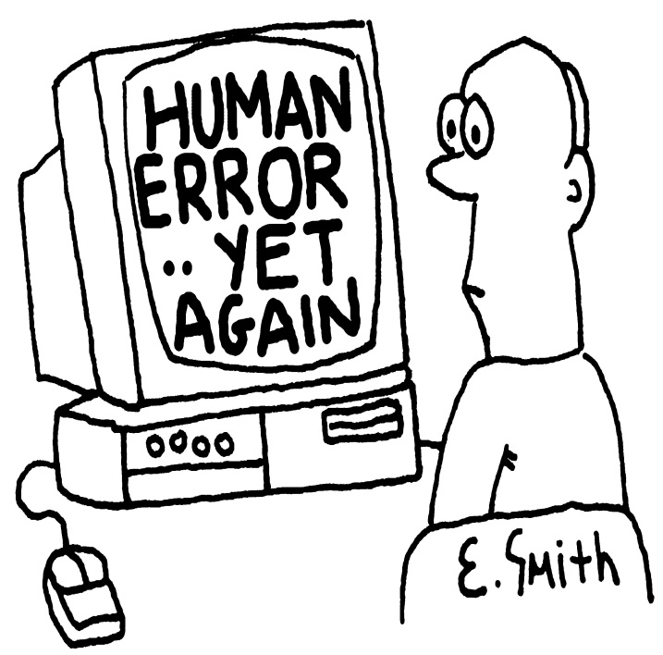


Storage Automation - Value Proposition
86% don’t use any kind of scripting

Slide 21
Storage : SMI-S Provider tested for vs. 1.4
Vendor
Brocade
Dell
EMC Corporation
Hewlett-Packard
Hitachi
Huawei Symantec
IBM
LSI, Engenio Storage Group
PMC-Sierra
Source : http://www.snia.org/ctp/

Slide 22

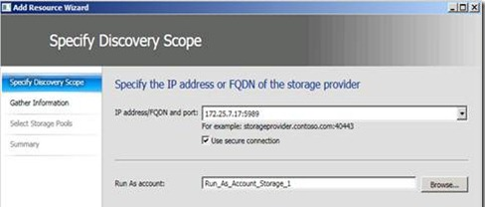
Storage : Integration Steps
Select Fabric | Storage
Click on Add Storage Devices from the Ribbon
Type the IP Address or FQDN
Type correct SMI-S port for the HP Command View EVA Server.

Slide 23
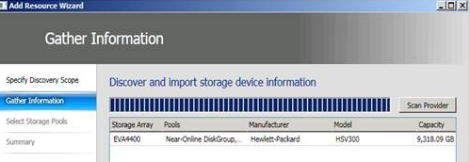
Storage : Integration Steps
If the connection succeeds, a certificate can be imported. Click on Import
When a storage device is discovered click on Next
Select a valid Run As account (with Access to HP Command View EVA)
Click Next

Slide 24
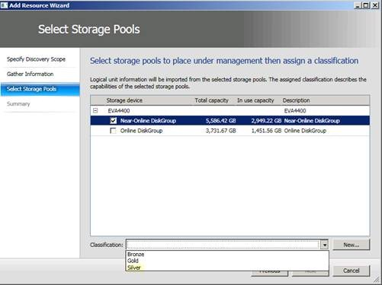
Storage : Integration Steps
Select a disk group and assign it a classification (defined under Create Classification in the Ribbon or with New)
Click Next
Confirm the settings with Finish

Slide 25
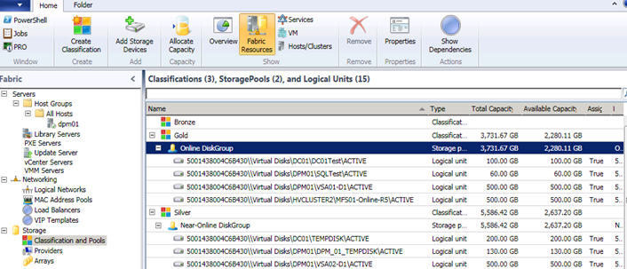
Storage : Integration Steps
Add other disks and view disks under Storage | Classification and Pools

Slide 26
Storage Automation – VMM
Discovery of LUNS
Mask and Unmask
Set ISCSI CHAP
Discovery of Array, Pool and LUNS
Mask and Unmask
LUN Clone
V-NEXT
VDS
Storage Service
VDS h/w provider
Discovery of portals and targets
Log on & log off
Port to LUN mappings
Host
iSCSI initiator
Host
Host
VDS
HBA Provider
Virtual to Physical port mappings
Create & delete Virtual Ports
Host
Host
NPIV Provider
Enumerate
Rescan
Mount/UnMount
Volume to Disk mapping
Disk to LUN mapping
FC Array / ISCSI Target
LUN
LUN
LUN
LUN
SAN admin tool

Slide 27
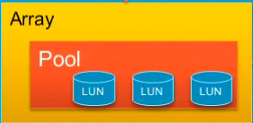
Storage Automation
WS-Man
WMI Server
Storage Service (WMI Provider)
SMI-S Module
CIM-XML
Client
CIM-XML
SMI-S Providers
SAN admin tool

Slide 28
Storage Automation: Discovery : VMM
VMM
Storage Management Service
Storage Provider
Array
Array
Pool
Pool
Unallocated
Allocated
Unallocated
Allocated
LUN
LUN
LUN
LUN

Slide 29
Storage Automation: Discovery : Host
VMM
  VMM Agent
Machine Resources
FC HBA
ISCSI Initiator
Disk Manager
Port
Port
IQN
Disk
Endpoints
vPorts
Endpoints
Volume
Endpoints

Slide 30
Array to Host Association
Array
Endpoints
SMI-S Provider
VMM Agent
FCHBA
Port
OS
Endpoints

Slide 31
LUN to Host Association
Array
Storage groups
Pools
Initiators
LUN
SMI-S Provider
VMM Agent
FCHBA
Port
OS
Disks (LUN)

Slide 32
Storage Automation – End to End Mapping
Service Instance
Machines
Virtual Layer
Logical Disk
Virtual Layer
In Guest

Slide 33
Storage Automation – End to End Mapping
Logical Disk
Volume
Logical Unit
Virtual Layer
In Guest
Physical Layer
In host OS
Physical Layer
In host OS
Logical Disk
Array Layer

Slide 34
Storage Automation – End to End Mapping
Logical Unit
Array Layer
Pool
Array
Array Layer
Provider

Slide 35
Classification
Array1
GOLD
(Pool1)
SMI-S Provider
SILVER
(Pool2)
Array2
BRONZE
(Pool1)
GREEN
(Pool2)

Slide 36
Allocation
Seattle (host group)
LUN1
LUN2
LUN3
Pool1
Pool2

Slide 37
Provisioning
Logical unit operations
  New logical unit from available capacity
  New logical unit clone
  New logical unit snapshot
    e.g. FlexClone (NetApp)
  Unmask/Mask
Host Disk/Volume operations
  Initialize disk
  Create partition
  Format volume

Slide 38

Provisioning
Available storage disks
Allocate Storage
Dedicated Storage
Assign
Storage
CSV, available disks
Cluster1
Available storage pools
Shared Storage
Available disks
Host groups
Host1

Slide 39
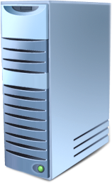



Rapid Provisioning
New VMs attached to VHDs contained in newly provisioned LUNs
VM
VM
VM
Placement finds hosts that can see array
Host
Host
Host
Template (SCC)
Array supports snapshot/clone
VHD is SAN Copy Capable
(SCC)
OS Profile
VHD
HW profile

Slide 40
Hyper-V Cluster Creation
Logical networks
Hyper-V servers
New Cluster Wizard
Shared Volumes
Cluster disks
Storage disks
Cluster1
Logical networks
Server1
Server2
Server3

Slide 41
Storage Automation – VM SAN Migration
Migration of VM uses SAN capabilities to avoid network copy
Support for migration using iSCSI and FC
iSCSI Migration
  Masking/unmasking
  Initiator logon/logoff
FC Migration
  Masking/unmasking
  NPIV vPort deletion/creation

Slide 42
SCVMM 2012
demo

Slide 43
My Tips
Download the load balancer from Citrix (NetScaler VPX) which you can run as a virtual machine http://try.citrix.com/NSVPXFREE
This will simulate their load balancer and is ideal for testing)

Slide 44
My Blog
Blog: http://virtualisationandmanagement.wordpress.com
Twitter:
#edvaldocardoso

Slide 45
What’s Next
SCVMM 2012: Deployment, Planning, Upgrade #VIR312

Slide 46

Enrol in Microsoft Virtual Academy Today
Why Enroll, other than it being free?
The MVA helps improve your IT skill set and advance your career with a free, easy to access training portal that allows you to learn at your own pace, focusing on Microsoft technologies.
What Do I get for enrolment?
Free training to make you become the Cloud-Hero in my Organization
Help mastering your Training Path and get the recognition
Connect with other IT Pros and discuss The Cloud
Where do I Enrol?
www.microsoftvirtualacademy.com
Then tell us what you think. TellTheDean@microsoft.com

Slide 47

© 2010 Microsoft Corporation. All rights reserved. Microsoft, Windows, Windows Vista and other product names are or may be registered trademarks and/or trademarks in the U.S. and/or other countries.
The information herein is for informational purposes only and represents the current view of Microsoft Corporation as of the date of this presentation. Because Microsoft must respond to changing market conditions, it should not be interpreted to be a commitment on the part of Microsoft, and Microsoft cannot guarantee the accuracy of any information provided after the date of this presentation. MICROSOFT MAKES NO WARRANTIES, EXPRESS, IMPLIED OR STATUTORY, AS TO THE INFORMATION IN THIS PRESENTATION.

Slide 48




Resources
www.msteched.com/Australia
  Sessions On-Demand & Community
www.microsoft.com/australia/learning
Microsoft Certification & Training Resources
http:// technet.microsoft.com/en-au
  Resources for IT Professionals
http://msdn.microsoft.com/en-au
  Resources for Developers

Slide 49
Appendix 1: PowerPoint Twitter Tools
In the next few slides you will find Twitter tools which you can use in your session to promote audience interaction.
These twitter tools allow presenters to see and react to tweets in real-time, embedded directly within your presentation, either as a ticker or a refreshable comment page.
To activate these components, simply view this PPT in slide-show mode to install the plug-in, and follow the instructions given.
Note: this is an optional add-in. You may remove these slides if you do not wish to use them.

Slide 50
You can “auto tweet” from presentations using the AutoTweet plugin, available here (Office 2007) or here (Office 2004)
Autotweet (tweet any notes between the tags [twitter] and [/twitter]

Slide 51
Twitter feedback slide
Display a feedback slide with questions and comments from Twitter

Slide 52

Twitter Voter – Real time voting over Twitter
To vote, make the first character of your tweet an option number, and include a unique voting string somewhere in the text, e.g. “1 is the option I choose! myvote” OR “@votebytweet 1 myvote” (your followers won’t see the votes by default)
1. Option 1
2. Option 2
3. Option 3

Slide 53
Twitter voter: Part Two
1. Option 1
2. Option 2
3. Option 3
4. Option 4
1. Option 1
2. Option 2
3. Option 3
4. Option 4
5. Option 5
1. Option 1
2. Option 2
3. Option 3
4. Option 4
5. Option 5
6. Option 6
1. Option 1
2. Option 2
3. Option 3
1. Option 1
2. Option 2

Slide 54
Twitter ticker and mood meter
This tool is a variation on the twitter voting. The audience can tweet either:
  @votebytweet warmer myuniqueid
  @votebytweet colder myuniqueid

Slide 55

PowerPoint noise meter (uses microphone)

