Slide 2
Operations Manager 2012: New Features to Enhance Your Enterprise Monitoring!
SESSION CODE: # SEC306
Justin Cook
Principal Consultant, Systems Management and MOE
Data#3
Noel Fairclough
Consultant, Systems Management and MOE
Data#3

Slide 3
Agenda
Introducing Operations Manager 2012
New Hierarchy
Extending Visibility
  Native Network Monitoring
  .NET / JEE Application Monitoring
Consoles / New Dashboards
Upgrading from SCOM 2007 R2

Slide 4
SCOM 2012 Value
IT Pro Visibility
Reduced TCO of
Management Infra
MTTR
Holistic view of
Application Health
Simple and Powerful Visualisations decreasing
time to value

Slide 5
Reduced TCO
Simple Topology requirements enables lower costs in hardware / maintenance / configuration
Reliable Environment enables no blackout in monitoring and reduction in labor costs for troubleshooting
Consistent operational continuity enables focus to shift from support -> innovation in IT organisations
IT Pro Visibility
Reduced TCO of
Management Infra
MTTR
Holistic view of
Application Health
Simple and Powerful Visualisations decreasing
time to value

Slide 6
SCOM 2007 R2
Deployment Topology
Provides the following services:
Console access
Alert notifications
Connectors to other mgmt systems
Health aggregation
Group membership calculation
Introduces the following challenges:
Performance and scalability bottleneck
High end hardware required
High availability requires clustering

Slide 7
SCOM 2012
Deployment Topology
Challenges Addressed:
Out of the box HA
Ability to run on commodity hardware
X

Slide 8
SCOM 2012
Deployment Topology (Cont….)
X

Slide 9
Application Health Views
Simple dashboards enable 360 view in a single tool
Reliable information enables easy reconciliation of internal monitoring with end user experience
Personalised views provides relevant information
Consistent views across multiple interfaces
IT Pro Visibility
Reduced TCO of
Management Infra
MTTR
Holistic view of
Application Health
Simple and Powerful Visualisations decreasing
time to value

Slide 10
Extending Visibility
SCOM 2007
  Distributed Application Models
SCOM 2007 R2
  Cross Platform Monitoring
SCOM 2012
  Native Network Monitoring
  .NET / J2EE Application Monitoring

Slide 11
Network Monitoring
Discovery
Monitoring
Visualisation
Reporting
Discovery Rules
Multi Protocol
Availability / Performance Details
Multi Vendor
Dashboards
Diagram, Alerts, Perf, State Views
Native Reports

Slide 12



Network Monitoring - What’s Monitored?
Port/Interface
  Up/Down (operational & admin status)
  Volumes of inbound/outbound traffic
  % Utilization
  Drop & Broadcast rates
Processor
  % Utilization
Memory
  In depth memory counters (Cisco Only)
  Free memory

Slide 13
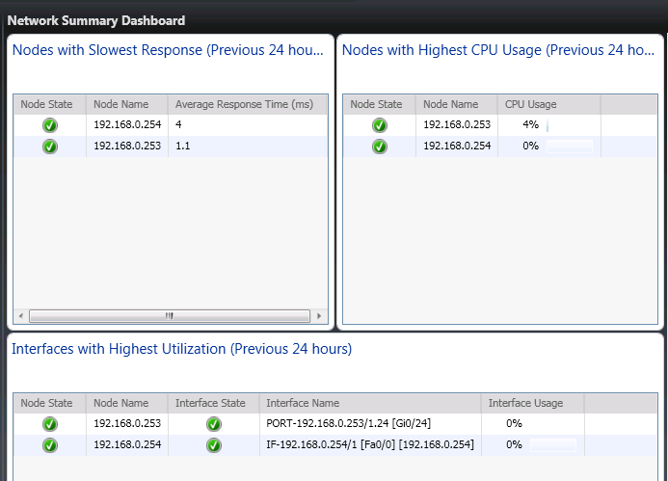
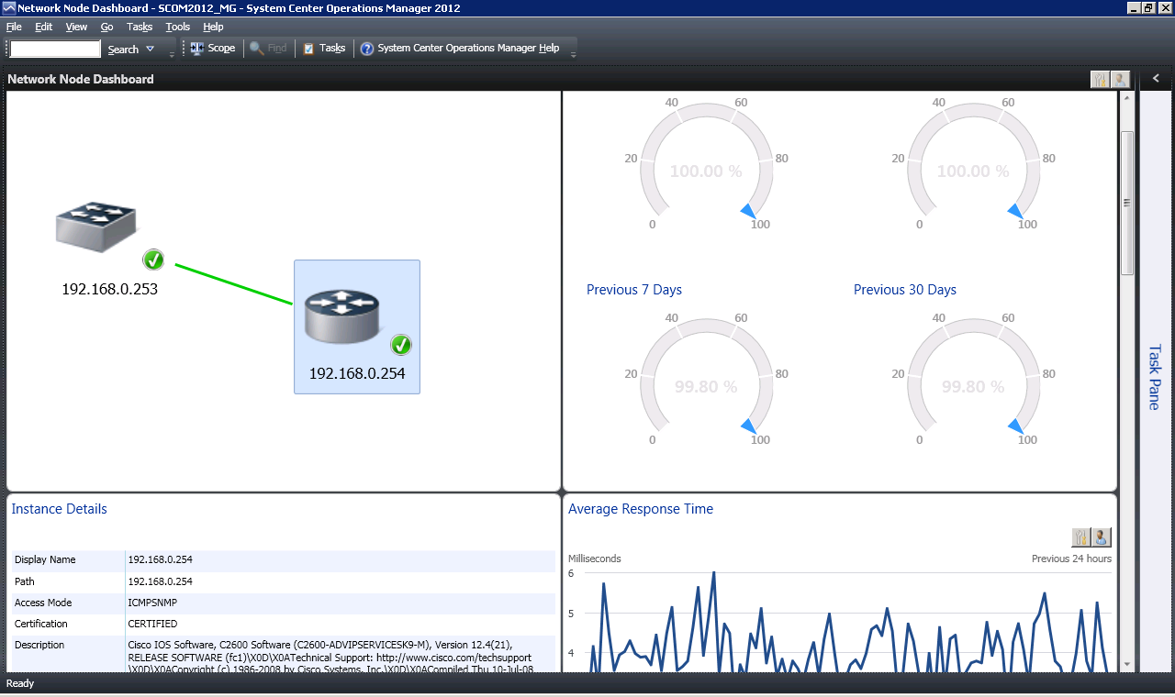
Network Dashboards
Network Summary
Network Node
Network Interface
Vicinity

Slide 14
Demo:
Network monitoring
Noel Fairclough
(c) 2011 Microsoft. All rights reserved.

Slide 15
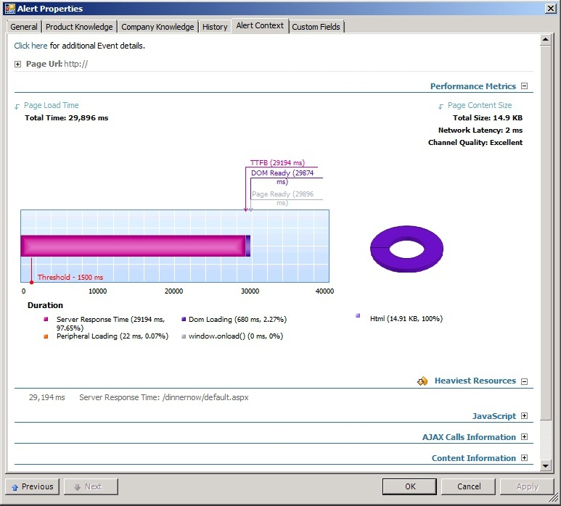
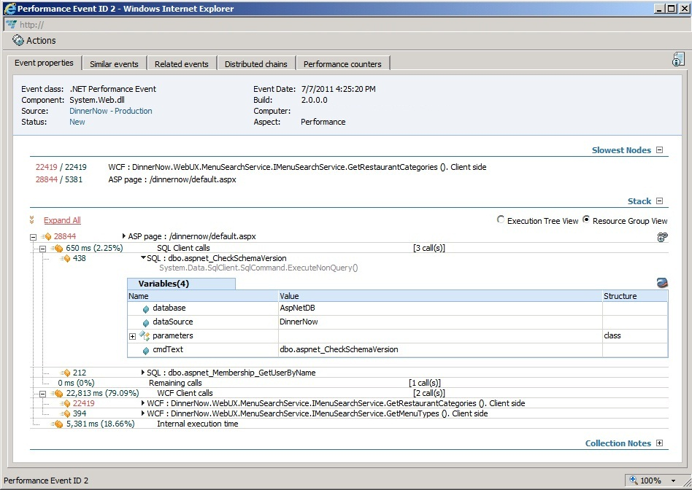
.NET Application Monitoring
Server Side and Client Side Perspectives
Provides insight into how web apps are performing
Alert Context Provides Rich Performance and Troubleshooting Details
Application Monitoring Tools
  Application Advisor
  Application Diagnostics

Slide 16
JEE Monitoring
Supported Platforms in SCOM 2012:
  Operating Systems
    Windows – All Below
    Red Hat Enterprise Linux 5 – JBOSS 5.1
  Java EE Application Servers
    WebSphere 6.1 & 7.0
    WebLogic 10gRel3 & 11gRel1
    JBOSS 4.2, 5.1 & 6
    Tomcat 5.5, 6.0 & 7

Slide 17
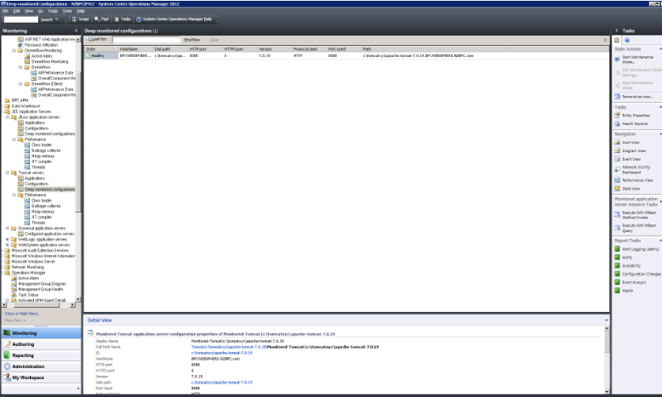
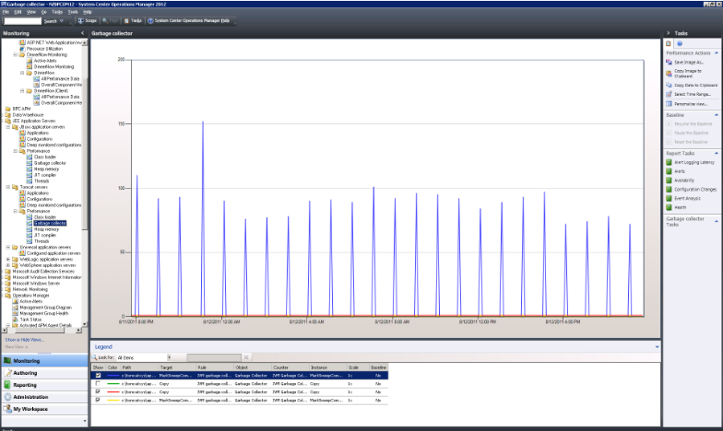
JEE Monitoring – What’s Monitored?
JEE Application Servers
  Automatic discovery
  Availability monitoring
  Performance Monitoring
    Memory
    Garbage Collection
    Threads
    Class Loader
    JIT Compiler
JEE Applications
  Automatic discovery
  Application module discovery
  Availability monitoring
  Template based custom monitoring

Slide 18
Demo:
Application monitoring
Justin Cook
(c) 2011 Microsoft. All rights reserved.

Slide 19
Consoles / Dashboards
Simple creation and customisation of Dashboards through Templates and Widgets
Personalised Dashboards enable increased service owner efficiency and troubleshooting
Consistent views across all consoles enable users to see and share Dashboards with various owners (Infra, Service, and Managers)
IT Pro Visibility
Reduced TCO of
Management Infra
MTTR
Holistic view of
Application Health
Simple and Powerful Visualisations decreasing
time to value

Slide 20
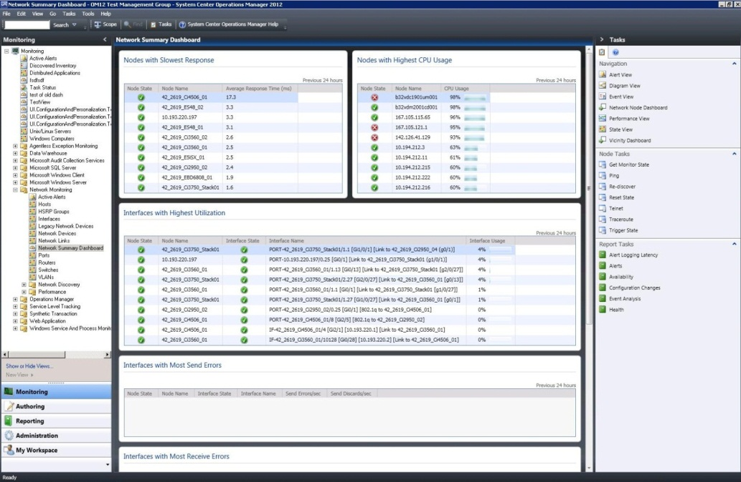
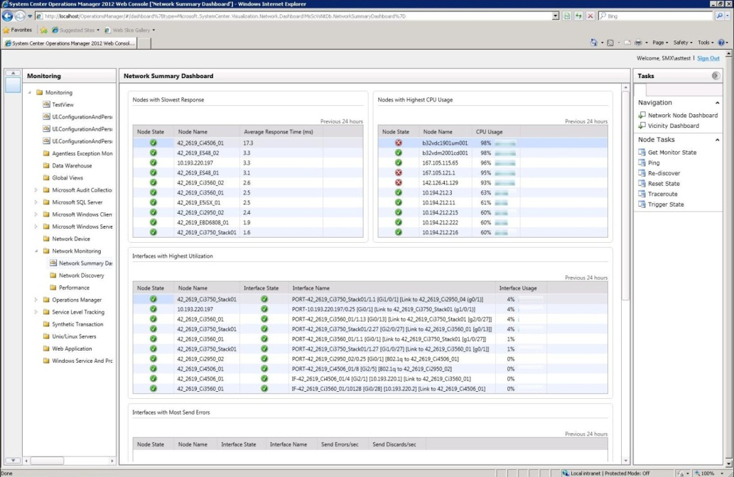
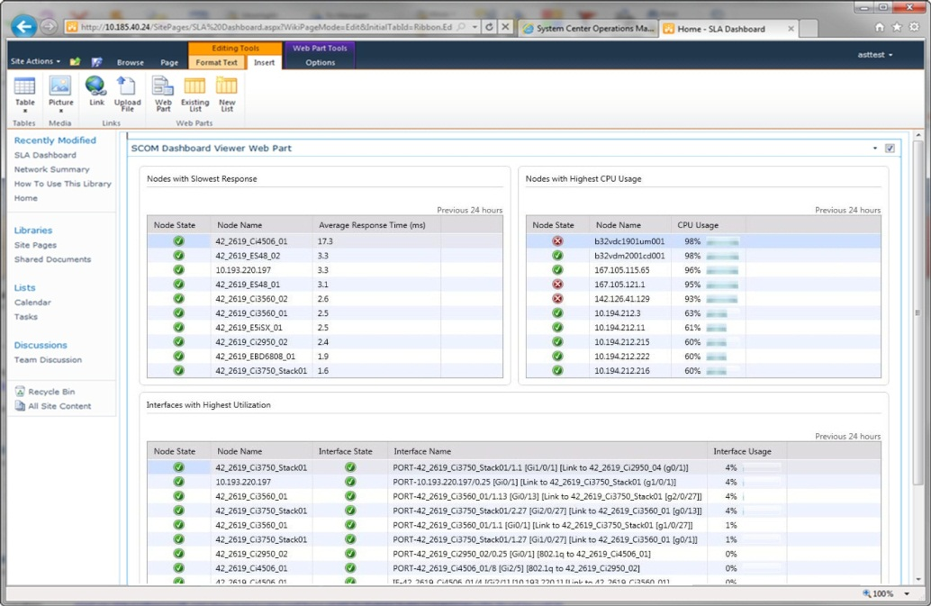
Consistent Experience
Consistent Dashboards Across
  Thick Console
  Web Console
  SharePoint

Slide 21
Visualisation (Dashboards)
New Service Level Dashboards
Widgets
  Provide Granular Control Over Objects Presented
  Alert, Performance and State
  Many More Widgets To Come…
Create Custom Dashboards using Widgets
Partner Dashboards
  Product Teams and External Partners
  Exchange, SQL, SharePoint, etc

Slide 22
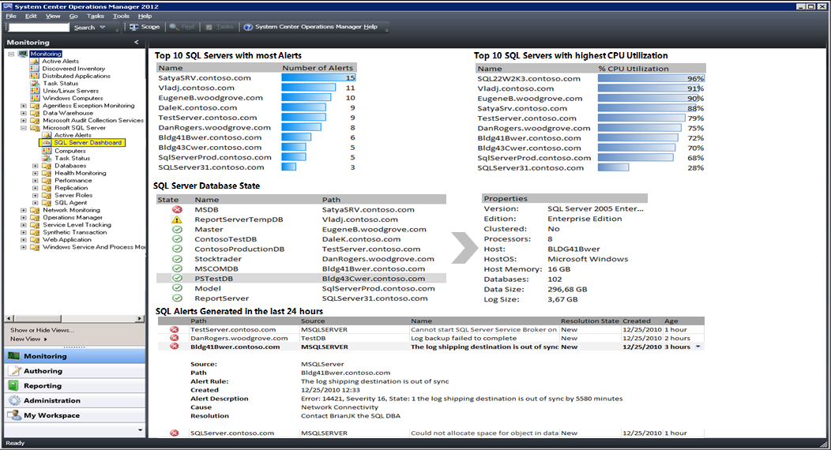
Example SQL Dashboard

Slide 23
Demo:
Dashboards
Noel Fairclough
(c) 2011 Microsoft. All rights reserved.

Slide 24
Upgrade Simulation
Get to the Right Starting Point
R2
R2
Operational Database
R2
Data Warehouse
R2
R2
R2
32-bit
R2
R2
R2
R2

Slide 25
Upgrade Simulation
Upgrade an MS to OM12
Using R2 Console approve agents
R2
R2
Operational Database
R2
Data Warehouse
OM12
R2
R2
R2
Upgrade Here
R2
R2
OM12
Agents Pending
R2
!

Slide 26
Upgrade Simulation
Upgrade MSs, GWs, Agents, Not RMS
R2
R2
R2
R2
Operational Database
R2
Data Warehouse
R2
OM12
R2
OM12
R2
R2
OM12
R2
OM12
R2
OM12

Slide 27
Upgrade Simulation
Option 1: Upgrade from the RMS
OM12
R2
R2
R2
Operational Database
OM12
Data Warehouse
OM12
R2
OM12
OM12
OM12
OM12
R2
OM12
OM12

Slide 28
Upgrade Simulation
Option 2: Upgrade from a MS
OM12
R2
OM12
OM12
Operational Database
R2
Data Warehouse
R2
OM12
R2
OM12
OM12
R2
OM12
OM12

Slide 29
Recapping
Introduced Operations Manager 2012
New Hierarchy
Extending Visibility
  Native Network Monitoring
  .NET / JEE Application Monitoring
Consoles / Dashboards
Upgrading from SCOM 2007 R2

Slide 30
Release Dates
Beta – Available Now!
RTM – Dec 2011

Slide 31
Related Content
SCOM 2012 Beta http://connect.microsoft.com/site1211/Survey/Survey.aspx?SurveyID=12787
Contact Us:
  Justin Cook
    justin_cook@data3.com.au
    b-jucook@microsoft.com
  Noel Fairclough
    noel_fairclough@data3.com.au

Slide 32

Enrol in Microsoft Virtual Academy Today
Why Enroll, other than it being free?
The MVA helps improve your IT skill set and advance your career with a free, easy to access training portal that allows you to learn at your own pace, focusing on Microsoft technologies.
What Do I get for enrolment?
Free training to make you become the Cloud-Hero in my Organization
Help mastering your Training Path and get the recognition
Connect with other IT Pros and discuss The Cloud
Where do I Enrol?
www.microsoftvirtualacademy.com
Then tell us what you think. TellTheDean@microsoft.com

Slide 33

© 2010 Microsoft Corporation. All rights reserved. Microsoft, Windows, Windows Vista and other product names are or may be registered trademarks and/or trademarks
in the U.S. and/or other countries.
The information herein is for informational purposes only and represents the current view of Microsoft Corporation as of the date of this presentation. Because Microsoft must respond to changing market conditions, it should not be interpreted to be a commitment on the part of Microsoft, and Microsoft cannot guarantee the accuracy of any information provided after the date of this presentation. MICROSOFT MAKES NO WARRANTIES, EXPRESS, IMPLIED OR STATUTORY, AS TO THE INFORMATION IN THIS PRESENTATION.

Slide 34




Resources
www.msteched.com/Australia
  Sessions On-Demand & Community
www.microsoft.com/australia/learning
Microsoft Certification & Training Resources
http:// technet.microsoft.com/en-au
  Resources for IT Professionals
http://msdn.microsoft.com/en-au
  Resources for Developers

