Slide 2

What SharePoint consultant should know about SQL Server
SESSION CODE: OFS203
Shashank Pawar
SQL Server Technology Specialist
Microsoft
http://blogs.technet.com/sqlman
@sqlman101
Shimron Shimla
Practice Manager and Productivity vTSP
Ensyst
http://www.linkedin.com/in/shimronshimla
@sshimla

Slide 3
What are we doing today?

Slide 4
Our Scenario
SP2010 Deployment
3 Global Offices
SME Portals with Search
Internet Page Publishing
99.9% availability
Rich Media content
BI and LOB Apps
1,500 Users

Slide 5
Overall Design Goals
Minimum number of server farms supporting intranet, extranet and Internet sites.
Environment that can grow, can add applications to the solution without affecting the design of the initial applications.
Access for several groups of users without compromising the security of the content within the different types of sites.
Enable access to remote employees, partner employees, partner companies, and customers.
The design can be used in an extranet environment. Deliberate design choices are made to ensure that the server farms can be securely deployed in a perimeter network.

Slide 6
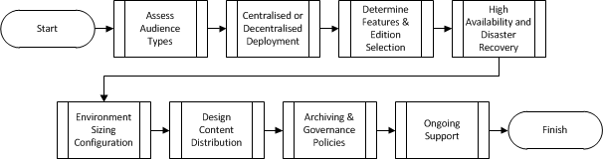
Deployment Road
Steps to follow

Slide 7
Assess Audience Types
Audience
Authentication
  FBA
  Mixed Zones
  Claims Based
Zones
  Internet
  Intranet
  Extranet
  Kiosk

Slide 8
Centralised / Decentralised Deployment
Audience
Usage Analysis is crucial
Bandwidth and Latency considerations
Impact on Site Structure Design in some scenarios
WAN Optimisation Tools
(De) Central

Slide 9
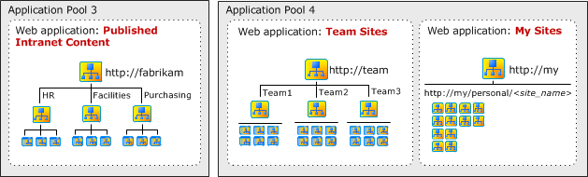
Centralised / Decentralised Deployment
Audience
Intranet
(De) Central

Slide 10
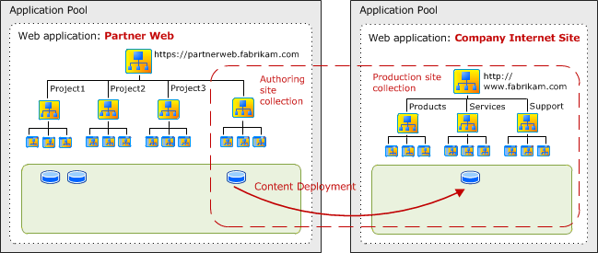
Centralised / Decentralised Deployment
Audience
Internet
(De) Central

Slide 11
Centralised / Decentralised Deployment
Audience
(De) Central

Slide 12
Platform Features Selection
SharePoint 2010, Foundation, Standard, Enterprise and Online
Connectivity | BCS ATOM/RSS Search (Enterprise, Federated, FAST, etc.) API PowerShell
Deployment | Sandbox WSP PowerShell
Availability | Multiple WFEs Multiple App Servers
Functions | Form Libraries Enterprise Search Single Sign On Business Intelligence (ECS, PPS)
Audience
(De) Central
Features

Slide 13
Platform Features Selection
For SharePoint 2010 , best practice is to use SQL Server 2008 R2
Enterprise Edition
SQL Server Version | SQL Server 2005 is supported, it is recommended to implement latest version of SQL Server – 2008 R2 for SharePoint 2010. Improved performance (at least 4X better) Additional functionality with PowerPivot for SharePoint 2010
Storage Consideration | Compression – data (Search Crawl/Property DBs) & backup (50-60%) Remote Blob Storage – store data on cheaper storage options Web Analytics service application - can take advantage of table partitioning for improved performance.
Availability | Clustering Mirroring Database Snapshots – can be used for content deployment; backup of site collection; maintain historical data Fast Recovery
Audience
(De) Central
Features

Slide 14
Platform Features Selection
Performance & Scalability | Operations can take advantage of multi CPU/cores and performed ONLINE Ability to address up to 8 sockets with Enterprise Editions & 2TB of RAM Hot Add Memory & CPU support (Dynamic Memory configuration in Virtualisation) Resource Governor
Manageability | Online Operations Manage multiple servers with Utility Control Point (UCP)
Security | Transparent Database Encryption Audit Everything
Licensing | SQL Server in Virtualised environment especially when it comes to the mobility of the Virtual Machines
Audience
(De) Central
Features

Slide 15



















Microsoft Business Intelligence
Leader in Gartner’s BI Magic Quadrant
Most Broadly adopted Productivity & Collaboration Tools
SharePoint
Search & Dashboards
SharePoint
Scorecards
Visualization
Visio
Services
Data
Mining
Excel
Workbooks/Services
PowerPivot Applications
#1 OLAP vendor
for the last 5 years
– BI Survey
Analysis
Services
Reporting
Services
StreamInsight
Most widely deployed EIM & BI Platform
Integration
Services
Master Data
Services
1TB of data transferred
in under 30 minutes
LOB
Apps
Odata
Feeds

Slide 16

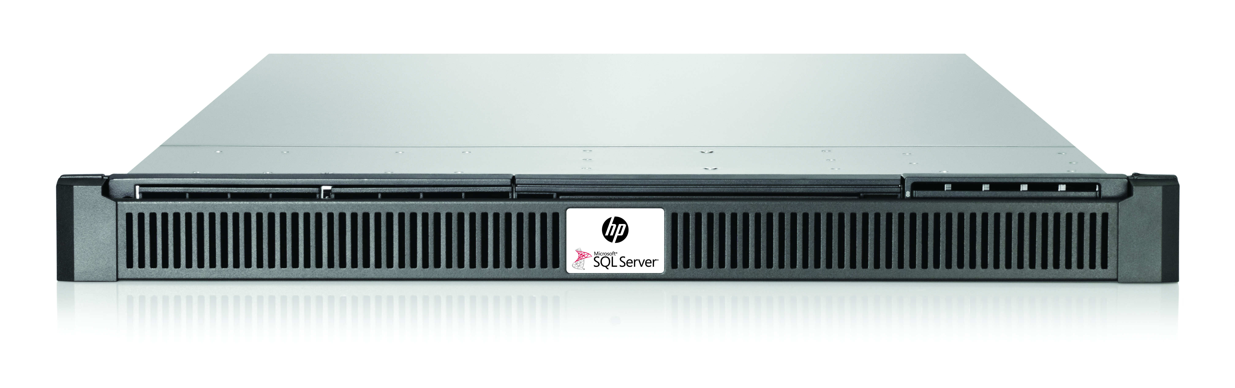
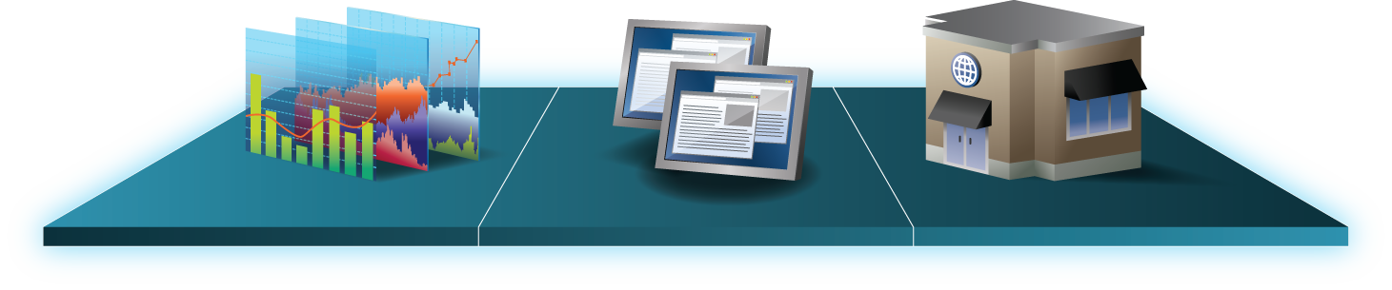
HP Business Decision Appliance
Optimized for SQL Server 2008 R2 and SharePoint Server 2010
  Hardware: DL360 G7, 96GB RAM,
  8 x internal 300GB SFF SAS disks
Complete
  HW, SW and Support included, installed, tuned, tested
  Windows Server + SQL Server + SharePoint Server + PowerPivot for SharePoint
OPTIMIZED
  Share and refresh PowerPivot workbooks (often containing millions of rows and multiple data sources) with ease
  Appliance style support included
AGILE
  Deploy in less than an hour
  Business insight in less than a week
  Developed for Mid-market, enterprise workgroup and remote offices
Notes:
16

Slide 17
High Availability (HA) &
Disaster Recovery (DR)
High Availability options for SharePoint
  Multiple WFEs
  Multiple Application Servers
High Availability options for SQL Server
  Failover Clustering
  Database Mirroring
Disaster Recovery Options
  Stretched Failover Clustering
  Database Mirroring
  Log Shipping
Database Replication not recommended/supported
Audience
(De) Central
Features
HA / DR

Slide 18

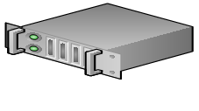
Multi-site Failover Cluster Instance
SQL Server 2008 (R2)
V-LAN
Audience
Network Name: SqlClus
(De) Central
IP: 10.10.10.10
Features
subnet 1
subnet 2
HA / DR
Node1
Node2
site 1
site 2
SAN Replication

Slide 19
AlwaysOn Multi-site Failover Cluster Instance
Denali
Corpnet
Audience
Network Name: SqlClus
(De) Central
OR
Features
IP1: 10.168.0.10
IP2: 192.168.0.10
subnet 1
subnet 2
HA / DR
Node1
Node2
site 1
site 2
SAN Replication

Slide 20

Disaster Recovery
SQL Server 2005, 2008, 2008 R2
Audience
Primary Data Center
Disaster Recovery Data Center
(De) Central
Witness
Features
Principal
Mirror
Log Shipping Secondary
HA / DR
Synchronous
Database
Mirroring
Log Shipping

Slide 21
Disaster Recovery
Denali
Replace Database Mirroring and Log Shipping with Availability Group
Advantages:
  One integrated solution for HA and DR
  Groups of databases failing over together
  Readable secondary
  Multiple secondaries
  Backup on secondary
  Listener for Client Connectivity
  And More
Restrictions:
  No delayed apply on the secondary
Audience
(De) Central
Features
HA / DR

Slide 22
Disaster Recovery
Denali
Windows Server Failover Cluster
Audience
Primary Data Center
Disaster Recovery Data Center
(De) Central
Fileshare Witness
Availability Group
Features
Primary
Secondary
Secondary
HA / DR
Synchronous
Synchronous / Asynchronous
Note: More secondaries (total up to 4) can be added for additional resiliency or read scale out

Slide 23
Environment Sizing Configuration
SQL Server on dedicated server
  Add an additional database server when you have more than four Web servers that are running at full capacity.
  Add an additional database server when your current server has reached its effective resource limits of RAM, CPU, disk IO throughput, disk capacity, or network throughput.
Disk Configuration
  RAID 5 for many reads few writes
  RAID 10 (1+0) for many reads many writes
  System must consistently return the first byte of data within 20ms.
  Align the file system to the offset
  Best practices and recommendations for prioritising data:
    Tempdb data files and transaction logs
    Database transaction log files
    Search databases, except for the Search administration database
    Database data files
Audience
(De) Central
Features
HA / DR
Sizing

Slide 24
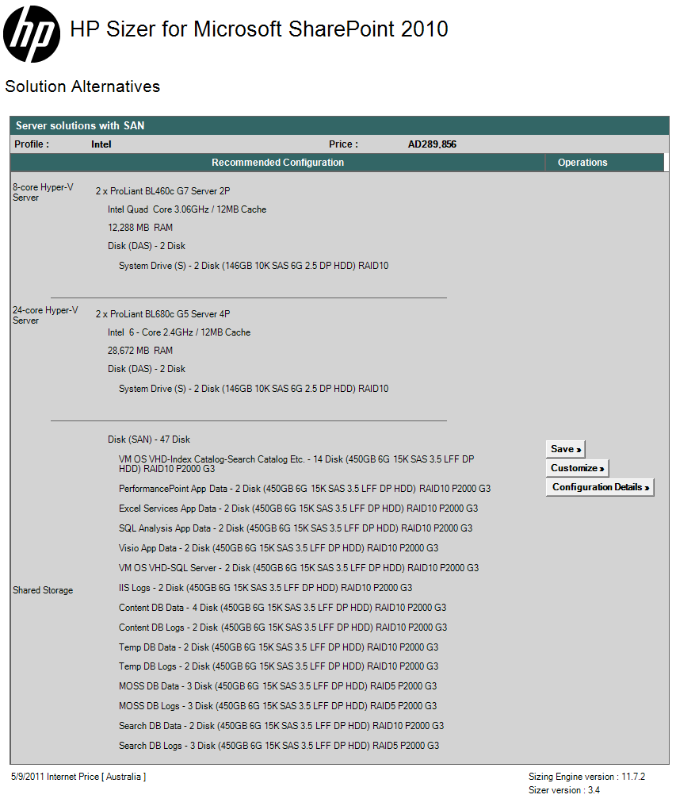
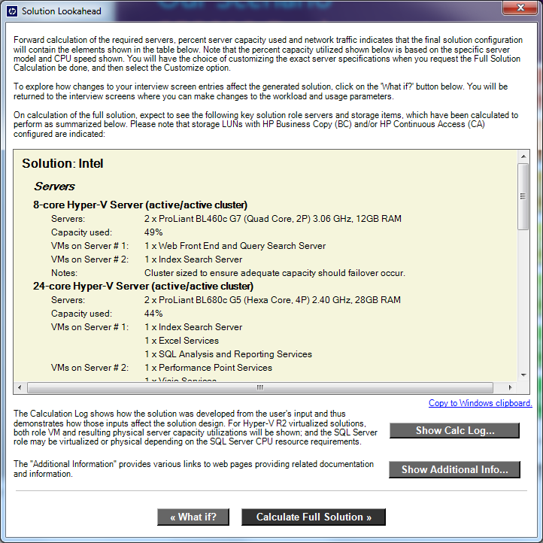
Demo
Audience
(De) Central
Features
HP SharePoint 2010 Sizing Wizard
HA / DR
Sizing

Slide 25
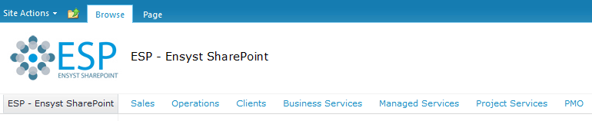
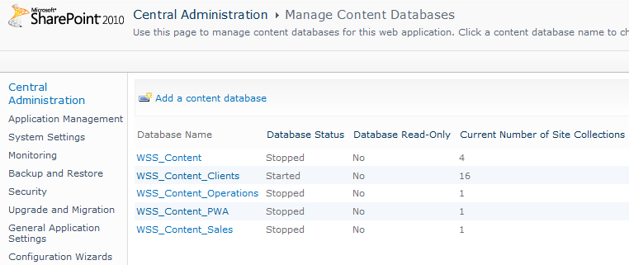
Design Content Database Distribution
Site Collection to Content Database Relationship
Content Databases Restrictions in SP2010
4TB limitation (post SP1), up to 32,767 per SQL Instance
Multiple data files of equal size (based on number of cores)
Audience
(De) Central
Features
HA / DR
Sizing
Content

Slide 26
Content Database Configuration
SQL Server configuration
  Do not enable auto-create statistics
    SharePoint Server provides coded hints for queries as needed to provide the best performance across all scenarios.
  Set max degree of parallelism (MAXDOP) to 1
  Configure SQL Server connection aliases for each database server in your farm
  Autogrowth setting for file size
    content databases that exceed the recommended size (200 GB), set the database autogrowth value to a fixed number of megabytes.
    Set the autogrowth value for the Search service application Property Store database to 10 percent.
Audience
(De) Central
Features
HA / DR
Sizing
Content

Slide 27
Archival & Governance Policies
SharePoint level
  3rd party tools (AvePoint, CA, CommVault, EMC, Metalogix, Mimosa, NetApp, Quest, Symantec, etc.).
Database level
  Site Collections to Content Databases (package)
Data Migration
  PowerShell / Code
  Metalogix, AvePoint, ControlPoint
Shrinking Database Files
  Use only after very large quantity (>50%) of data deleted and if the space is not planned to be used again e.g. relocation of site collections, deletion of large lists.
  Only consider content database
Audience
(De) Central
Features
HA / DR
Sizing
Content
Archival

Slide 28
Ongoing Support & Maintenance
SharePoint 2010 Health Analyzer evaluates health of DB indexes & statistics daily (config, content, user profile, web analytics and word automation databases)
  Note: Previous versions this needed to be done manually
Routine database maintenance essential for smooth operation of SharePoint 2010:
  Check database integrity (DBCC CHECKDB)
  Defragmenting indexes – rebuild/reorganise (esp. AllDocs table)
  Setting fill factor for server (tests show 80% fill factor is good)
Monitor Performance
  SQL Server Perspective
    CPU
    Memory
    Disk I/O
    For exact counters and values see:
      Storage and SQL Server capacity planning and configuration (SharePoint Server 2010)
Audience
(De) Central
Features
HA / DR
Sizing
Content
Archival
Support

Slide 29
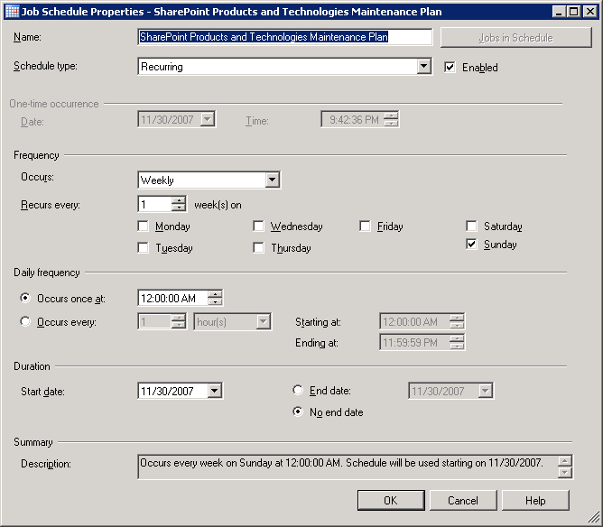
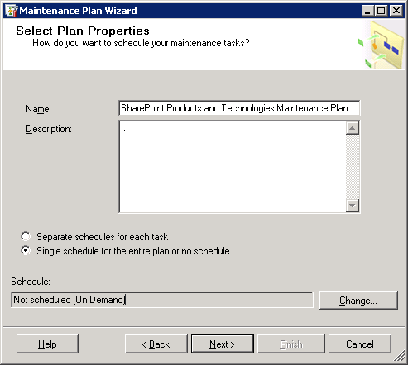
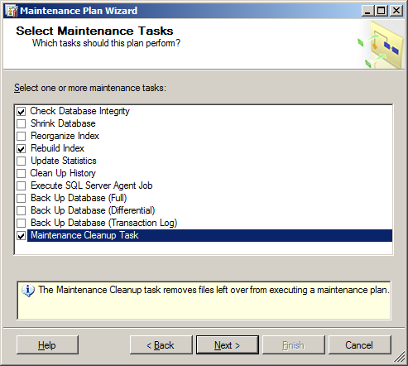
Ongoing Support & Maintenance
Automation via SQL Server Maintenance Plans
Audience
(De) Central
Features
HA / DR
Sizing
Content
Archival
Support

Slide 30
Summary
Design of SQL Server infrastructure is important
  Affects performance of SharePoint
  Affects availability of SharePoint
  Affects functionality of SharePoint
  Ensures focus in around user adoption rather than platform availability

Slide 31

Deployment Road
Steps to follow

Slide 32
Resources
Whitepapers
  SQL Server 2008 R2 and SharePoint 2010 Products: Better Together
  Database maintenance for SharePoint Server 2010
Technet
  Storage and SQL Server capacity planning and configuration (SharePoint Server 2010)
  Design Sample: Corporate Deployment

Slide 33

Enrol in Microsoft Virtual Academy Today
Why Enroll, other than it being free?
The MVA helps improve your IT skill set and advance your career with a free, easy to access training portal that allows you to learn at your own pace, focusing on Microsoft technologies.
What Do I get for enrolment?
Free training to make you become the Cloud-Hero in my Organization
Help mastering your Training Path and get the recognition
Connect with other IT Pros and discuss The Cloud
Where do I Enrol?
www.microsoftvirtualacademy.com
Then tell us what you think. TellTheDean@microsoft.com

Slide 34




Resources
www.msteched.com/Australia
  Sessions On-Demand & Community
www.microsoft.com/australia/learning
Microsoft Certification & Training Resources
http:// technet.microsoft.com/en-au
  Resources for IT Professionals
http://msdn.microsoft.com/en-au
  Resources for Developers

Slide 35

© 2010 Microsoft Corporation. All rights reserved. Microsoft, Windows, Windows Vista and other product names are or may be registered trademarks and/or trademarks in the U.S. and/or other countries.
The information herein is for informational purposes only and represents the current view of Microsoft Corporation as of the date of this presentation. Because Microsoft must respond to changing market conditions, it should not be interpreted to be a commitment on the part of Microsoft, and Microsoft cannot guarantee the accuracy of any information provided after the date of this presentation. MICROSOFT MAKES NO WARRANTIES, EXPRESS, IMPLIED OR STATUTORY, AS TO THE INFORMATION IN THIS PRESENTATION.

