Slide 2
Setting Up and Deploying Microsoft Lync Server 2010 Edge Servers
SESSION CODE: EXL312
Vakhtang Assatrian Nathan Chapman
Voice TSP, WW Target Accounts CTO, Lync MCM
Microsoft Generation-E

Slide 3
Agenda
‘what makes this session interesting’
Protocols for establishing media
  NAT, ICE, STUN, TURN
  Address discovery process
Deploying Lync Edge
  Topologies & Architecture
  Load Balancing (DNS & HLB)
Reverse Proxy
Authentication
Security
Federation
Troubleshooting

Slide 4
Objective & what you should already know
Objective:
  What is Lync Edge Server actually doing?
Scope
  300 (400) level
  Limited to media scenarios
Assumptions
  Basic understanding of SIP and RTP
  Basic understanding of the Lync server roles
  Basic understanding of a typical Lync topology

Slide 5
Lync Server Edge scenarios
External User Access
  Lync clients can transparently connect to the Lync Server deployment over the public Internet
PIC
  Connecting with public IM providers
Conferencing with anonymous/external users
Federation
  Federation with other Enterprises
  IM&P only, or
  All modalities A/V and Application Sharing

Slide 6
Edge supported scenarios
Scenario | Remote User | Federated | Anonymous | PIC/ Interop
Presence | ü | ü |  | ü
IM Peer-to-Peer | ü | ü |  | ü
IM conferencing | ü | ü | ü
Collaboration | ü | ü | ü
A/V Peer-to-Peer | ü | ü |  | ü *
A/V Conferencing | ü | ü | ü
File Transfer | ü | ü
* Latest Windows Live Messenger

Slide 7


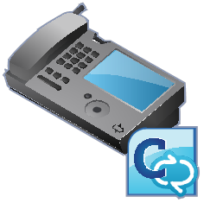













Reverse Proxy
Remote, Federated
and anonymous users
Edge Server
Monitoring
Director
SBA
Front End
Back End
Archiving
PSTN
SBC
Mediation
Server
Exchange
UM
AV
Conferencing
Gateway

Slide 8
Why should I care?
Traversing NATs

Slide 9
More Terms & Acronyms
Candidate
  Possible combination of IP address and port for media channel
NAT
  Network Address Translation
TURN
  Traversal Using Relay NAT
STUN
  Simple Traversal of UDP through NAT
  Session Traversal Utilities for NAT
ICE
  Interactive Connectivity Establishment
  Exchanges candidates and determines optimal media path

Slide 10

Home NATs
General NAT/Firewall behavior
  Allow connections from the private network
  Blocks connection from the Internet
Security/usability tradeoff
  Blocks attackers from harming your system
  PROBLEM: Also blocks incoming signaling and media
Home
Internet
Home NAT

Slide 11
Corporate Firewalls
Though more scrutinized, goals are similar
  Sharing of IP addresses
  Controlling data traffic from the internet
Two firewalls isolate via perimeter network
Work
Internet
Perimeter
Network
Outer FW
Inner FW

Slide 12
Why is NAT Traversal a problem?
SIP signaling over TCP uses Access Edge
UDP media flows over separate channel
Pre-ICE endpoints uses local IPs & ports
No media can be sent between (a) and (w)
Access
Edge
SIP proxy
INVITE
m/c = a
200 OK
m/c = w
Home
Work
a
w
Home NAT
Outer FW
Inner FW

Slide 13
Solution – STUN, TURN, ICE
Add a Media Relay (aka A/V Edge Server)
  STUN reflects NAT addresses (b) and (e)
  TURN relays media packets (c) (d) (x) (y)
ICE exchanges candidates and determines optimal media path
All three protocols based IETF standards
INVITE
m/c = a
Access
Edge
200 OK
m/c = w
Home
cand=a,b,c,d,e
cand=w,x,y
Work
a
b
c
STUN
TURN Server
(AV Edge)
e
d
w
x
y
Home NAT
Outer FW
Inner FW

Slide 14
How to establish connections across Firewalls
Address Discovery

Slide 15

Address Discovery (AV)
UDP
TCP
nic
a
c
default
a
MRAS
b
candidate list
Allocate UDP
b
c
c
Media
Relay
d
Allocate TCP
d
e
e
local
remote
Endpoint
NAT/Firewall

Slide 16
Address Discovery (Desktop Sharing)
UDP
TCP
nic
a
c
default
a
MRAS
b
c
candidate list
Media
Relay
Allocate TCP
b
c
local
remote
Endpoint
NAT/Firewall

Slide 17
Address Exchange
nic
nic
a
b
x
w
SIP INVITE
c :: a,b,c,d
local
remote
remote
local
c
y
c
y
default
183 Session Progress
y :: w,x,y,z
default
a
w
a
w
x
200 OK
y :: w,x,y,z
b
b
x
candidate list
candidate list
c
y
c
y
d
z
d
z
c
y
TURN
TURN
d
z
SIP
Endpoint
NAT/Firewall
NAT/Firewall
Endpoint
17

Slide 18
Lync Candidate Demo
[---------]:1 2 [---3--] [----4---] [------5-----] [-6-] [---7---] [---------------8---------------]
a=candidate:1 1 UDP 2130706431 192.168.0.103 50012 typ host
a=candidate:1 2 UDP 2130705918 192.168.0.103 50013 typ host
a=candidate:2 1 UDP 2130705919 192.168.0.100 50036 typ host
a=candidate:2 2 UDP 2130705406 192.168.0.100 50037 typ host
a=candidate:3 1 TCP-PASS 6556159 94.245.124.238 59782 typ relay raddr 10.166.24.59 rport 50023
a=candidate:3 2 TCP-PASS 6556158 94.245.124.238 59782 typ relay raddr 10.166.24.59 rport 50023
a=candidate:4 1 UDP 16648703 94.245.124.238 50570 typ relay raddr 84.112.158.142 rport 50016
a=candidate:4 2 UDP 16648702 94.245.124.238 56248 typ relay raddr 84.112.158.142 rport 50017
a=candidate:5 1 TCP-ACT 7076351 94.245.124.238 59782 typ relay raddr 10.166.24.59 rport 50023
a=candidate:5 2 TCP-ACT 7075838 94.245.124.238 59782 typ relay raddr 10.166.24.59 rport 50023
a=candidate:6 1 TCP-ACT 1684797439 10.166.24.59 50023 typ srflx raddr 192.168.0.103 rport 50023
a=candidate:6 2 TCP-ACT 1684796926 10.166.24.59 50023 typ srflx raddr 192.168.0.103 rport 50023
a=candidate:7 1 UDP 1694234111 84.112.158.142 50016 typ srflx raddr 192.168.0.103 rport 50016
a=candidate:7 2 UDP 1694233598 84.112.158.142 50017 typ srflx raddr 192.168.0.103 rport 50017

Slide 19
What Reference Architectures can I use?
  Edge with single IP address
  Edge with multiple IP addresses
  Edge with NAT-ed IP addresses
Edge Topologies

Slide 20

Common Firewall topologies
Internet
LAN
Internet
LAN
Outside
Inside
Outside
Inside
Lync Edge
Internet
LAN
Lync Edge
Outside
Inside
Lync Edge

Slide 21
Edge & IP: Private vs Public vs NAT
Topology | High Availability | NAT/Public IP required | Additional External DNS A record required for each Edge Server in the Edge Pool | Failover*
Single Edge | No | NAT mandatory | No | No
Scaled Edge (DNS LB) | Yes | NAT Mandatory | Yes | No
Scaled Edge (HLB) | Yes | Public IP | No (Only one per VP) | Yes
http://technet.microsoft.com/en-us/library/gg425716.aspx
* Failover for Exchange UM (remote user), public instant messaging (IM) connectivity, and federation with servers running Office Communications Server

Slide 22

Single IP address Edge with NAT
DNS A record:
edge.contoso.com
131.107.155.10
SIP: 5061
Web Conf: 444
A/V Conf: 443, 3478
NAT
Edge Server
edge-int.contoso.com
172.25.33.10
SIP: 5061
Web Conf: 8057
A/V Conf: 443, 3478
IP1*
IP1
External
Internal
Translated AV IP addresses must
be configured in Lync Server individually
IP1 to IP1*

Slide 23
Multiple IP address Edge using NAT
NAT
Edge Server
IP1*
IP1
External SIP
access.contoso.com
131.107.155.10 443, 5061
Lync Server does not need
to know translated SIP and
Web Conf IP
edge-int.contoso.com
172.25.33.10
SIP: 5061
Web Conf: 8057
A/V Conf: 443, 3478
IP2*
IP2
External
Web Conf
Internal
webcon.contoso.com
131.107.155.20 443
Translated AV IP must be configured in Lync Server:
IP3 to IP3*
IP3*
IP3
External AV
av.contoso.com
131.107.155.30 443, 3478

Slide 24
What Load Balancing options are available?
  DNS Load Balancing using NAT
  Hardware Load Balancing (HLB)
Edge Topologies

Slide 25
DNS Load Balanced Edge using NAT
Public IP space
NAT
Edge Server 1
DNS A records
access.contoso.com IP1* and IP4*
webcon.contoso.com IP2* and IP5*
av.contoso.com IP3* and IP6*
IP1*
IP1
IP2*
IP2
Int
IP3*
IP3
Translated AV IP addresses must
be configured in Lync Server individually
IP3 to IP3*
IP6 to IP6*
Edge Server 2
IP4*
IP4
IP5*
IP5
Int
Client can retrieve and handle multiple IP addresses and can fail over DNS server returns randomized IP address
IP6*
IP6

Slide 26
Hardware Load Balanced Edge
Public IP space
HLB
Edge Server 1
IP1*
DNS A records
access.contoso.com VIP1
webcon.contoso.com VIP2
av.contoso.com VIP3
All IP - public
IP2*
Int
VIP1*
IP3*
VIP2*
AV client connections are initiated over the VIP.
Subsequent client AV traffic (UDP) connect directly to Edge.
TCP traffic continues to use VIP.
NAT and HLB is not possible
VIP3*
Edge Server 2
IP4*
IP5*
Int
IP6*

Slide 27
DNS Load Balancing and Interop/Migration
Co-existence/Side-by-Side
  OCS 2007 OR OCS 2007 R2 pool and Edge Server can co-exist with Lync Server pool and Lync Edge Server
  Only a single Edge (server/pool) for Federation is possible
DNS Load Balancing
  Legacy components do not support DNS LB
  If co-existence time is short: DNS LB
  If co-existence time is long: Hardware LB

Slide 28
Adding Edge using Lync Topology Builder
DEMO

Slide 29
Why do you need it?
Reverse Proxy

Slide 30
Reverse Proxy and external access
Forwards External HTTPS and HTTP traffic to Front End and Director Pool
HTTPS
  Simple URLs (Join Launcher URL)
  Address Book (download and/or web service) ABS
  Distribution List Expansion DLX
  Web Ticket (Web Auth)
HTTP
  Device Updates (Firmware)
  Device Update logs upload

Slide 31
Reverse Proxy and external access
Simple URL forward to Director (recommended)
  Forwarding rule for Simple URL to a single Director (or Pool); port 443
  Reverse Proxy certificate’s SAN to contain base FQDN of each Simple URL
Web External Pool traffic forwarded to pools by Reverse Proxy
  Reverse Proxy requires a forwarding rule each Web External FQDN (Front End Pool and Director); port 443
  If external Phone Devices are implemented, Reverse Proxy rule for port 80 is required
  Reverse Proxy certificate’s SAN to contain base FQDN of all configured Web external Pools (Front End Pool and Director)

Slide 32
How do clients establish A/V connections?
Authentication

Slide 33
Credentials for remote client
SIP Subscribe
200 OK
Access
Edge
ms-user-logon-data: RemoteUser
<mrasUri>sip:Mras.contoso.com
Lync FE
Server
SIP Service
<location>internet</location>
200 OK
<hostName>avedge.contoso.com
<udpPort>3478
<tcpPort>443
<username> 77qq8yXccBc2lwOmFy
<password> Wnujl0eo00YkV/5dg=
<duration>480
Service
MTLS
200 OK
MRAS
A/V
Edge
Outer
Firewall
Inner
Firewall
Endpoint

Slide 34
How do I secure my Edge Server?
Security

Slide 35
Tips to secure my Edge Servers
Use a different subnet.
Lock down the routing rules for access to that subnet (disable broadcast, multicast, and traffic to other perimeter network subnets).
Sandwich the Edge Server between 2 firewalls.
Disable IPv6, File/Print Sharing, NETBIOS
Leverage the Lync Server 2010 security guide
Read and use the information in Protecting the Edge Server Against DoS and Password Brute-Force Attacks in Lync Server 2010

Slide 36
Secure Communications in Lync
Can someone sniff the packets and access my IM/audio/video/data?
Traffic Type | Protected By
Server-to-Server | MTLS
Client-to-Server | TLS
IM&P | TLS (if configured for TLS )
A/V Conferencing & Desktop Sharing of media | SRTP
Desktop Sharing (signalling) | TLS
Web Conferencing | TLS
Meeting Content download, address book download, distribution group expansion | HTTPS

Slide 37
Which ports do I really need to open?
Federation

Slide 38
Port Requirements for Audio/Video
Lync 2010
  UDP 3478, TCP 443
  UDP/TCP 50,000-59,999 inbound/outbound
    Enables federation with OCS 2007 Edges
OCS 2007 R2
  UDP 3478, TCP 443
    No additional ports needed for remote access only
  TCP 50,000-59,999 outbound
    Enables federation with R2 Edges
  UDP/TCP 50,000-59,999 inbound/outbound
    Enables federation with OCS 2007 Edges
OCS 2007
  UDP 3478, TCP 443
  UDP/TCP 50,000-59,999 inbound/outbound

Slide 39

A/V Federation 2007-2007
Access
Proxy
Access
Proxy
Work1
OC/Console
A/V MCU
w1
w2
Work2
OC/Console
A/V MCU
UDP
3478
TCP
443
UDP
3478
TCP
443
UDP/TCP
50000
.
.
.
.
.
.
.
.
.
UDP/TCP
59999
UDP/TCP
50000
.
.
.
.
.
.
.
.
.
UDP/TCP
59999
w1
w2
w1
w2
Inner FW
2007
Edge
Outer FWs
(no NAT)
2007
Edge
Inner FW

Slide 40
A/V Federation R2 Tunnel Mode
Access
Proxy
Access
Proxy
Work1
OC/Console
A/V MCU
w1
w2
Work2
OC/Console
A/V MCU
UDP
3478
TCP
443
UDP
3478
TCP
443
UDP/TCP
50000
.
.
.
.
.
.
.
.
.
UDP/TCP
59999
UDP/TCP
50000
.
.
.
.
.
.
.
.
.
UDP/TCP
59999
w1
w2
w1
w2
Inner FW
R2
Edge
Outer FWs
(no NAT)
R2
Edge
Inner FW

Slide 41

A/V Federation R2-2007 Interop
Access
Proxy
Access
Proxy
Work1
OC/Console
A/V MCU
w1
w2
Work2
OC/Console
A/V MCU
UDP
3478
TCP
443
UDP
3478
TCP
443
UDP/TCP
50000
.
.
.
.
.
.
.
.
.
UDP/TCP
59999
UDP/TCP
50000
.
.
.
.
.
.
.
.
.
UDP/TCP
59999
w1
w2
w1
w2
Inner FW
R2
Edge
Outer FWs
(no NAT)
2007
Edge
Inner FW

Slide 42
A/V Federation Lync
Access
Proxy
Access
Proxy
Work1
OC/Console
A/V MCU
w1
w2
Work2
OC/Console
A/V MCU
UDP
3478
TCP
443
UDP
3478
TCP
443
UDP/TCP
50000
.
.
.
.
.
.
.
.
.
UDP/TCP
59999
UDP/TCP
50000
.
.
.
.
.
.
.
.
.
UDP/TCP
59999
Inner FW
Lync
Edge
Outer FWs
(no NAT)
Lync
Edge
Inner FW

Slide 43
50,000 Port Range minimum requirements
OCS 2007 A/V Edge
  UDP 3478, TCP 443 inbound
  UDP/TCP 50,000-59,999 inbound/outbound
R2/Lync A/V Edge
  UDP 3478, TCP 443 inbound
  UDP 3478 outbound
  TCP 50,000-59,999 outbound
  UDP/TCP 50,000-59,999 inbound/outbound
    Interop with OCS 2007 Edges

Slide 44
Where do I start?
Troubleshooting

Slide 45
Troubleshooting
Inbound provisioning without “MRAS”
  AV Edge Server is not configured at pool
“MRAS” credentials not provided
  No connectivity between Front End Server and Av Edge Server internal interface
    Wrong AV Edge Server FQDN?
    Firewall?
No STUN/TURN candidates
  No connectivity between client and AV Edge Server on port 443 TCP and 3478 UDP
    Wrong AV Edge Server FQDN?
    Firewall?
TURN candidates internal NATed IP address
  AV Edge Server not aware of of external IP address

Slide 46
Logs
Server Side Logs from Lync Logging tool
Use Snooper for reading logs
Where to get logs from
  Lync/Office Communicator
    Activate “Turn on logging in Lync”
    Logs in “%userprofile%/tracing”
  Live Meeting
    HKEY_CURRENT_USER\Software\Microsoft\Tracing\uccp\LiveMeeting
    "EnableFileTracing"= DWORD:00000001
    Logs in “%userprofile%/tracing”

Slide 47
In Review: Session Takeaways
Protocols for establishing media
  NAT, ICE, STUN, TURN
  Address discovery process
Deploying Lync Edge
  Topologies & Architecture
  Load Balancing (DNS & HLB)
Reverse Proxy
Authentication
Security
Federation
Troubleshooting

Slide 48
Track Resources
Planning for External User Access
Protecting the Edge Server Against DoS and Password Brute-Force Attacks in Lync Server 2010
Lync Server 2010 security guide
Ports and Protocols for Internal Servers

Slide 49
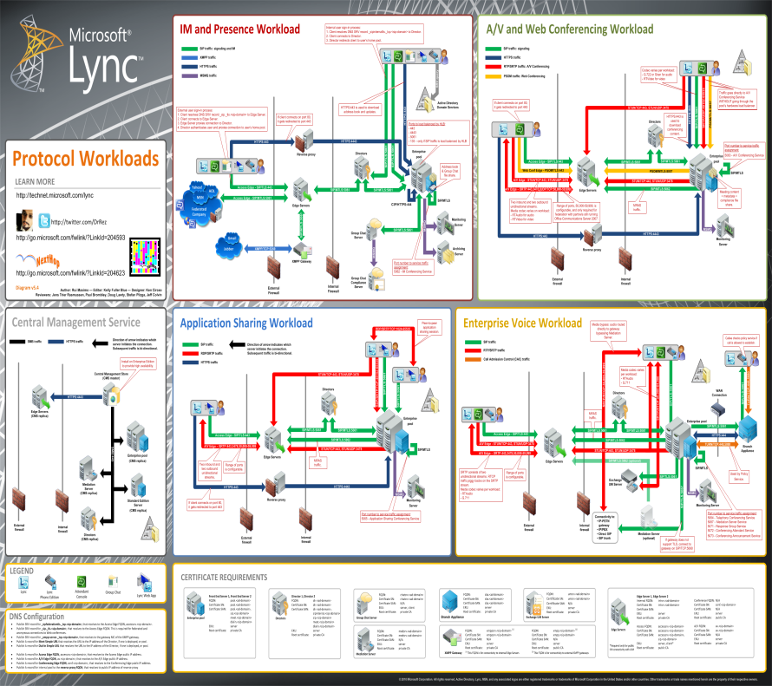


Track Resources
Tech Center home page
Technical Library
First Run videos
Visio Protocol Flow poster
Lync Powershell blog
Next Hop blog
Next Hop Community: http://nexthop.info

Slide 50

Related Content
EXL202 | Microsoft Lync 2010: High Availability and Resiliency
EXL201 | Audio, Video and Web Conferencing Architecture and Experience
EXL305 | Microsoft Lync 2010: Lync and the Enterprise Network
EXL306 | Interoperability, Integration with Legacy Systems
EXL309 | Microsoft Lync 2010: How to go big with voice

Slide 51

Enrol in Microsoft Virtual Academy Today
Why Enroll, other than it being free?
The MVA helps improve your IT skill set and advance your career with a free, easy to access training portal that allows you to learn at your own pace, focusing on Microsoft technologies.
What Do I get for enrolment?
Free training to make you become the Cloud-Hero in my Organization
Help mastering your Training Path and get the recognition
Connect with other IT Pros and discuss The Cloud
Where do I Enrol?
www.microsoftvirtualacademy.com
Then tell us what you think. TellTheDean@microsoft.com

Slide 52

© 2010 Microsoft Corporation. All rights reserved. Microsoft, Windows, Windows Vista and other product names are or may be registered trademarks and/or trademarks in the U.S. and/or other countries.
The information herein is for informational purposes only and represents the current view of Microsoft Corporation as of the date of this presentation. Because Microsoft must respond to changing market conditions, it should not be interpreted to be a commitment on the part of Microsoft, and Microsoft cannot guarantee the accuracy of any information provided after the date of this presentation. MICROSOFT MAKES NO WARRANTIES, EXPRESS, IMPLIED OR STATUTORY, AS TO THE INFORMATION IN THIS PRESENTATION.

Slide 53




Resources
www.msteched.com/Australia
  Sessions On-Demand & Community
www.microsoft.com/australia/learning
Microsoft Certification & Training Resources
http:// technet.microsoft.com/en-au
  Resources for IT Professionals
http://msdn.microsoft.com/en-au
  Resources for Developers

