Slide 2
Visual Studio vnext directions
#auteched
#dev309
SESSION CODE: DEV309
Anthony Borton
ALM Consultant/Trainer
Enhance ALM Pty Ltd

Slide 3
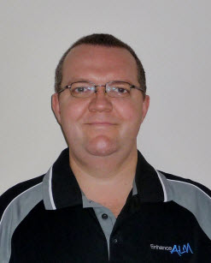





Anthony Borton
anthonyb@enhancealm.com.au
@anthonyborton
http://www.enhancealm.com.au
http://www.myalmblog.com

Slide 4


Where are the bits?

Slide 5
Microsoft’s Guiding Principals for ALM
Collaboration
Actionable Feedback
Respect your work styles
Transparent agile processes

Slide 6
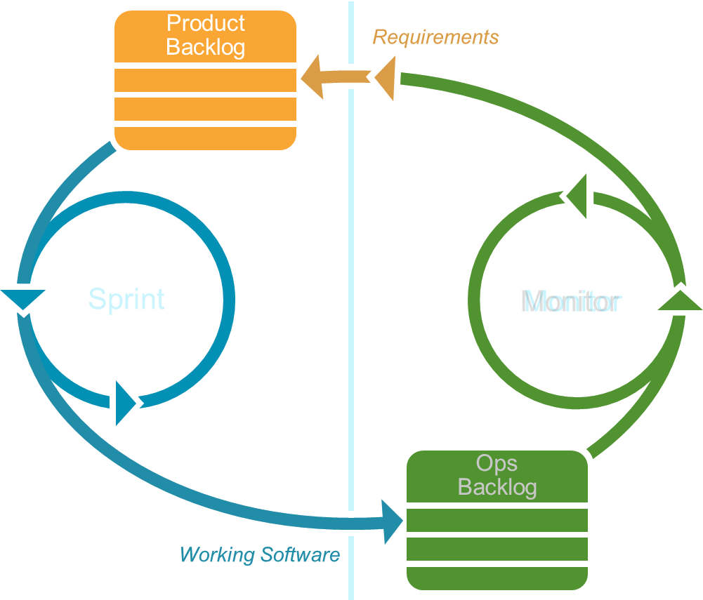
The Virtuous Cycle
DEVELOP
OPERATE

Slide 7
Actionable Incident
Eliminating “No-repro” bugs was a cornerstone of Visual Studio 2010
The IntelliTrace™ Diagnostic Data Adapter made the process of finding bugs during testing significantly quicker and easier
Wouldn’t it be great if we could do this in Production as well?

Slide 8

The Virtuous Cycle
DEVELOP
OPERATE
Story Boarding
Backlog Management
Sprint Planning
& Execution
IntelliTrace
in production
Personalised
Productivity
Feedback
Client
SCOM & TFS
Integration

Slide 9
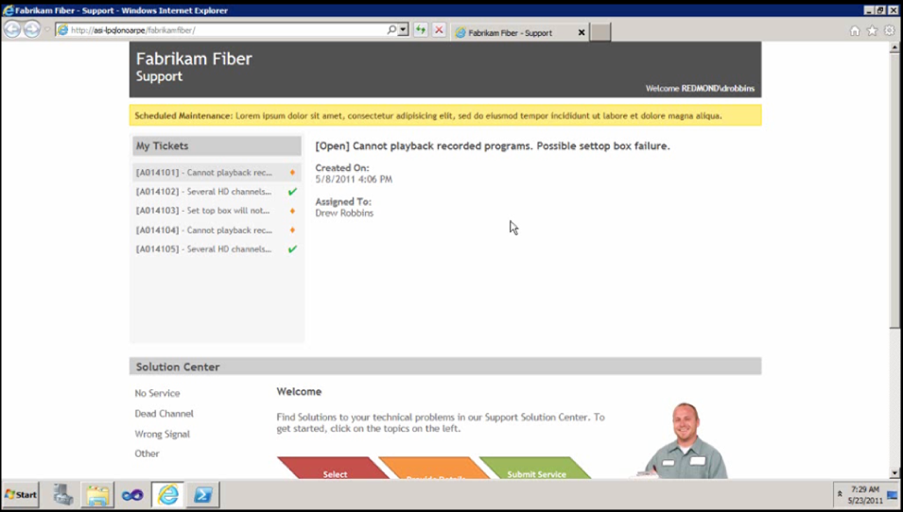
IntelliTrace in Production

Slide 10
Prototyping the User Interface
Often business stakeholders have a vision for what they want the app to look like and what the experience should be
Rarely can they put it into words until after you’ve built screens. Then they can tell you everything that’s wrong with your version.
Wouldn’t it be nice if we could use a familiar tool to rapidly create a visual prototype?

Slide 11
The Virtuous Cycle
DEVELOP
OPERATE
Story Boarding
Backlog Management
Sprint Planning
& Execution
IntelliTrace
in production
Personalised
Productivity
Feedback
Client
SCOM & TFS
Integration

Slide 12
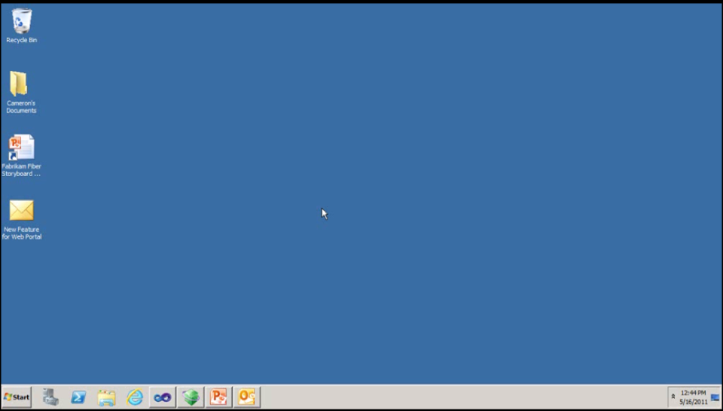
Storyboarding

Slide 13
Managing the Backlog
Managing the backlog is a continuous task that requires us to be able to see the backlog and easily manipulate it
Prioritisation is something that involves effort to keep up with ever changing business priorities
Managing the backlog and changing priorities in Visual Studio 2010 wasn’t quite as smooth as it should have been.
Wouldn’t it be nice to have a rich graphical experience that utilises drag and drop for our backlog work?

Slide 14
The Virtuous Cycle
DEVELOP
OPERATE
Story Boarding
Backlog Management
Sprint Planning
& Execution
IntelliTrace
in production
Personalised
Productivity
Feedback
Client
SCOM & TFS
Integration

Slide 15
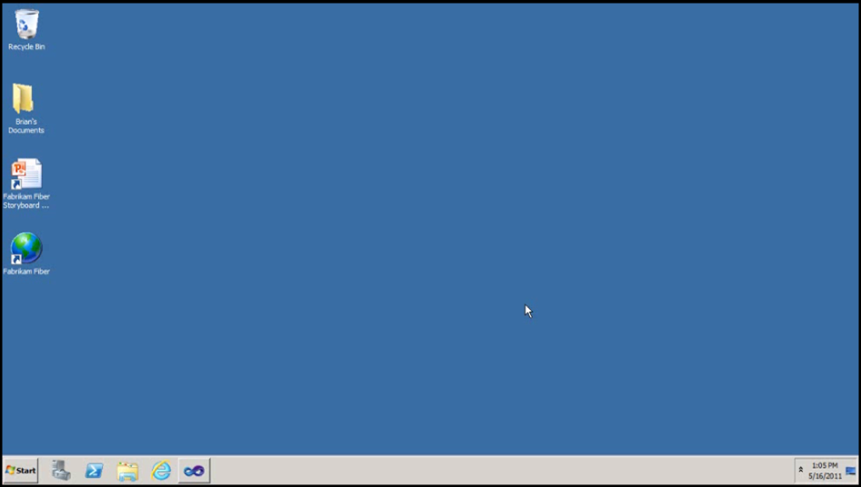
Backlog Management

Slide 16
Sprint Planning
Sprint planning is a time consuming task that requires access to a range of information to do it well
We need to manage our team members and take into consideration their capacity and any leave requirements
We need to monitor progress in real time and often make adjustments on the fly
Wouldn’t it be nice if we had a convenient graphical way to manage our sprint planning?

Slide 17
The Virtuous Cycle
DEVELOP
OPERATE
Story Boarding
Backlog Management
Sprint Planning
& Execution
IntelliTrace
in production
Personalised
Productivity
Feedback
Client
SCOM & TFS
Integration

Slide 18
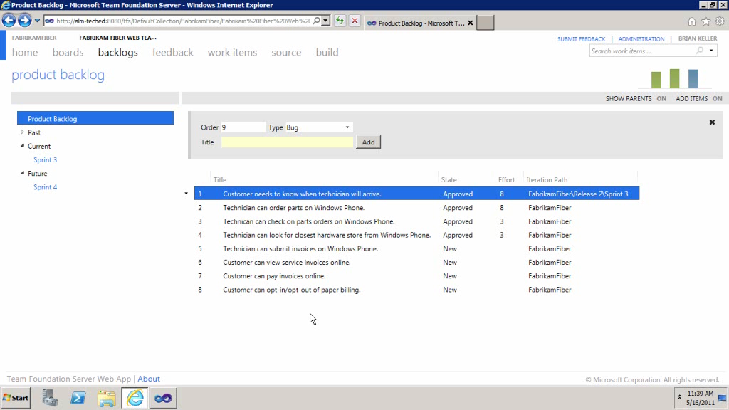
Sprint Planning & Execution

Slide 19
Personalised productivity
Developers need to see their work in progress and to Do items easily
Developers are often interrupted when they are doing their work. This context switching is expensive
Developers want better ways to manage their unit testing and more freedom to choose as well
Code reviews are critical to delivering high quality software
Duplication in code is a form of technical debt
Ouch! Wouldn’t it be nice if there was something in Visual Studio vNext just for developers?

Slide 20
The Virtuous Cycle
DEVELOP
OPERATE
Story Boarding
Backlog Management
Sprint Planning
& Execution
IntelliTrace
in production
Personalised
Productivity
Feedback
Client
SCOM & TFS
Integration

Slide 21
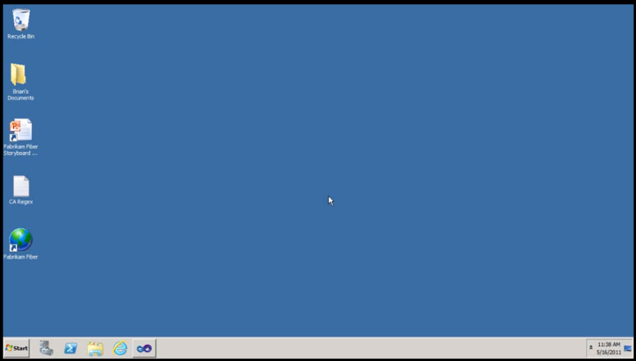
Personalised Productivity

Slide 22
Continuous Stakeholder Feedback
Constant and actionable feedback from your customers is very important to ensure you deliver exactly what they require
Stakeholders often see “bugs” that are not necessarily caught by testers
Getting feedback by email or even a phone call is “OK” but there’s got to be something better.
Wouldn’t it be great if you had a tool just for collecting great actionable feedback?

Slide 23
The Virtuous Cycle
DEVELOP
OPERATE
Story Boarding
Backlog Management
Sprint Planning
& Execution
IntelliTrace
in production
Personalised
Productivity
Feedback
Client
SCOM & TFS
Integration

Slide 24
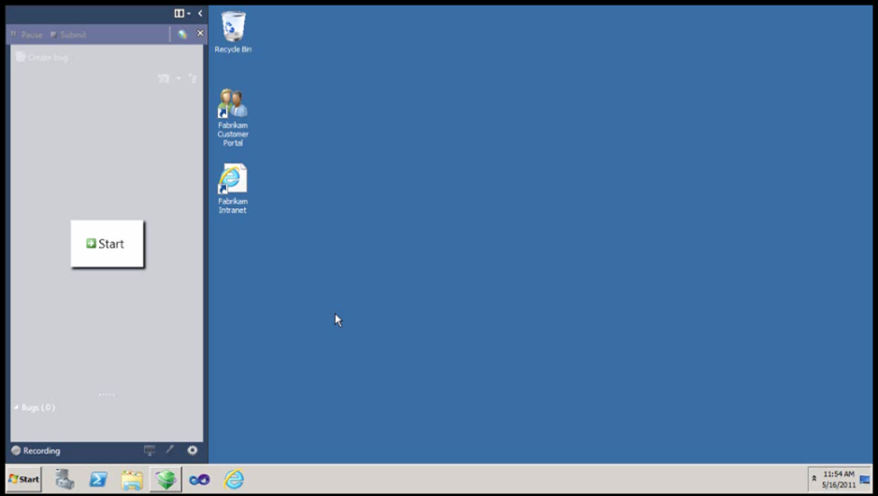
Feedback Client

Slide 25
Operational Support
Once you’ve deployed to Production, we’re not done
How do we get information from our operations staff?
How do we manage communication and convey status between the teams?
Wouldn’t it be nice if we could work better between our development teams and our operations teams?

Slide 26
The Virtuous Cycle
DEVELOP
OPERATE
Story Boarding
Backlog Management
Sprint Planning
& Execution
IntelliTrace
in production
Personalised
Productivity
Feedback
Client
SCOM & TFS
Integration

Slide 27
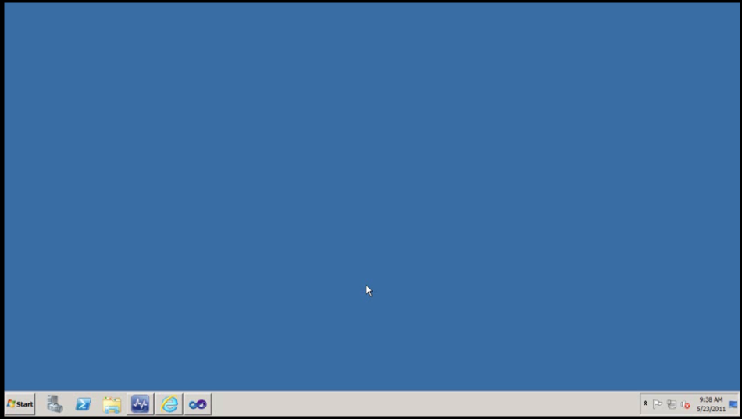
SCOM and TFS

Slide 28
Recap
Actionable Incident
  IntelliTrace in Production
Managing the Backlog
  Storyboarding, Managing Priorities
Sprint Planning
  Capacity, Sprint Burndown
Sprint Execution
  Context switching, My Work, Unit Testing, Code Clone & Review
Continuous Stakeholder Feedback
Operational Support

Slide 29
Call to Action
Get Visual Studio 2010 w/ Team Foundation Server
Get or Renew Your MSDN Subscription
Download the System Center Connector CTP
Get the whitepaper on Zander’s Blog
Stay Informed by following these blogs:
Jason Zander
Brian Harry
Cameron Skinner

Slide 30
Contact Details
anthonyb@enhancealm.com.au
@anthonyborton
http://www.enhancealm.com.au
http://www.myalmblog.com

Slide 31

Enrol in Microsoft Virtual Academy Today
Why Enroll, other than it being free?
The MVA helps improve your IT skill set and advance your career with a free, easy to access training portal that allows you to learn at your own pace, focusing on Microsoft technologies.
What Do I get for enrolment?
Free training to make you become the Cloud-Hero in my Organization
Help mastering your Training Path and get the recognition
Connect with other IT Pros and discuss The Cloud
Where do I Enrol?
www.microsoftvirtualacademy.com
Then tell us what you think. TellTheDean@microsoft.com

Slide 32




Resources
www.msteched.com/Australia
  Sessions On-Demand & Community
www.microsoft.com/australia/learning
Microsoft Certification & Training Resources
http:// technet.microsoft.com/en-au
  Resources for IT Professionals
http://msdn.microsoft.com/en-au
  Resources for Developers

Slide 33

© 2010 Microsoft Corporation. All rights reserved. Microsoft, Windows, Windows Vista and other product names are or may be registered trademarks and/or trademarks in the U.S. and/or other countries.
The information herein is for informational purposes only and represents the current view of Microsoft Corporation as of the date of this presentation. Because Microsoft must respond to changing market conditions, it should not be interpreted to be a commitment on the part of Microsoft, and Microsoft cannot guarantee the accuracy of any information provided after the date of this presentation. MICROSOFT MAKES NO WARRANTIES, EXPRESS, IMPLIED OR STATUTORY, AS TO THE INFORMATION IN THIS PRESENTATION.

