Slide 2
2 Screens and A Cloud, Without Being Cut!
DEV305
An MMO in 45 Minutes

Slide 3
Who We Are

Slide 4


Richard Banks
Luke Drumm
Aaron Powell
Steven Nagy

Slide 5
What’s this Session all about?

Slide 6

Not Quite “3 Screens and A Cloud”

Slide 7
Design, Architecture,
Sharp Edges,
Tips & Techniques

Slide 8
Team Development

Slide 9
Screen 1: Windows Phone 7

Slide 10
Screen 2: Windows PC

Slide 11
Cloud: Windows Azure

Slide 12
Beyond the Game: Web

Slide 13
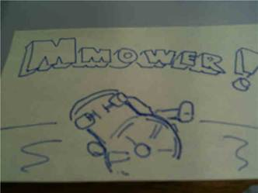
Let’s Play!!

Slide 14
Organising a Team

Slide 15
Agile Process

Slide 16
Weekly Planning via Skype

Slide 17
TFS 2010

Slide 18
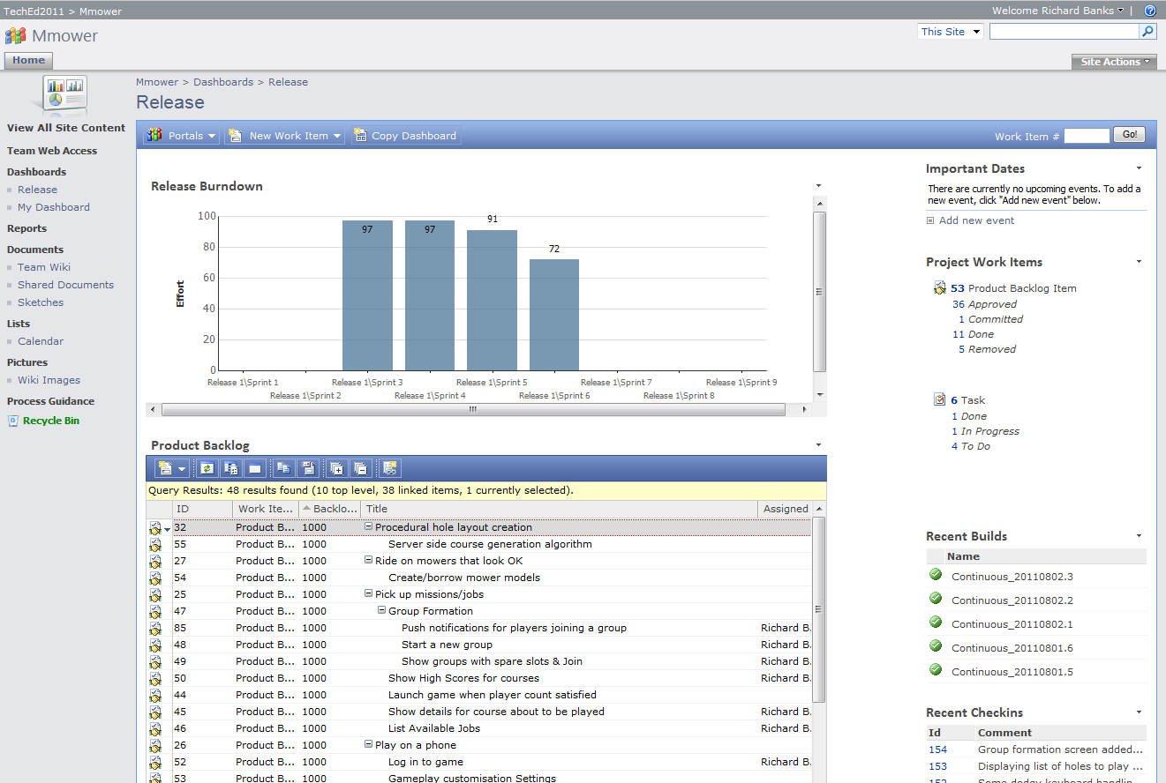

Slide 19
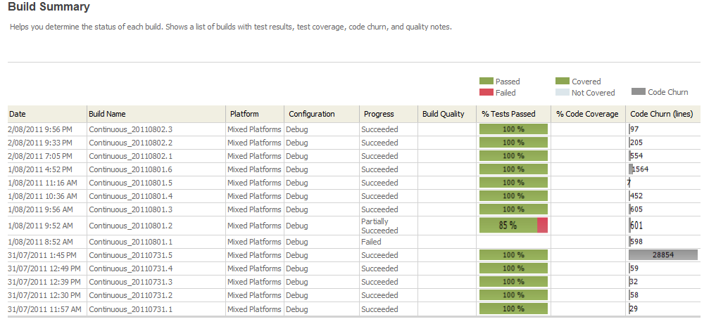
Continuous Builds

Slide 20
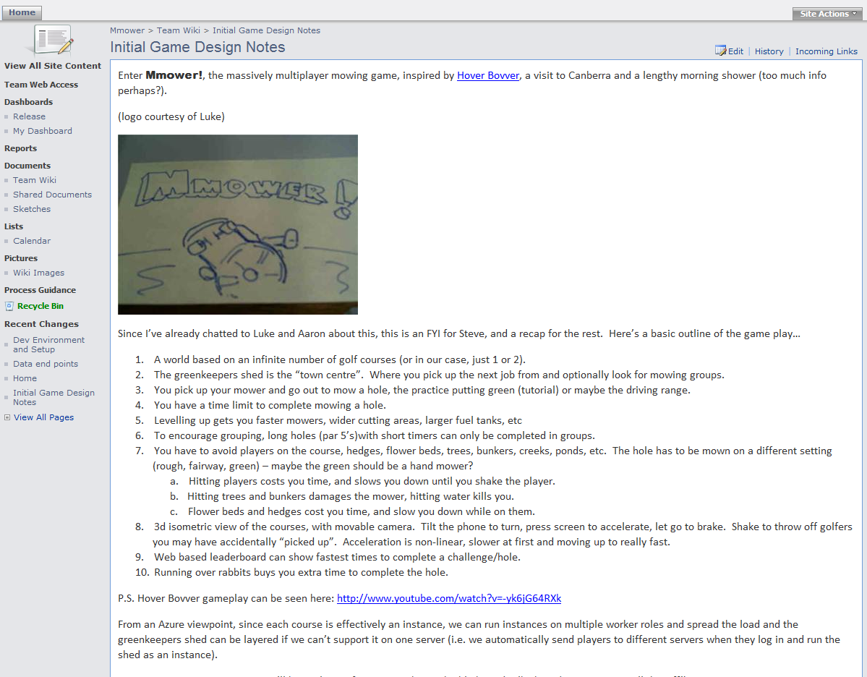
Wiki

Slide 21
Initial Concept

Slide 22
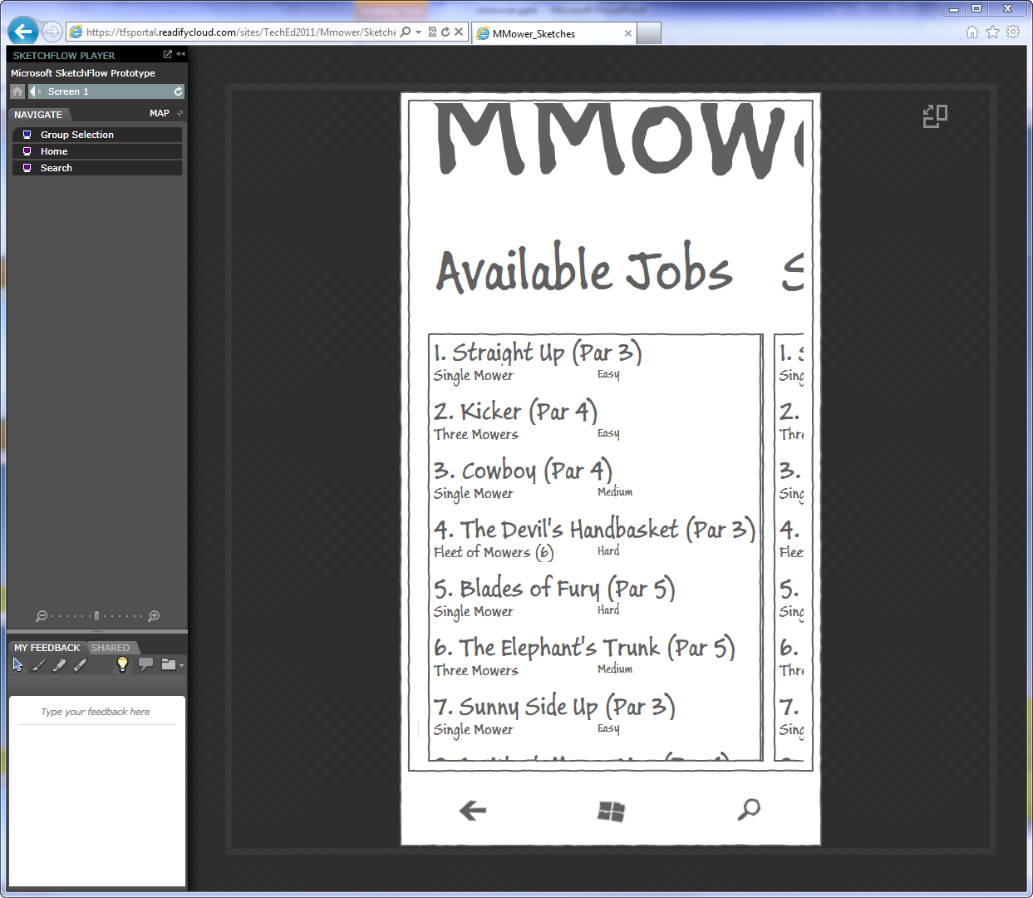
Sketch Flow (WP7)

Slide 23
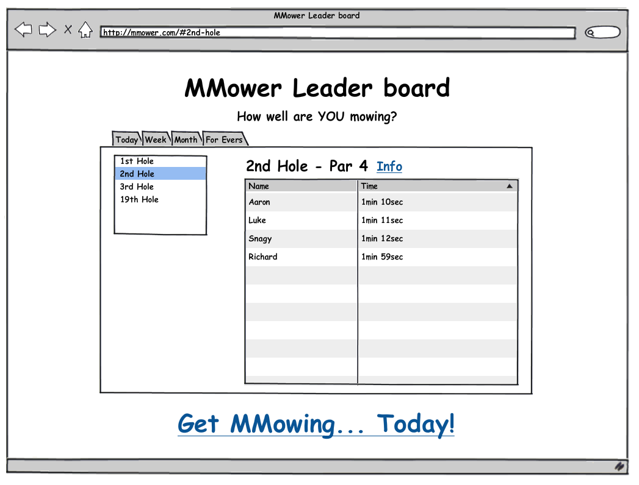
Balsamiq (Web)

Slide 24
Building It:
Toolset

Slide 25
Windows Azure SDK 1.4
XNA Game Studio 4.0
WP 7.1 ‘Mango’ SDK
ASP.NET MVC 3
Portable Library Tools

Slide 26
NSubstitute
MvvmLight
Autofac
Amplify JS
Knockout JS
RestSharp
SnowMaker

Slide 27
Building It:
Architecture

Slide 28
Windows Client
(XNA)
ASP.NET MVC3 JSON Services
Data Persistence
(Table Storage)
Phone 7 Client
(Silverlight & XNA)
Login
JSON
Grouping
Game State Updates
Game Engine
Web Site
Holes & Stats

Slide 29
Building It:
Windows XNA Client

Slide 30
Model Creation

Slide 31
Lawn State

Slide 32
Building It:
Network Communication

Slide 33
Trade-offs

Slide 34
Azure Security

Slide 35
Phone Latency

Slide 36
Movement Prediction

Slide 37
Minimising Traffic Volume

Slide 38
BUILDING It:
Game State

Slide 39
Who’s the Boss?

Slide 40
Simulation Engine

Slide 41
Portable Library Tools

Slide 42
Building It:
Web Services

Slide 43
Services Support All Clients

Slide 44
REST & JSON

Slide 45
Portable Library Tools

Slide 46
Building It:
WP7 Client

Slide 47
Silverlight & XNA

Slide 48
Device ID Usage

Slide 49
MvvmLight & RestSharp

Slide 50
Running Multiple Emulators

Slide 51
Building It:
Table Storage

Slide 52
Why not SQL Azure?

Slide 53
Table Storage Repository

Slide 54
SnowMaker Id Generator

Slide 55
Building It:
Game Completion

Slide 56
Azure Messages and Queues

Slide 57
Azure Worker Roles

Slide 58
Building It:
The Web Site

Slide 59
Extending the Game Beyond the Game

Slide 60
Single Page Web Application

Slide 61
JavaScript Libraries

Slide 62
Building It:
What else would we do?

Slide 63
Graphic Design!

Slide 64
Richer Gameplay Challenge

Slide 65
Mower Customisation and Levelling/Progression

Slide 66
2D Game Replays via Canvas

Slide 67
Sharding & Game Servers

Slide 68
Screen 3: Xbox 360 Client

Slide 69
Security and Hack Prevention

Slide 70
Voice Chat

Slide 71
Automated Azure Deployment

Slide 72
… and muchmuchmuchmuch more

Slide 73
Question time!

Slide 74

Enrol in Microsoft Virtual Academy Today
Why Enroll, other than it being free?
The MVA helps improve your IT skill set and advance your career with a free, easy to access training portal that allows you to learn at your own pace, focusing on Microsoft technologies.
What Do I get for enrolment?
Free training to make you become the Cloud-Hero in my Organization
Help mastering your Training Path and get the recognition
Connect with other IT Pros and discuss The Cloud
Where do I Enrol?
www.microsoftvirtualacademy.com
Then tell us what you think. TellTheDean@microsoft.com

Slide 75

© 2010 Microsoft Corporation. All rights reserved. Microsoft, Windows, Windows Vista and other product names are or may be registered trademarks and/or trademarks in the U.S. and/or other countries.
The information herein is for informational purposes only and represents the current view of Microsoft Corporation as of the date of this presentation. Because Microsoft must respond to changing market conditions, it should not be interpreted to be a commitment on the part of Microsoft, and Microsoft cannot guarantee the accuracy of any information provided after the date of this presentation. MICROSOFT MAKES NO WARRANTIES, EXPRESS, IMPLIED OR STATUTORY, AS TO THE INFORMATION IN THIS PRESENTATION.

Slide 76




Resources
www.msteched.com/Australia
  Sessions On-Demand & Community
www.microsoft.com/australia/learning
Microsoft Certification & Training Resources
http:// technet.microsoft.com/en-au
  Resources for IT Professionals
http://msdn.microsoft.com/en-au
  Resources for Developers

