Slide 1
DEV201
#auteched
#dev201
Introducing Visual Studio® LightSwitch™
Andrew Coates Microsoft
blogs.msdn.com/acoat @coatsy

Slide 2
The simplest way to create
business applications
for the desktop and the cloud

Slide 3
LightSwitch is for End User Developers

Slide 4
What do End User Developers Want?
A smooth on-ramp to development
Built-in plumbing that handles common application requirements
Simple and flexible deployment

Slide 5
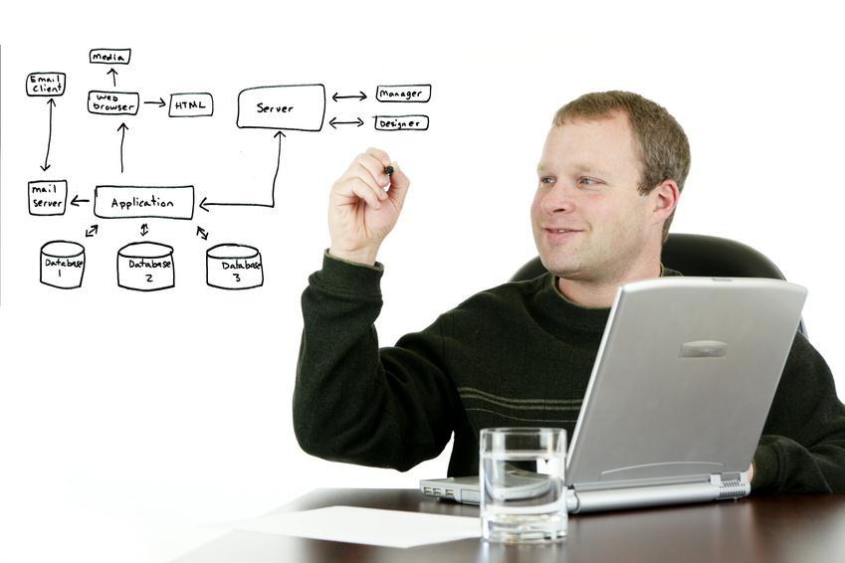
LightSwitch is for Professional Developers

Slide 6
The LightSwitch Development Experience
Start
Refine
Extend
Describe your data
Author business logic
Explore ecosystem components
Create screens for common tasks
Customise screen layouts
Create custom Silverlight controls
Define custom queries
Integrate with custom data sources

Slide 7
Introduction to LightSwitch
demo

Slide 8
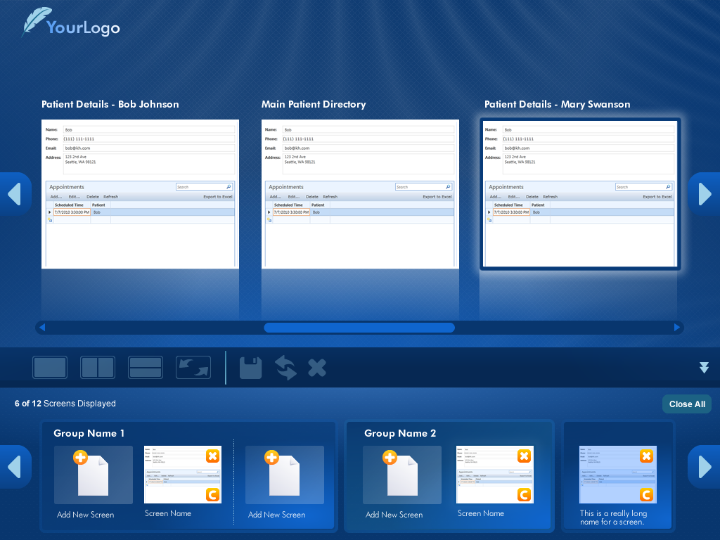
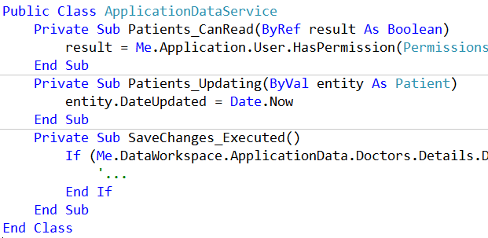
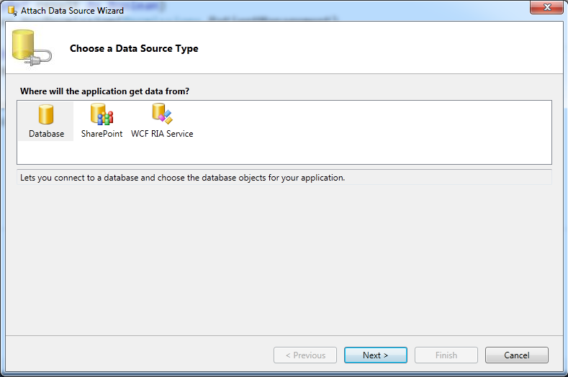
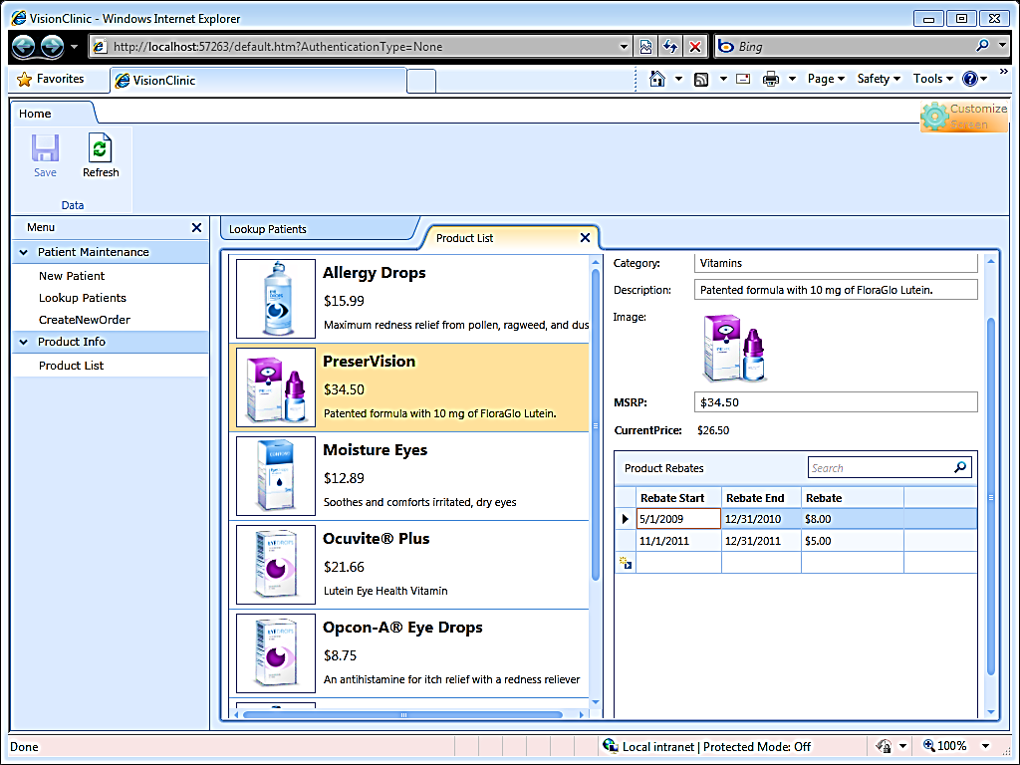
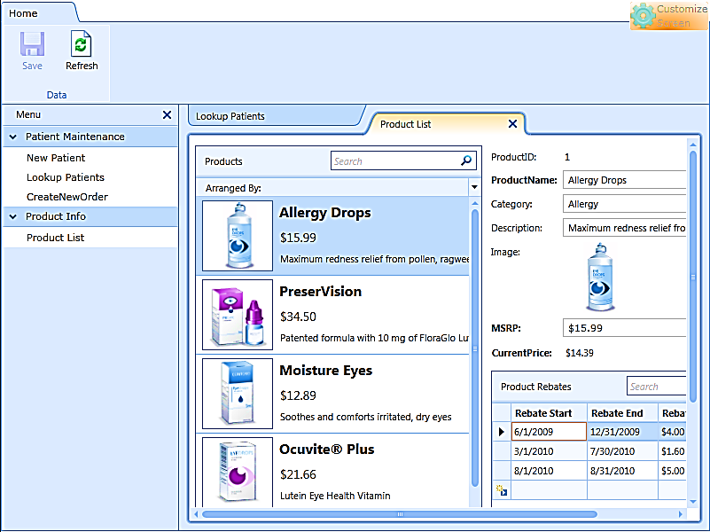
LightSwitch Architecture
Client Tier
Middle Tier
Data Access
Screens
Methods
Controls
Submit Pipeline
Queries
Data Workspace
Data Workspace
WCF RIA Services
WCF RIA Services
Other
SQL Server
SQL Azure
Silverlight 4.0
ASP.NET 4.0
SharePoint
Browser Host
Desktop Host
IIS 6.0/7.0

Slide 9
Entities
Notes:
Can be local (SQL Server Express) or attached (SQL Server, SQL Azure, SharePoint, WCF RIA service)

Slide 10
Custom Business Types
http://www.flickr.com/photos/photohome_uk/1494590209/sizes/z/in/photostream/
http://www.flickr.com/photos/grongar/4965971376/sizes/l/in/photostream/
Notes:
Custom business types
Provide validation and formatting
http://www.flickr.com/photos/photohome_uk/1494590209/sizes/z/in/photostream/ - cc Attrib
http://www.flickr.com/photos/grongar/4965971376/sizes/l/in/photostream/ - cc Attrib

Slide 11
Calculated Properties
partial void FullName_Compute(ref string result)
{
// Set result to the desired field value
result = string.Format("{0} {1}", this.GivenName, this.FamilyName);
}
Notes:
Write code to generate value

Slide 12
Relationships
Notes:
Can create relationships within and across data sources

Slide 13
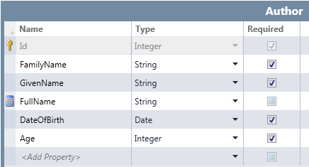
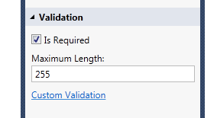
Validation

Slide 14
Validation
partial void DateOfBirth_Validate(EntityValidationResultsBuilder results)
{
if(DateOfBirth.AddYears(15) > DateTime.Now)
{
results.AddPropertyError("Must be at least 15 years old");
}
}
partial void Authors_Validate(Author entity, EntitySetValidationResultsBuilder results)
{
// could call out to a service here or whatever
if (entity.DateOfBirth == null && entity.Age == null)
{
results.AddEntityError("Must set either the date of birth or the age");
}
}
Notes:
Can validate at the entity or property level

Slide 15
Screens
Built in screens
New
Search
Details
Editable grid
List and details
Developers can modify screens at design-time and runtime
Can use auto-generated screens for add/edit or create your own
Generated screens do not expose XAML
Can use Silverlight controls you create yourself
Can add UI elements packaged as extensions
Always based on queries

Slide 16
Queries
LightSwitch creates queries automatically
Select * query is a collection, eg. CustomerCollection
Select where query is a detail, eg. CustomerDetail
You can edit existing queries
Filter, sort, add parameters
You can create new queries
You can base queries on other queries

Slide 17
The LightSwitch Development Experience
Start
Refine
Extend
Describe your data
Author business logic
Explore ecosystem components
Create screens for common tasks
Customise screen layouts
Create custom Silverlight controls
Define custom queries
Integrate with custom data sources

Slide 18
The LightSwitch Development Experience
Start
Refine
Extend
Describe your data
Author business logic
Explore ecosystem components
Create screens for common tasks
Customise screen layouts
Create custom Silverlight controls
Define custom queries
Integrate with custom data sources

Slide 19
Entities, Screens, Queries and Code
demo

Slide 20
Access Control
Windows and Forms authentication
Authorization
Define permissions and check them in code at entity and property level
Permissions are granted through administration screens
Notes:
Forms-based Auth is ASP.NET Membership Provider

Slide 21
Access Control
Permissions defined by the developer
Application’s administrators define users and roles
Permissions assigned to roles
Users are assigned to roles
Notes:
A user’s effective permissions are the combined permissions assigned to their roles

Slide 22
Two-tier Desktop App
Logic
Data
UI
Notes:
Application runs entirely on user’s computer

Slide 23
Three-tier Desktop App
Data
Logic
UI
Notes:
User interface runs on user’s computer
Middle-tier components run on Internet Information Services (IIS) or Windows Azure

Slide 24
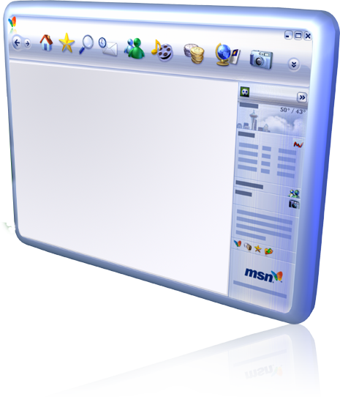
Three-tier Web App
Data
Logic
UI
Notes:
User interface is browser based
Middle-tier components run on IIS or Windows Azure

Slide 25
Access Control and Deployment
demo

Slide 26
LightSwitch Gives You
A smooth on-ramp to development
Built-in plumbing that handles common application requirements
Simple and flexible deployment

Slide 27
The simplest way to create
business applications
for the desktop and the cloud

Slide 28
Next Steps
MSDN LightSwitch Developer Center http://msdn.com/lightswitch
LightSwitch Team Blog
Download LightSwitch Trial
Download the LightSwitch Training Kit
Visit the LightSwitch Forums on MSDN

Slide 29
My Contact Information
andrew.coates@microsoft.com
http://blogs.msdn.com/acoat
http://twitter.com/coatsy

Slide 30
Get Cool Stuff
Go to the Booth and install the LS Trial
T-shirt*
Tweet LS Trial URL (http://aka.ms/lsmsau)
Hoodie*
* While Stocks Last

Slide 31
Related Content
DEV213 Visual Studio LightSwitch - Beyond the Basics
Thursday 15:30 Meeting Room 7
Developer Area Demos
Wednesday 12:30 (Introduction to LightSwitch)
Thursday 11:00 (Advanced LightSwitch)
Friday 11:00 (Introduction to LightSwitch)
Friday 12:30 (Advanced LightSwitch)

Slide 32
TechQuest
See me for code …

Slide 33
Question & Answer Session

Slide 34
Complete an Evaluation online and enter to WIN these prizes!

Slide 35
© 2011 Microsoft Corporation. All rights reserved. Microsoft, Windows, Windows Vista and other product names are or may be registered trademarks and/or trademarks in the U.S. and/or other countries.
The information herein is for informational purposes only and represents the current view of Microsoft Corporation as of the date of this presentation. Because Microsoft must respond to changing market conditions, it should not be interpreted to be a commitment on the part of Microsoft, and Microsoft cannot guarantee the accuracy of any information provided after the date of this presentation. MICROSOFT MAKES NO WARRANTIES, EXPRESS, IMPLIED OR STATUTORY, AS TO THE INFORMATION IN THIS PRESENTATION.

