Slide 2
The Essential Windows Azure Developers Toolkit
SESSION CODE: #DEV315
Mahesh Krishnan
Principal Consultant
Readify

Slide 3

About me
Principal Consultant, Readify
Mahesh.Krishnan@readify.net
@MaheshKrishnan

Slide 4

The Road ahead…

Slide 5

The Challenges…

Slide 6
The Agenda
Roll out 10 Developer Tools one after the other!

Slide 7
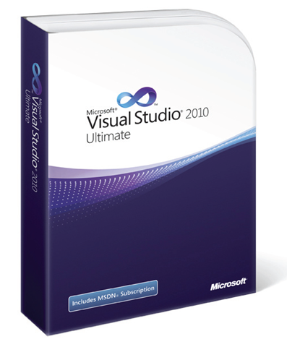
#1: Visual Studio Ultimate

Slide 8

#2: Remote Desktop

Slide 9


#3: WindowsAzure4e

Slide 10

#4: Accelerator

Slide 11

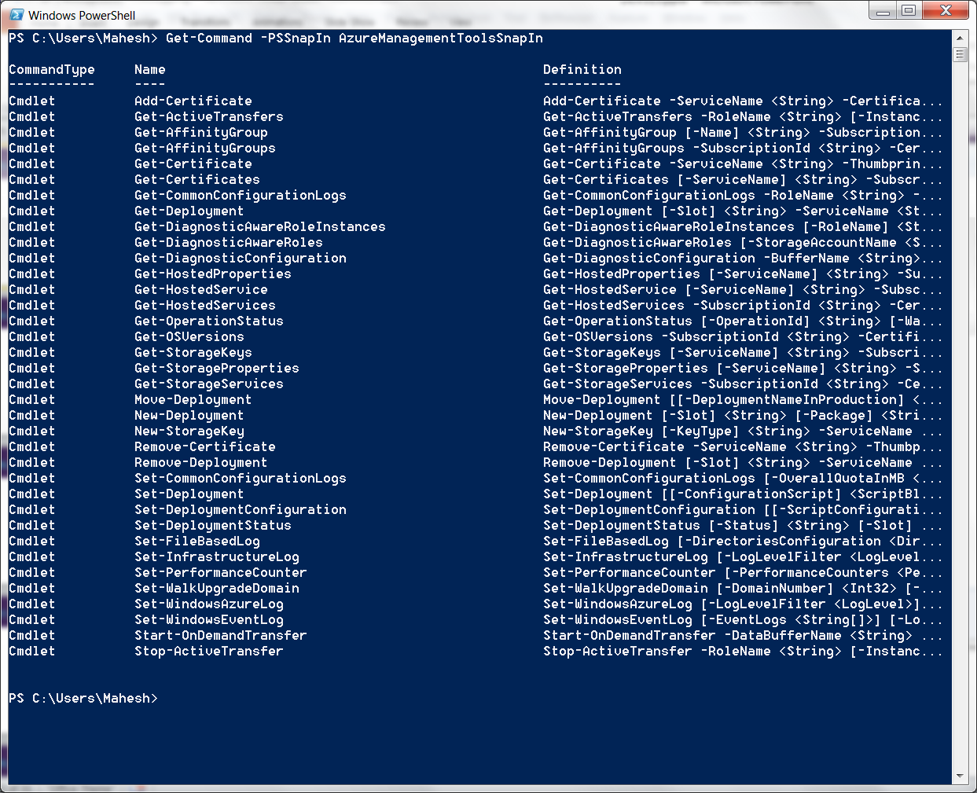
#5: Powershell Cmdlets

Slide 12

#6: Cloud Storage Studio

Slide 13

#7: Diagnostics Manager

Slide 14
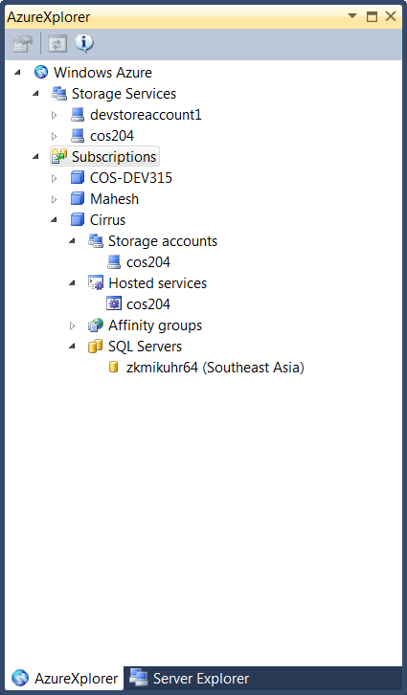
#8: Clumsy Leaf

Slide 15
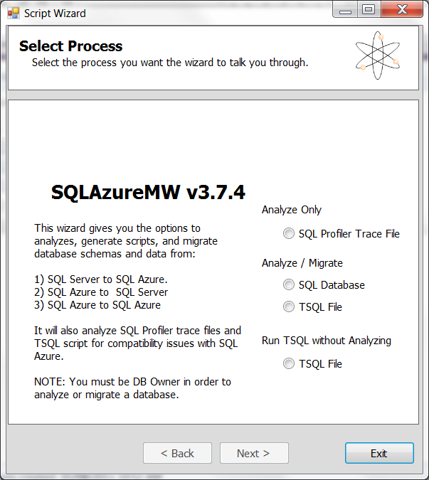
#9: SQL Azure Migration Wizard

Slide 16

#10: LinqPad

Slide 17

OK. I lied #11: Fiddler

Slide 18

Enrol in Microsoft Virtual Academy Today
Why Enroll, other than it being free?
The MVA helps improve your IT skill set and advance your career with a free, easy to access training portal that allows you to learn at your own pace, focusing on Microsoft technologies.
What Do I get for enrolment?
Free training to make you become the Cloud-Hero in my Organization
Help mastering your Training Path and get the recognition
Connect with other IT Pros and discuss The Cloud
Where do I Enrol?
www.microsoftvirtualacademy.com
Then tell us what you think. TellTheDean@microsoft.com

Slide 19

© 2010 Microsoft Corporation. All rights reserved. Microsoft, Windows, Windows Vista and other product names are or may be registered trademarks and/or trademarks in the U.S. and/or other countries.
The information herein is for informational purposes only and represents the current view of Microsoft Corporation as of the date of this presentation. Because Microsoft must respond to changing market conditions, it should not be interpreted to be a commitment on the part of Microsoft, and Microsoft cannot guarantee the accuracy of any information provided after the date of this presentation. MICROSOFT MAKES NO WARRANTIES, EXPRESS, IMPLIED OR STATUTORY, AS TO THE INFORMATION IN THIS PRESENTATION.

Slide 20




Resources
www.msteched.com/Australia
  Sessions On-Demand & Community
www.microsoft.com/australia/learning
Microsoft Certification & Training Resources
http:// technet.microsoft.com/en-au
  Resources for IT Professionals
http://msdn.microsoft.com/en-au
  Resources for Developers

