Slide 2
Reporting Services - What's New in Denali?
SESSION CODE: #DAT306
Carolyn Chau
Principal Program Manager
Microsoft

Slide 3
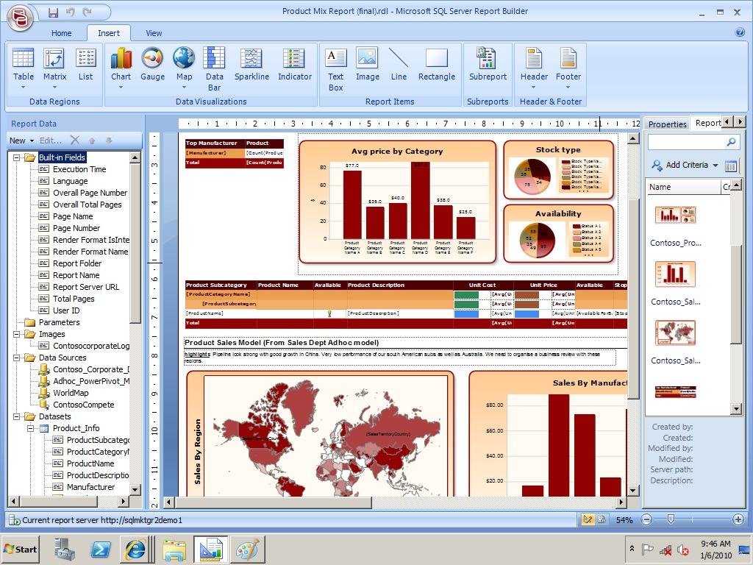
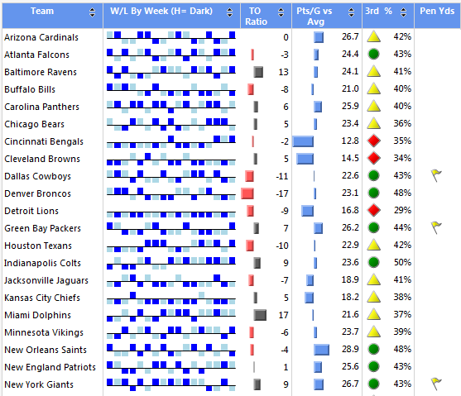
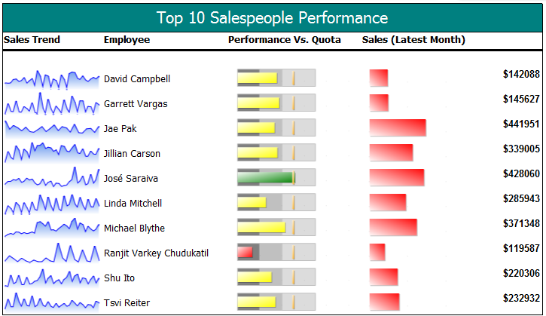
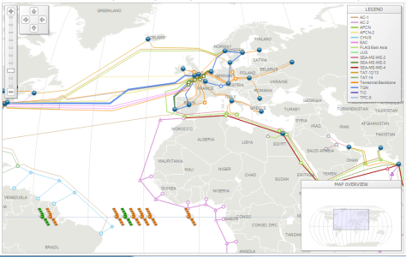
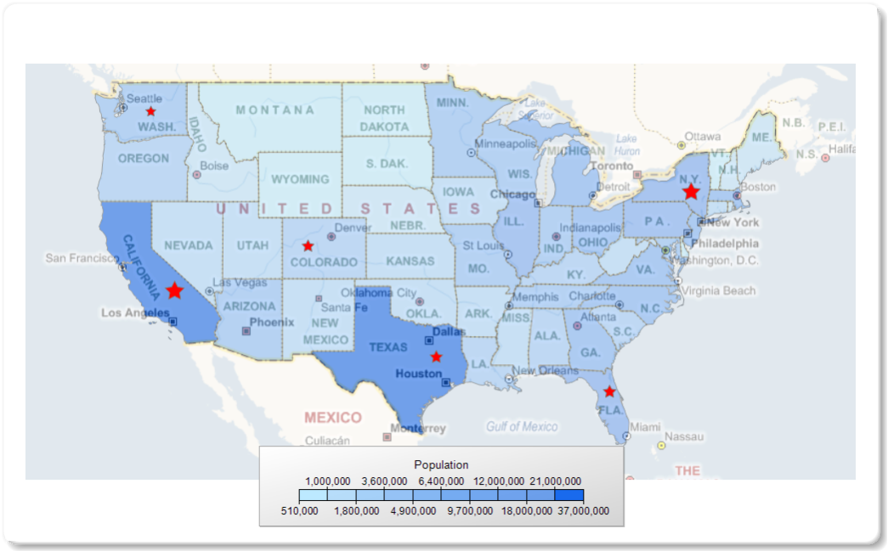
Recap: What did we do in 2008 R2?
We invested heavily for Corporate BI
  Shared DataSets
  Report parts, Report part gallery
  New Visualizations: Map, gauge, sparkline, databar, KPI
  Ajax Report viewer
  Tons of Customer DCRs
We had to cut a few key scenarios:
  Adhoc reporting
  Alerting

Slide 4

Denali planning exercise
BI Leadership team planning Cross Division (office, Sharepoint, SQL)
2 pagers define priorities across divisions
Office Mission: Build Excel as the Analyst tool of choice
Denali AS mission: Build a unified BI semantic model
Denali RS mission: Deliver Thin Adhoc reporting & Self Service Alerting
Other 2nd priority tasks needed:
  Address SSRS-Sharepoint performance,
  SSRS-Sharepoint configuration and deployment
  Deliver Office 2007/2010 renderers,
  Upgrade BIDS to Dev10 and Dev11

Slide 5





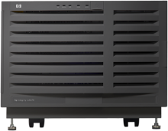






Delivering business agility and innovation to gain strategic value out of your information
SQL Server codename “Denali”
MISSION CRITICAL PLATFORM
DEVELOPER & IT PRODUCTIVITY
PERVASIVE INSIGHT
Increase flexibility with integrated high availability
Gain higher return on HA investments
Breakthrough data warehousing scale and performance
Realize lower cost of
IT administration
Accelerate time-to-market for developers
Build more flexible, innovative applications
Expand the reach of BI to business users
Breakthrough Performance with in-memory Analytics at scale
Deliver credible, consistent data to right users
Microsoft Confidential—Preliminary Information Subject to Change

Slide 6



SQL Denali: Reporting and Alerting
Empower users
Increase Productivity Proactive Intelligence
Increase efficiency
  Project “Crescent”
  Highly visual design experience
  Rich metadata-driven interactivity
  Presentation-ready
  at all times
  End User Alerting
  Defined from within operational or
  ad-hoc reports
  Intuitive Alert rules
  Alerts self-managed through SharePoint
  XLS/Word 2007/2010
  Enabled as SharePoint Shared Service
  Built-in scale-out for RS Service Apps
  SharePoint Cross-farm reporting
  Integrated backup & recovery, ULS logging, PowerShell etc.
Managed Self Service BI – Corporate BI

Slide 7
Infrastructure Investments:
The New SharePoint Mode

Slide 8


Increase Efficiency
SITUATION TODAY
SHAREPOINT INTEGRATION REDEFINED
Providing Reporting capability in SharePoint require separate configuration and sometime challenging integration tasks
Only a limited set of SharePoint IT management capability was available
Different skills are required from IT to build reporting capability and SharePoint farm
Reporting Services is now configured and monitored like other SharePoint shared applications.
Maximum set of SharePoint IT management capability enabled
Lower TCO on IT who can now leverage existing SharePoint skillset and experience.

Slide 9

New SSRS SharePoint Integration benefits
SSRS SharePoint 2010 Shared Service
  Hosted in SharePoint Shared Service App pool
  SSRS catalog DBs are SharePoint Service App DBs
  WCF and Claims based communication
  PowerShell Cmdlets
  Central Admin UI for all RS administration
  ULS Logging integration
  Built-in scale-out and load balancer
Report Performance Improvements
  For reports in AJAX Viewer
  Parity with Denali Native mode performance
    Top SharePoint mode pain point
    Small reports used to be 2-3 times slower: Fixed
  Faster than 2008 R2 SharePoint mode ~ 30-60%
SQL Setup option for SSRS SharePoint service

Slide 10





Denali SSRS in SharePoint mode Architecture
Web Front End
Application Server
WCF
Claims
SharePoint 2010 Web Application host (IIS hosted)
SharePoint 2010 Service
Application host (IIS Hosted)
Denali SSRS Web Application Functionality
SSRS ServiceApp. Proxy
Denali SSRS Service Application
SharePoint Configuration and Content DBs
Report Server Shared Service DB

Slide 11





Denali SSRS SharePoint Architecture
SharePoint 2010
App Server
SharePoint 2010 WFE
SharePoint Web Application
SharePoint Service Application (IIS Hosted)
WCF Claims
SSRS Shared Service WCF Endpoint
SSRS and Alerting Service App Runtime
Report Viewer web part
Crescent Silverlight Bits
Background Processing
SSRS
Service
Proxy
SOAP
Data Management
Security
URLAccess
SharePoint Object Model
SharePoint Object Model
SharePoint Config / Content DB
Report Sever Service DB

Slide 12

Install and Configuration Experience
Install RS Add-in on Shpt WFEs and RS Shpt shared service on Shpt App Servers
Create, configure and manage RS Shpt Service Applications via Central Admin UI
Scripting via PowerShell instead of WMI
Diagnose with SharePoint ULS Logging
Leverage SharePoint Backup/Restore

Slide 13
RS Denali SharePoint Mode
IT Experience
demo

Slide 14
Operational Reporting investments:
Self Service Alerting
Office 2007/2010 Integration

Slide 15


Proactive Intelligence
SITUATION TODAY
SELF SERVICE ALERTING
Need for the ability to proactively respond to exceptional data changes or trends.
Data volumes are always increasing leading to data overload.
Each Information Worker needs to monitor data specific to their job.
Proactive and responsive data monitoring that enables action.
Data Alerts help IWs cope with information overload.
Intuitive and flexible alert rules customized to each Information Worker.
Microsoft SQL Server 2011 new Self Services Alerting capability makes it trivial for any end user while viewing a report to define rules and thresholds on data and be alerted when they are reached. This transforms a traditional pull mode activity to a push mode activity greatly increasing Information Workers productivity.

Slide 16
Self Service Alerting
demo

Slide 17
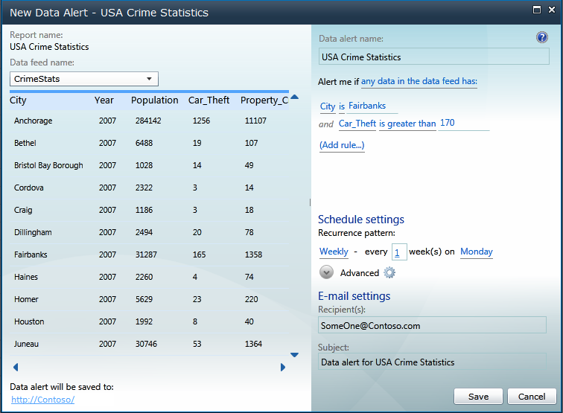
Self Service Alerting – User Benefits
Create data alerts from within reports
Users create alerts directly on the data they see in reports
Report authors control which data is available for alerting
Supports reports created in Report Builder or BI Development Studio (BIDS)
Detect important data changes
Intuitive Alert Rules (greater than, before/after)
Easy to use scheduling (weekly, daily, monthly)
Relevant data included in Alert Message
Source: Data.gov - Data.gov and the Federal Government cannot vouch for the data or analyses derived from these data after the data have been retrieved from Data.gov.

Slide 18
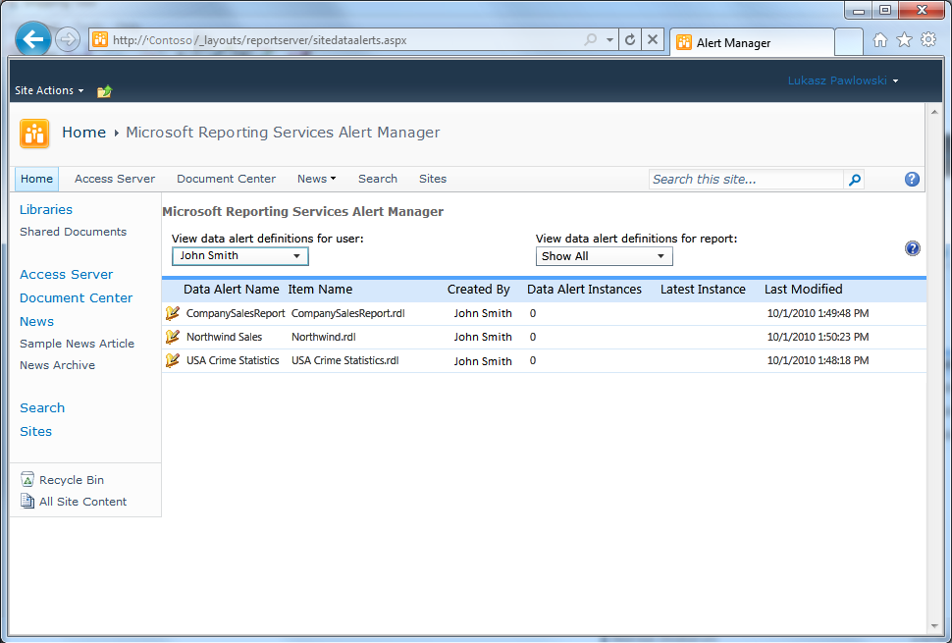
Self Service Alerting – IT Benefits
Managed through SharePoint
Per site administration reduces IT burden
Fine grained authorization
Self-managed through SharePoint
IT Visibility & Control of user-defined alerts

Slide 19
Alerting key capabilities
Scenario
  Operational Reports
    Stored Credentials
  SharePoint Mode
    SharePoint Permissions
Tools
  Alert Designer
  Alert Manager
Alert Rules
  Simple rules
  Static thresholds
Alert Messages
  Description
  Alert Rules
  Alert Parameters
Alert Schedules
  Daily, Weekly, Hourly, Minute
  Start/End Date
Production Capabilities
  Execution Log
  Globalized Alert Rules
  Localization ready

Slide 20

RS Denali SharePoint Architecture
SharePoint WFE
SharePoint App Server
SSRS in Web Application
SSRS Shared Service Application
Report Viewer web part
Shared Service WCF Endpoint
Service App Runtime
Background Processing
SOAP
SSRS
Service
Proxy
Alerting Shared Service WCF Endpoint
Alerting Interactive Service
URLAccess
Alerting Runtime
Alerting Web Service (internal only)
Security
Data Management
SharePoint Object Model
SharePoint Object Model
Report Server Shared Service DB
Report Server
Alerting DB
SharePoint Config / Content DB

Slide 21
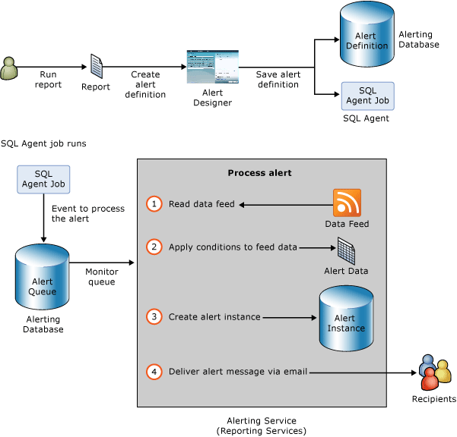
Self-Service Alerting – How it works

Slide 22


Office Open XML Rendering Extensions
Support for new file formats introduced in Office 2007
  Word rendering to *.docx format
  Excel rendering to *.xlsx format
Feature parity with existing Word and Excel renderers
ZIP-compressed files
Larger worksheets in Excel
  65k -> 1M rows
  256 -> 16k columns
More colors in Excel
  56-color palette -> 24-bit color (16M colors)

Slide 23
Self Service BI Investments:
Thin Adhoc Reporting :
Project Crescent

Slide 24

What is Crescent?
Crescent is an interactive data exploration and visual presentation experience.

Slide 25
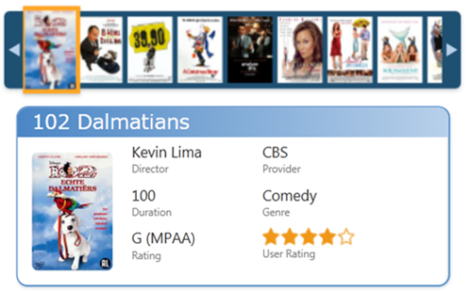
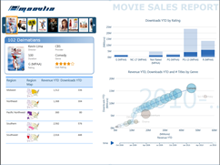
Project “Crescent”
Highly Visual Design Experience
Interactive, web-based authoring and sharing of information
Familiar Microsoft Office design patterns
Powerful data layout with banding, callout and small multiples visualizations
Rich metadata-driven interactivity
Fully integrated with PowerPivot
Drive greater insight through smart and powerful querying
Zero configuration highlighting and filtering
Animated trending and comparisons
Presentation-ready at all times
Interactive Presentation turns pervasive information into persuasive information
Deliver and collaborate through SharePoint
Full screen presentation mode for interactive boardroom session

Slide 26

Crescent
demo

Slide 27
Other Denali Wave Investments:
Dev10, Dev11
SQL Azure Reporting

Slide 28
SSRS Report Designer Integration with VS 2010,and Dev 11
VS 2010
  Moved BIDS, RDLC Designer, Report Viewer controls to VS 2010
  Using the SQL 2008 R2 engine
Dev 11
  Also working on Moving BIDS, RDLC, Controls to Dev11 with Denali engine
  Goal is to separate RS VS Addin so that we can refresh RS VS bits within 3 months after any VS release

Slide 29

SQL Azure Reporting
Value Proposition
Who: Developers, System Integrators, Consultants and IT Departments
Benefits: Elasticity, scalability and reliability of Cloud Computing
Cost effective: Decrease Capital expenditure and time-to-solution
Symmetrical: Design, develop and deploy your BI solutions using the tools and expertise you already have
V1 Scenarios
“Operational reports over SQL Azure data” – Customers can report over their SQL Azure data, publish and view reports against SQL Azure Reporting
“Embedding reports into Windows or Windows Azure application” – Developers can use same patterns and tools they use today to embed reports into their applications against SQL Azure Reporting
Architecture
Infrastructure: SQL Azure for data tier and Windows Azure for hosting
Availability: RS Gateway for tenant isolation and “smart” routing
Multitenancy: Stateless RS instances as a shared “engine”
Performance: Co-locate RS with user DBs
CTP
Currently in Limited CTP, but sign-up has closed
Sign-up for the next Public CTP is open at http://connect.microsoft.com/sqlazurectps

Slide 30
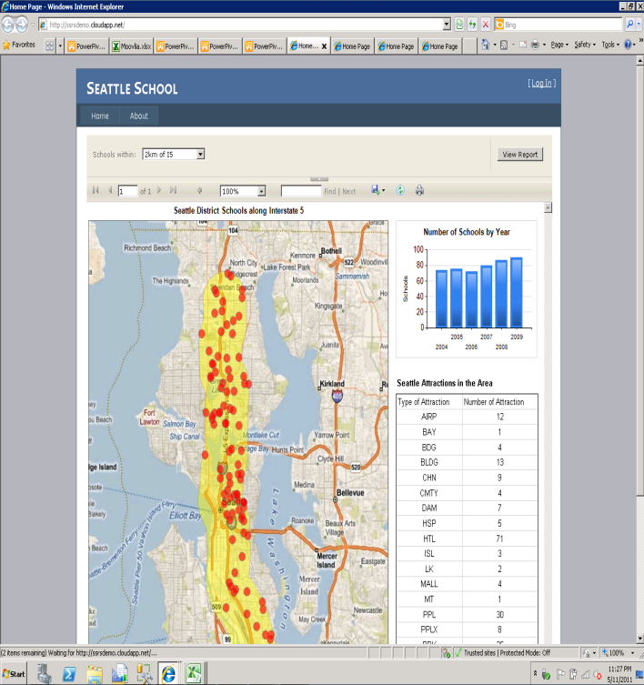
Publishing and Embedding Reports
Build and publish reports from BIDS
  Leverage all of BIDS report creation functions when authoring a report for SQL Azure Reporting
  Test by deploying the BIDS project to on-premise RS Server at http://servername/reportserver
  Change the ‘TargetServerURL’ in BIDS project property, then deploy to SQL Azure Reporting https://servername.reporting.database.windows.net/ReportServer
  Example: https://rsprodctp2075.ctp.reporting.database.windows.net/ReportServer?%2fSDR%2fContoso_Competitors&rs:Command=Render
Embed report hosted on SQL Azure Reporting in
Windows Azure applications, examples:
  Contoso Competitors: http://sar.cloudapp.net/
  Seattle School: http://ssrsdemo.cloudapp.net/
  Bellevue Speed Limit: http://ssrstr12.cloudapp.net/
  Building 34 Floorplan: http://floorplan.cloudapp.net

Slide 31
SQL Azure Reporting Preview
demo

Slide 32

Enrol in Microsoft Virtual Academy Today
Why Enroll, other than it being free?
The MVA helps improve your IT skill set and advance your career with a free, easy to access training portal that allows you to learn at your own pace, focusing on Microsoft technologies.
What Do I get for enrolment?
Free training to make you become the Cloud-Hero in my Organization
Help mastering your Training Path and get the recognition
Connect with other IT Pros and discuss The Cloud
Where do I Enrol?
www.microsoftvirtualacademy.com
Then tell us what you think. TellTheDean@microsoft.com

Slide 33




Resources
www.msteched.com/Australia
  Sessions On-Demand & Community
www.microsoft.com/australia/learning
Microsoft Certification & Training Resources
http:// technet.microsoft.com/en-a
  Resources for IT Professionals
http://msdn.microsoft.com/en-au
  Resources for Developers

