Slide 2
Abundantly “Crescent”
SESSION CODE: DAT201
Carolyn Chau
Principal Program Manager
Microsoft

Slide 3
Agenda
Agenda Subtitle
What is Crescent?
Learn about Crescent’s key capabilities
Architecture and requirements
Crescent and the Microsoft BI stack
Have fun with data!

Slide 4



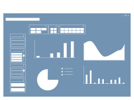












Microsoft Business Intelligence
Most Broadly adopted Productivity & Collaboration Tools
SharePoint
Dashboards & Scorecards
SharePoint
Collaboration
Excel
Workbooks
PowerPivot Applications
Analysis
Services
Reporting
Services
Most widely deployed EIM & BI Platform
Integration
Services
Master Data
Services
LOB
Apps
Odata
Feeds

Slide 5












Delivering business agility and innovation to gain strategic value out of your information
SQL Server codename “Denali”
MISSION CRITICAL PLATFORM
DEVELOPER & IT PRODUCTIVITY
PERVASIVE INSIGHT
Increase flexibility with integrated high availability
Gain higher return on HA investments
Breakthrough data warehousing scale and performance
Realize lower cost of IT administration
Accelerate time-to-market for developers
Build more flexible, innovative applications
Expand the reach of BI to business users
Breakthrough Performance with in-memory Analytics at scale
Deliver credible, consistent data to right users
Microsoft Confidential—Preliminary Information Subject to Change

Slide 6



Denali Reporting and Alerting
Empower users
Increase Productivity Proactive Intelligence
Increase efficiency
  Project “Crescent”
  Highly visual design experience
  Rich metadata-driven interactivity
  Presentation-ready
  at all times
  End User Alerting
  Defined from within operational or
  ad-hoc reports
  Intuitive Alert rules
  Alerts self-managed through SharePoint
  XLS/Word 2007/2010
  Enabled as SharePoint Shared Service
  Built-in scale-out for RS Service Apps
  SharePoint Cross-farm reporting
  Integrated backup & recovery, ULS logging, PowerShell etc.
Managed Self Service BI – Corporate BI

Slide 7


Slide 8

What is Project “Crescent”?
Crescent is an interactive data exploration and visual presentation experience.

Slide 9
“Crescent” Experiences
demo

Slide 10
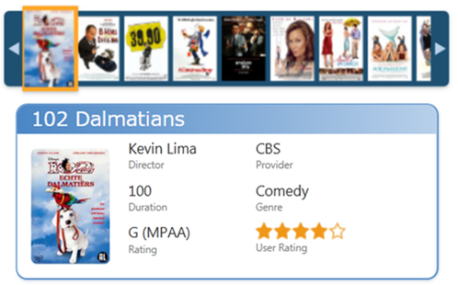
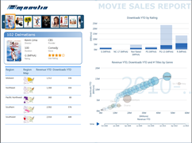
Project “Crescent”
Highly Visual Design Experience
Interactive, web-based authoring and sharing of information
Familiar Microsoft Office design patterns
Powerful data layout with banding, callout and small multiples visualizations
Rich metadata-driven interactivity
Fully integrated with PowerPivot
Drive greater insight through smart and powerful querying
Zero configuration highlighting and filtering
Animated trending and comparisons
Presentation-ready at all times
Interactive Presentation turns pervasive information into persuasive information
Deliver and collaborate through SharePoint
Full screen presentation mode for interactive boardroom session

Slide 11
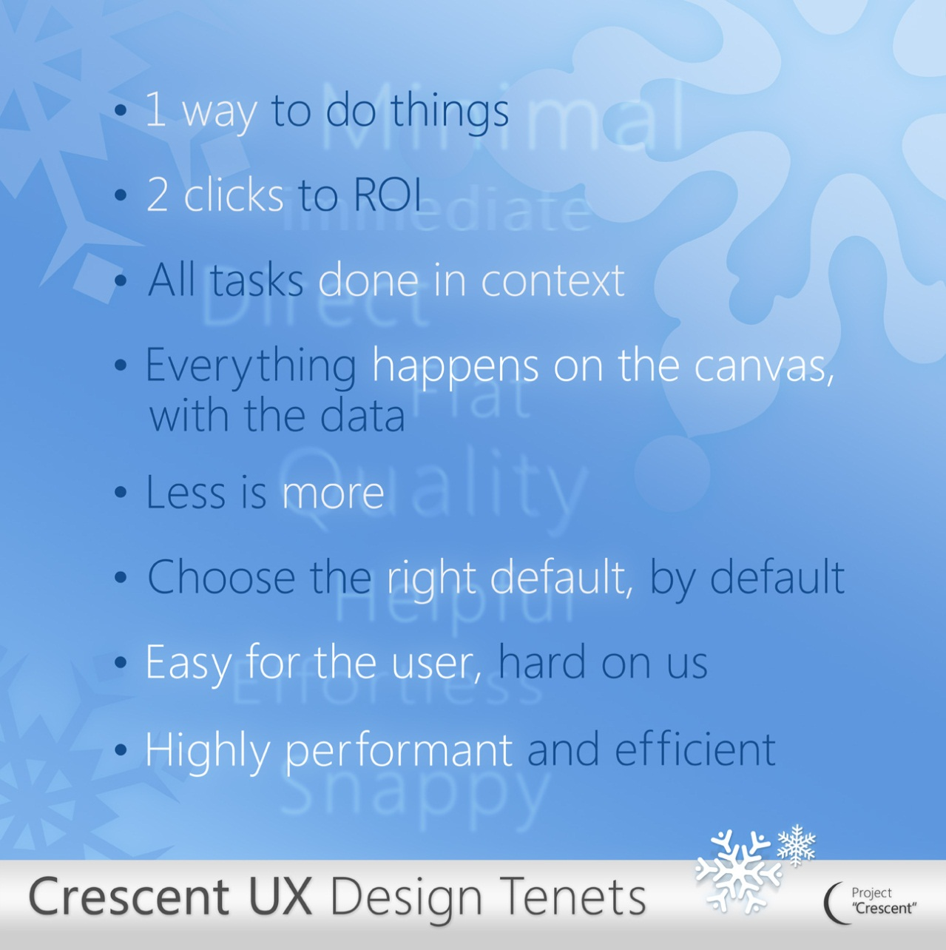
Design for a new wave of Information workers

Slide 12






Architecture
SharePoint Farm
SQL Server BIDS
BISM Model
Web Front End
App Server
SSRS Addin for SharePoint
RS Shared Service
Crescent client
AS Server
PowerPivot
System Service
PowerPivot
Web Service
Analysis Services SP Integrated
Excel PowerPivot
Model
Data sources

Slide 13

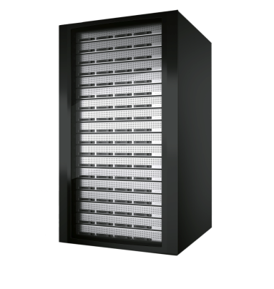

BI Semantic Model: Benefits
Flexibility
Richness
Scalability
Tabular and multidimensional modeling
Cached or passthrough storage
VertiPaq for performance, MOLAP for scale
Choice of end-user BI tools
Serves entire range of BI solutions
Rich modeling capabilities
Complex business logic
Fine-grained security
VertiPaq in-memory engine
State-of-the-art compression algorithms
Scales to largest enterprise servers
Improved SharePoint configuration and performance

Slide 14













BI Semantic Model: Architecture
Third-party
applications
Reporting
Services
Excel
SharePoint
Insights
PowerPivot
BI Semantic Model
Data model
Multi-
dimensional
Tabular
Business logic
and queries
MDX
DAX
Data access
ROLAP
MOLAP
VertiPaq
Direct
Query
Databases
LOB Applications
Files
OData Feeds
Cloud Services

Slide 15
BI Semantic Model and
More “Crescent” Experiences
demo

Slide 16







IT Pros
Power Users
Developers
End Users
Sophisticated
Design Environment
Productive
Authoring
Visual data
representation
Report
Viewer Controls
Re-use
of insights
Highly
Interactive
Rich Design
Capabilities
Flexible
layout
Rich
Presentation
Report Designer
Report Builder
Project “Crescent”
Embedded Operational Business

Slide 17
Project “Crescent” is NOT
Crescent is an interactive data exploration and visual presentation experience.
Does not replace RB 2.0, 3.0 or BIDS
Not a goal to edit or add new interactivity to Dev/IT Pro reports built in RB or BIDS
Not a high-end analysis experience
  Not a goal to provide complex calculation building
Not a cell-based calculation tool
Not a forecasting/write back tool
Not a replacement for PPS scorecards or ProClarity

Slide 18

Enrol in Microsoft Virtual Academy Today
Why Enroll, other than it being free?
The MVA helps improve your IT skill set and advance your career with a free, easy to access training portal that allows you to learn at your own pace, focusing on Microsoft technologies.
What Do I get for enrolment?
Free training to make you become the Cloud-Hero in my Organization
Help mastering your Training Path and get the recognition
Connect with other IT Pros and discuss The Cloud
Where do I Enrol?
www.microsoftvirtualacademy.com
Then tell us what you think. TellTheDean@microsoft.com

Slide 19

© 2010 Microsoft Corporation. All rights reserved. Microsoft, Windows, Windows Vista and other product names are or may be registered trademarks and/or trademarks in the U.S. and/or other countries.
The information herein is for informational purposes only and represents the current view of Microsoft Corporation as of the date of this presentation. Because Microsoft must respond to changing market conditions, it should not be interpreted to be a commitment on the part of Microsoft, and Microsoft cannot guarantee the accuracy of any information provided after the date of this presentation. MICROSOFT MAKES NO WARRANTIES, EXPRESS, IMPLIED OR STATUTORY, AS TO THE INFORMATION IN THIS PRESENTATION.

Slide 20




Resources
www.msteched.com/Australia
  Sessions On-Demand & Community
www.microsoft.com/australia/learning
Microsoft Certification & Training Resources
http:// technet.microsoft.com/en-au
  Resources for IT Professionals
http://msdn.microsoft.com/en-au
  Resources for Developers

