Slide 2
Developing with SQL Azure
Tools and Frameworks in Action
SESSION CODE: COS203
Lynn Langit
Sr. Developer Evangelist
Microsoft

Slide 3
Session Objectives and Takeaways
Session Objective(s):
  See and understand the breadth of developer tools for SQL Azure
  These tools include the following:
    Windows Azure Portal
    SQL Server Management Studio
    Visual Studio (Juneau –or SSDT)/ LightSwitch
    PowerShell, Command-Line, Open Source, 3rd Party
Session Takeaway:
  SQL Azure has a variety of tools for developers
  Use the right tool for the task(s)
Notes:
Session Abstract
DEVCT308 - Developing with SQL Azure: Tools & Frameworks In Action
This session will be jam-packed with hands-on demonstrations lighting up SQL Azure with new and existing applications. We'll start with the steps to creating a SQL Azure account and database, then walk through the tools to connect to it. Then we'll open Visual Studio to connect to .NET applications with Entity Framework, OData, and SQL Server Tools Codename "Juneau".
Track Name, Acronym and Track PM
Business Intelligence (BIN) – Peter Sprague
Business Solutions (MSDY) - Pattie Grimm, Scarlet Leung
Database (DB) –Dandy Weyn, Kevin Ashby, Maxine Coo
Development Tools & Technologies (DEV) – Bijan Javidi
Cross Track Coverage
Application Platform – APS/DB/AZR/ARC Solution Accelerators – Michelle Arney, Michelle Walls
Compete – Mike Brevard Trustworthy Computing – Christopher Pelletier
Next Web – Olga Londer User Experience – Alison Clark
Private Cloud – Aurora Santiago Windows Embedded – Olivier Bloch

Slide 4
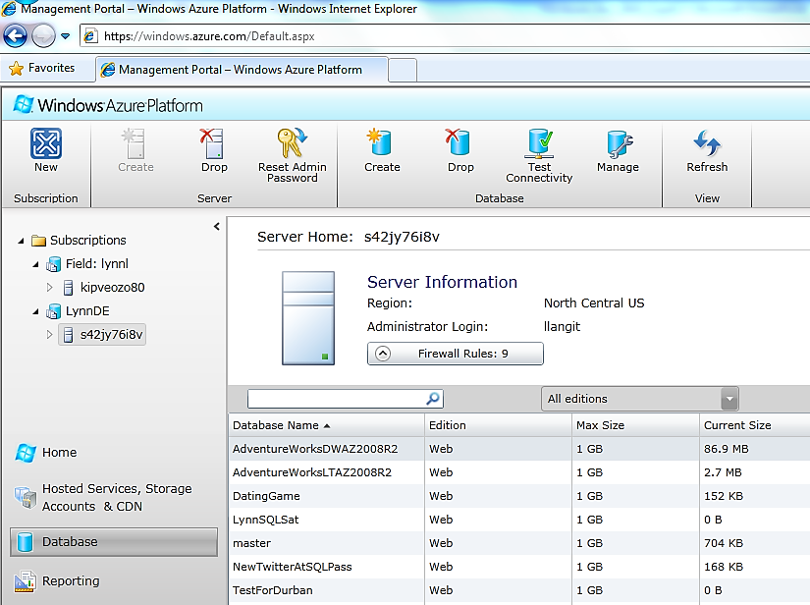
SQL Azure Portal
Notes:
Connection failures…
#1 cause of incidents
Intermittent and difficult to diagnose
Many reasons for connection, network issues
Requirement:
Implement connection re-try logic
Capture and log details about returned error codes, connection specific details
Resources:
SQL Azure: Connection Management in SQL Azure: http://social.technet.microsoft.com/wiki/contents/articles/sql-azure-connection-management-in-sql-azure.aspx
Connections and SQL Azure: http://blogs.msdn.com/b/sqlazure/archive/2010/05/11/10011247.aspx
Best Practices for Handling Transient Conditions in SQL Azure Client : http://blogs.msdn.com/b/appfabriccat/archive/2010/10/28/best-practices-for-handling-transient-conditions-in-sql-azure-client-applications.aspx

Slide 5
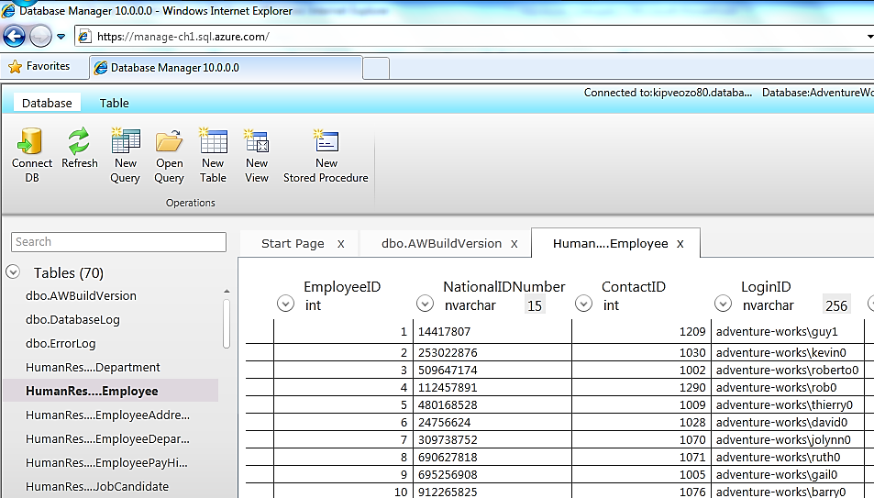
Portal for Database Management
Notes:
SQL authentication
Features being added to this portal, will ‘appear’ when enabled.

Slide 6
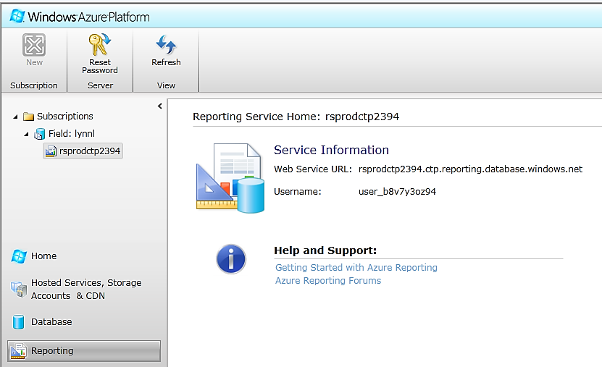
SQL Azure Reporting Beta
Notes:
Limited, invite-only beta at this time.

Slide 7
SQL Azure Portal
demo
Silverlight-based tools
Notes:
Server management options
Create database options
Then over to the database management portal and
Database management options
Also show SQLAzureLabs portal

Slide 8
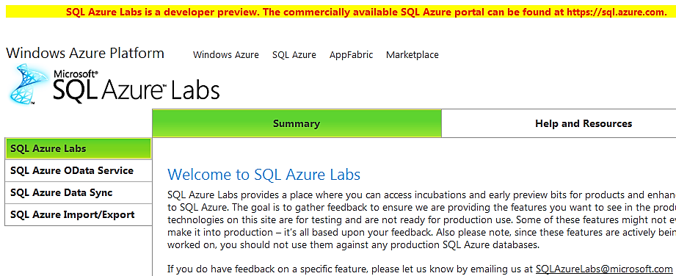
SQL Azure Labs
Portal Location for CTP (Beta) content
http://www.sqlazurelabs.com
Notes:
More about OData - http://msdn.microsoft.com/en-us/data/ee844254 also still more here - http://www.odata.org/

Slide 9
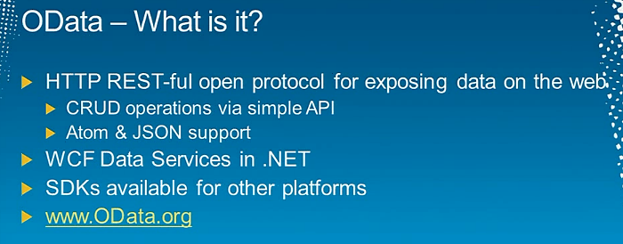
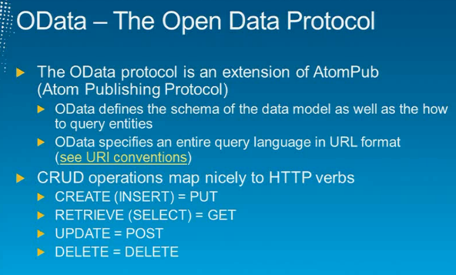
About OData
Notes:
Beth Massi – TechEd 2011 North America talk on OData - http://channel9.msdn.com/Events/TechEd/NorthAmerica/2011/DEV308

Slide 10
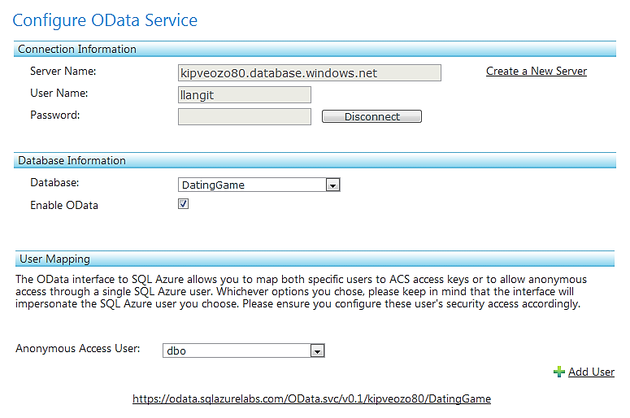
About SQL Azure & OData

Slide 11
SQL Azure Labs
demo
https://www.sqlazurelabs.com/
--OData
--EF & WCF (comparison)
Notes:
Also show SQLAzureLabs portal
EF 4.1 - http://www.microsoft.com/download/en/details.aspx?displaylang=en&id=8363

Slide 12
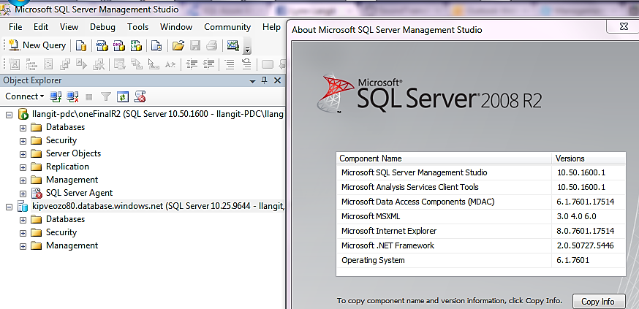
About SQL Azure & SSMS 2008 R2 SP1
Be sure to update to SP1 - here
Notes:
Per the SQL Azure team blog
“We will be making updates to SQL Azure over the next few months, to ensure uninterrupted connectivity to SQL Azure using SQL Server Management Studio 2008 R2 please install SP1”

Slide 13
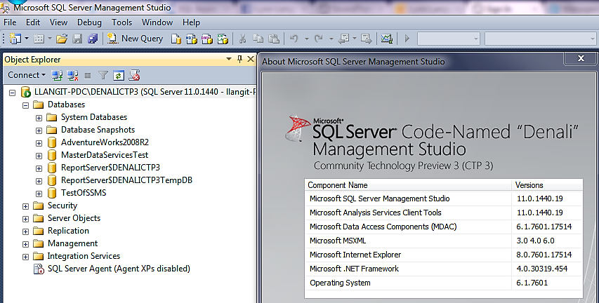
About SQL Azure & SSMS (Denali)
Notes:
Intellisense for Denali databases in CTP 3
MSDN ‘unsupported T-SQL’ http://msdn.microsoft.com/en-us/library/ee336253.aspx

Slide 14
SQL Server Management Studio
demo
SQL Server Denali CTP 3
--Connection Info
--UAC
--DACPAC
Notes:
From MSDN documentation – also ‘supported’ objects (http://msdn.microsoft.com/en-us/library/ee210549(v=SQL.110).aspx)
The following changes have been made for data-tier applications (DACs) in CTP3:
The data-tier application (DAC) upgrade has been changed to an in-place process that alters the existing database to match the schema defined in the new version of the DAC. This replaces the side-by-side upgrade process, which created a new database with the new schema definitions. The Upgrade a Data-Tier Application wizard has been updated to perform an in-place upgrade. The Upgrade method of the DacStore type is now deprecated, and replaced with a new IncrementalUpgrademethod. Upgrades are also supported for DACs deployed to SQL Azure. For more information, see Upgrade a Data-tier Application.
In addition to just extracting a schema definition as a new DAC package file, you can now export both the schema definition and data from a database as a DAC export file. You can then import the file to create a new database with the same schema and data. For more information, see Export a Data-tier Application and Import a Data-tier Application.
Data-tier applications now support many more objects than in SQL Server 2008 R2. For more information, see DAC Support For SQL Server Objects and Versions.

Slide 15

Project "Juneau" CTP 3
announcing
SQL Server Developer Tools
Codename “Juneau”
Notes:
Download site - http://msdn.microsoft.com/en-us/data/gg427686
Be sure to read the release notes on installation - http://msdn.microsoft.com/en-us/data/hh310512

Slide 16
Project “Juneau” (CTP 3)
SQL Server Developer Tools in Visual Studio
Can target SQL Azure (version targeting)
Server Explorer
  Can Snapshot project (database)
  Can Schema compare
  Supports entity framework
Improved Intellisense
  Error syntax highlighting
  Easier refactoring
  Easier debugging (including stored procs)
Notes:
http://msdn.microsoft.com/en-us/data/tools.aspx
Some notable new features:
¦The Server Explorer in Juneau now provides you with an SSMS-like view of your database objects
¦The ability to analyze a set of changes and generate a script that will then update the database based on those changes in the development environment
¦Preview database updates – The commit operation will provide a deployment report, which contains a preview of all the actions it is going to take, together with potential issues it has identified
¦Improved intellisense
¦Ships with a single-user lightweight SQL Server version to help with debugging
¦Refactor table names, field names, etc, without losing data
¦Debug stored procedures
¦Can target different versions of SQL Server, including Azure
¦Can take a snapshot of the project. Allows you to have versions of your database. Can track history of changes over time
¦Can compare your project to the current state of the database. So you can see, for example, indexes added to the live database and add those index changes to your project. Can do things like a schema compare between two versions: a developer can start with a snapshot, make changes, then send the differences to the dba to implement; ISV’s can track databases it has sent to customers and send them scripts to update their database
¦On the horizon: reference data support (storing data with the schema), database diagrams, query designer
¦Any errors caused by editing in either the TSQL Editor or Table Designer immediately show up in the Error List pane, and are platform specific
¦You can now add SQLCLR objects directly to the same database project that is opened, without resorting to opening a specific SQLCLR project. Your TSQL stored procedures can interact with your SQLCLR objects within the same project. Debugging and deployment can also happen seamlessly
¦Coding support that includes: Go To Definition and Find All References; the Refactor contextual menu which enables you to rename or move an object and do a preview of all affected areas before committing to the change
¦You can create an ADO.NET Entity Data Model and choose to have the model contents generated from an existing database project. Fine-grained synchronization control settings are provided to enable you to specify how changes are propagated between the entity data model and the database project

Slide 17
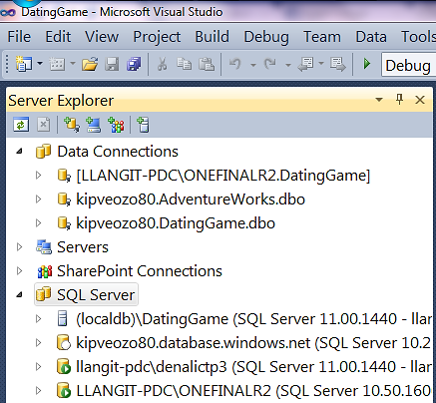
Juneau in Visual Studio
Server Explorer
  Data Connections
  New Node – SQL Server
    Connect to SQL Azure
    Connect to SQL Server
    LocalDB
Can work online or offline

Slide 18
More About Juneau
Table Designer
Schema Compare
Refactoring (find all references & go to definition)
SSDT project (to create objects)
Debug/test w/local DB
Publish (sync and/or apply incremental updates)
Notes:
Read the FAQ – particularly good for comparision of features to ‘Data Dude’
http://msdn.microsoft.com/en-us/data/hh322942

Slide 19
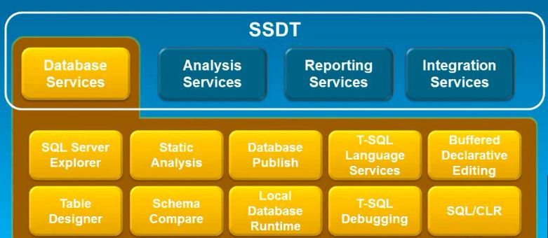
SSDT Architecture
Notes:
Diagram credit - http://www.jamesserra.com/wp-content/uploads/2011/05/Untitled-picture2.png

Slide 20
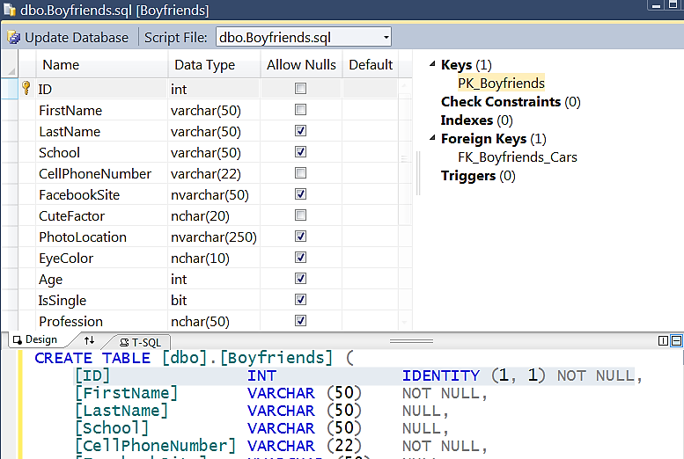
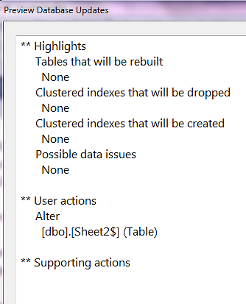
New – Table Designer in Visual Studio

Slide 21
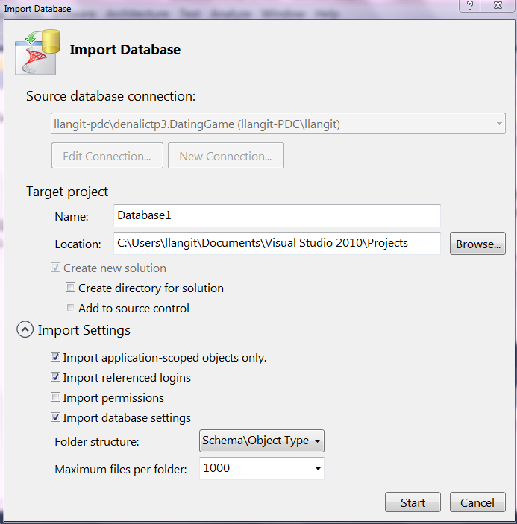
Offline Projects – Visual Studio
New Project Type
  --Set Source connection
  --Set Target project
  --Set Import settings
  --Creates Off-line Project

Slide 22
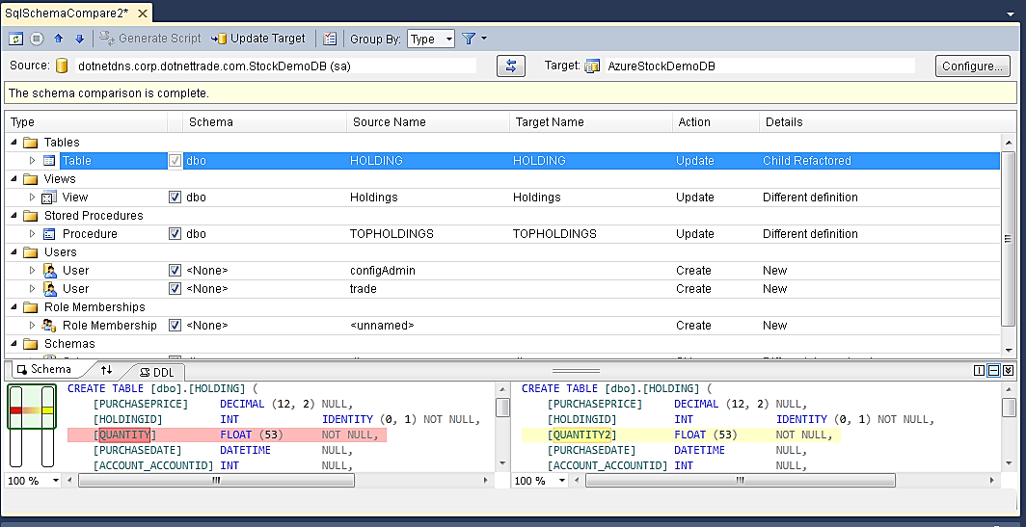
SSDT Schema Compare

Slide 23
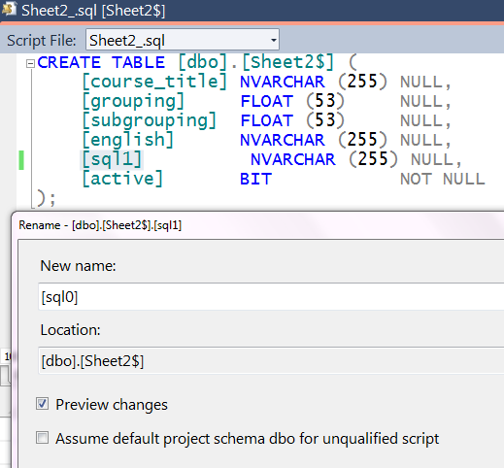
Refactoring
Find All Dependencies
Rename with Preview
Intellisense

Slide 24
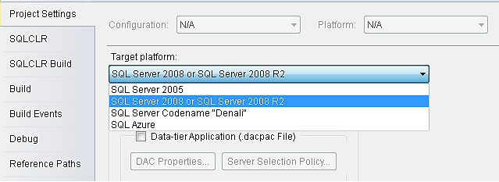
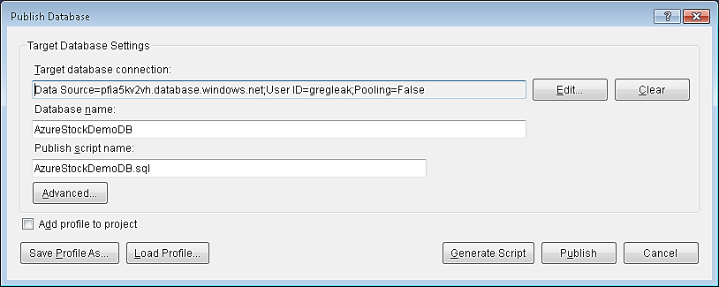
Version Targeting & Publishing

Slide 25
Visual Studio 2010 SP1
demo
“Juneau” -- SQL Server Developer Tools
Notes:
More info - http://msdn.microsoft.com/en-us/data/tools.aspx
Connected Development
Offline Development
Publish to SQL Azure
Drift Detection and Snapshots
· Develop SQL Server tables using SSDT’s new Table Designer.
· Safely update the structure (i.e., schema) of SQL Server databases using SSDT. (add FK)
· Develop SQL Server views and other database objects using T-SQL code.
· Synchronize a SQL Server database project with a SQL Server database using SSDT’s Schema Compare feature.
Leverage SSDT’s code productivity features for refactoring, Find All References, and Go To Definition.
· Use a SSDT project to create SQL Server database objects.
· Debug/test database projects using SSDT’s Local DB feature.
Synchronize a SQL Server database with a SQL Server database project using SSDT’s Publish feature.
To generate incremental T-SQL update scripts from an database project using SSDT’s Publish feature.

Slide 26
Visual Studio 2010 SP1
demo
Included tools
--Server Explorer
--Entity Framework
--DACPAC
--Refactoring
--Intellisense

Slide 27
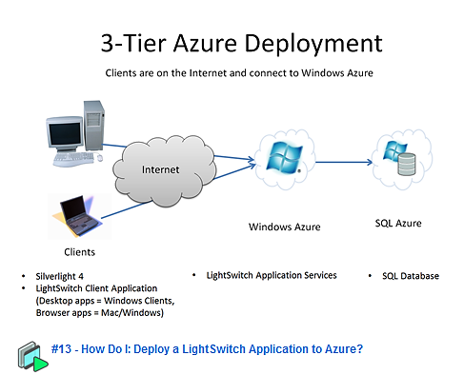
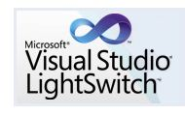
Visual Studio Light Switch
Beth Massi blog
  Azure and Light Switch – here

Slide 28
Visual Studio Light Switch
demo
Notes:
More info - http://msdn.microsoft.com/en-us/data/tools.aspx

Slide 29
Other tools
PowerShell
Command-line
  SQLCMD
  bcp
CodePlex tools
  SQL Azure Migration Wizard
3rd party tools
  Cerebrata, RedGate, Quest
Notes:
Session Abstract
DEVCT308 - Developing with SQL Azure: Tools & Frameworks In Action
This session will be jam-packed with hands-on demonstrations lighting up SQL Azure with new and existing applications. We'll start with the steps to creating a SQL Azure account and database, then walk through the tools to connect to it. Then we'll open Visual Studio to connect to .NET applications with Entity Framework, OData, and SQL Server Tools Codename "Juneau".
Track Name, Acronym and Track PM
Business Intelligence (BIN) – Peter Sprague
Business Solutions (MSDY) - Pattie Grimm, Scarlet Leung
Database (DB) –Dandy Weyn, Kevin Ashby, Maxine Coo
Development Tools & Technologies (DEV) – Bijan Javidi
Cross Track Coverage
Application Platform – APS/DB/AZR/ARC Solution Accelerators – Michelle Arney, Michelle Walls
Compete – Mike Brevard Trustworthy Computing – Christopher Pelletier
Next Web – Olga Londer User Experience – Alison Clark
Private Cloud – Aurora Santiago Windows Embedded – Olivier Bloch

Slide 30
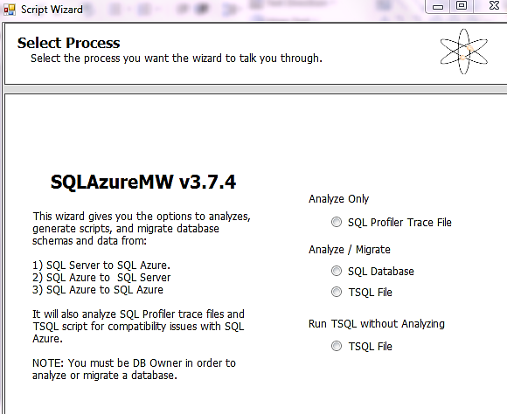
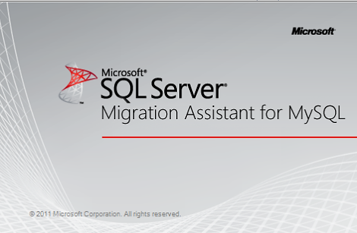
3rd Party Tools
Download Migration Tools – here
Download Migration Wizard - here
Notes:
July 2011 versions of these tools work with Denali CTP 3

Slide 31
Alternate tools
demo
Notes:
More info - http://msdn.microsoft.com/en-us/data/tools.aspx

Slide 32
Session Objectives and Takeaways
Session Objective(s):
  See and understand the breadth of developer tools for SQL Azure
  These tools include the following:
    Windows Azure Portal
    SQL Server Management Studio
    Visual Studio (Juneau –or SSDT)/ LightSwitch
    PowerShell, Command-Line, Open Source, 3rd Party
Session Takeaway:
  SQL Azure has a variety of tools for developers
  Use the right tool for the task(s)
Notes:
Session Abstract
DEVCT308 - Developing with SQL Azure: Tools & Frameworks In Action
This session will be jam-packed with hands-on demonstrations lighting up SQL Azure with new and existing applications. We'll start with the steps to creating a SQL Azure account and database, then walk through the tools to connect to it. Then we'll open Visual Studio to connect to .NET applications with Entity Framework, OData, and SQL Server Tools Codename "Juneau".
Track Name, Acronym and Track PM
Business Intelligence (BIN) – Peter Sprague
Business Solutions (MSDY) - Pattie Grimm, Scarlet Leung
Database (DB) –Dandy Weyn, Kevin Ashby, Maxine Coo
Development Tools & Technologies (DEV) – Bijan Javidi
Cross Track Coverage
Application Platform – APS/DB/AZR/ARC Solution Accelerators – Michelle Arney, Michelle Walls
Compete – Mike Brevard Trustworthy Computing – Christopher Pelletier
Next Web – Olga Londer User Experience – Alison Clark
Private Cloud – Aurora Santiago Windows Embedded – Olivier Bloch

Slide 33
Team Content – Juneau / SSDT
MSDN SSDT section
MSDN Forum – here
SSDT Team Blog - here

Slide 34
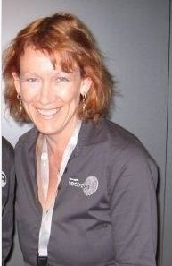
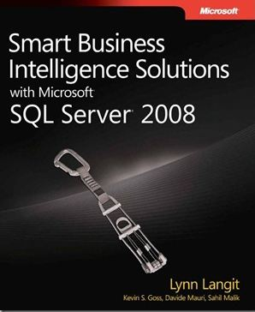
Other Related Content
Lynn’s Resources
  http://blogs.msdn.com/SoCalDevGal
  Twitter - @llangit
  http://www.slideshare.net/lynnlangit

Slide 35
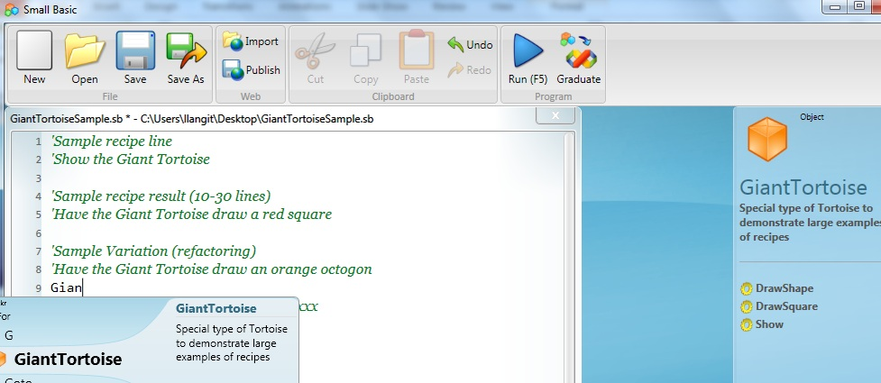
www.TeachingKidsProgramming.org
Do a Recipe → Teach a Kid (Ages 10 ++)
Microsoft SmallBasic → Free Courseware (recipes)
Notes:
Lynn

Slide 36




Resources
www.msteched.com/Australia
  Sessions On-Demand & Community
www.microsoft.com/australia/learning
Microsoft Certification & Training Resources
http:// technet.microsoft.com/en-au
  Resources for IT Professionals
http://msdn.microsoft.com/en-au
  Resources for Developers

Slide 37

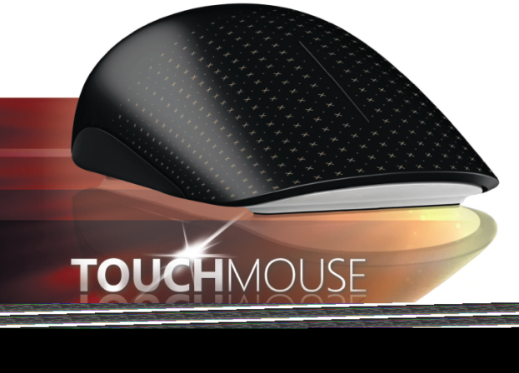
Win a Touch Mouse!
Complete your session evaluation on Schedule Builder for your chance to win a Windows 7 Touch Mouse
Exclusive for Windows 7
Eleven multi touch gestures
Contoured shape for superior comfort
10 prizes drawn every day!*
*Please see Registration for full terms and conditions

Slide 38

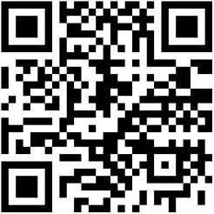
  GET REWARDED FOR
  SIMPLY PARTICIPATING
  IN TECH∙ED AUSTRALIA
DOWNLOAD QR CODE READER FOR YOUR MOBILE DEVICE
Windows Phone 7 we suggest Quick Reader
Symbian we suggest the built in reader or mobile Tag
IOS we suggest QR Reader
Blackberry we suggest Mobile Tag
Android phones we suggest Barcode Scanner
  GO TO THE TECHQUEST WEBSITE WWW.TAGLY.COM & CREATE A PROFILE
EXAMPLE ONLY

Slide 39

© 2011 Microsoft Corporation. All rights reserved. Microsoft, Windows, Windows Vista and other product names are or may be registered trademarks and/or trademarks in the U.S. and/or other countries.
The information herein is for informational purposes only and represents the current view of Microsoft Corporation as of the date of this presentation. Because Microsoft must respond to changing market conditions,
it should not be interpreted to be a commitment on the part of Microsoft, and Microsoft cannot guarantee the accuracy of any information provided after the date of this presentation.
MICROSOFT MAKES NO WARRANTIES, EXPRESS, IMPLIED OR STATUTORY, AS TO THE INFORMATION IN THIS PRESENTATION.

