Slide 2
Application Lifecycle Management for Windows Azure projects
SESSION CODE: COS201
Tom Hollander
Architect
Microsoft Australia

Slide 3
Agenda
Introduction
Build
Deployment
Testing
Operations

Slide 4
Introduction

Slide 5

Application Lifecycle Management
Application Lifecycle Management (ALM) is a continuous process of managing the life of an application through governance, development and maintenance.
Governance
Requirements
Specification
Architecture
Design
Development
Build
Operations
Deployment
Testing

Slide 6
Typical Activities
Build
Compile
Configure
Package
Deployment
Upload
Install
Verify
Testing
Functional Test
Acceptance Test
Load Test
Operations
Monitor
Manage
Support

Slide 7
Windows Azure Environment Concepts
Billing
Subscription
Service
Deployment
Role
Instance
Unit of Payment
Unit of Management
Represents a single application
Two slots: Production & Staging
Unit of Scaling
Running VM

Slide 8
Typical Environments
Development Billing Account
Operations Billing Account
Development Subscription
Test Subscription
Operations Subscription
Sandbox Service 1
Sandbox Service 2
Test Service
UAT Service
Production Service
Staging Deployment
Staging Deployment
Staging Deployment
Staging Deployment
Staging Deployment
Production Deployment
Production Deployment
Production Deployment
Production Deployment
Production Deployment

Slide 9
Build

Slide 10
Build and Deployment Overview
Build
Deployment

Slide 11
Build: Continuous Integration
Compile
Verify – Run Unit Tests
Ideally, this is not different than traditional CI, since Unit Tests should be testing classes, not integration.

Slide 12
Build: Daily Build
Compile
Verify – Run Unit Tests
Update Configuration
Package
… continue with Deploy

Slide 13
Build Approaches
MSBuild targets
  Azure SDK includes targets for packaging
  Customize .ccproj files or write your own msbuild scripts
  Can be integrated with TFS Build or 3rd party ALM tools
TFS-specific
  Custom XAML build process
  Custom activities
Scripts
  PowerShell

Slide 14
Build: Update Configuration
Most applications require different configuration for each environment
  Connection Strings, VM sizes and instances, Dependent system URIs, etc.
Changes to configuration should be controlled
  Per-environment settings checked in to source control
  Automatically applied for target environment as part of build server

Slide 15
Build: Update Configuration
Understand where your configuration lives
  ServiceConfiguration.cscfg is outside of the deployed package – can be applied after packaging
  Web.config and ServiceDefinition.csdef are inside the package – must my applied before packaging
Transformation approaches
  Web.config transforms, TransformXml target to apply to custom files
  XSLT
  Custom approaches

Slide 16
Build: Create the deployment package
Windows Azure applications are deployed as an encrypted package (*.cspkg)
Automatically created by Visual Studio when you publish
CSPACK command line tool
Easiest approach for automated builds: CorePublish target
Watch out for application dependencies
  GAC’d Assemblies
  Secondary web sites

Slide 17
Deployment

Slide 18
Deploy: To the Cloud
.cspkg
.cscfg
MSBuild
PowerShell
Deploy Script
To one or more target
environments (Test, Production)
Ideally executed as a part of daily build
Normally implemented via PowerShell scripts using Azure cmdlets, triggered from MSBuild
Requires Azure Management Certificate deployed to build server
Azure cmdlets
Azure Management API
Windows Azure
Deployments

Slide 19
Deploy: To the Cloud
Typical steps
  Deploy service certificates
  Upload package to Blob Storage
  Deploy package + ServiceConfiguration to Staging slot
  Run automatic verification tests
  Flip Staging to Production
  Stop and delete Staging deployment
To save money, delete unused deployments when no longer needed (Staging and Production)

Slide 20
Deploy: WebDeploy?
Allows code to be uploaded to the cloud without going through a full deployment process
  New code is there in seconds, not 10-30 minutes
OK for developers to test/troubleshoot in the cloud
Not recommended for test or production environments
  Only supported for web roles, not worker roles
  Only supports 1 instance per role
  Changes are not durable

Slide 21
Example: Targets in .ccproj project file
<PropertyGroup>
<PackageName>$(AssemblyName).cspkg</PackageName>
<ServiceConfigName>ServiceConfiguration.cscfg</ServiceConfigName>
<PackageLocation>$(OutDir)Publish</PackageLocation>
</PropertyGroup>
<Target Name="AzureDeploy" AfterTargets="Build"
DependsOnTargets="CorePublish"
Condition="$(AzureDeployEnvironment)!=''">
<Exec WorkingDirectory="$(MSBuildProjectDirectory)" Command=" $(windir)\system32\WindowsPowerShell\v1.0\powershell.exe -f
\build\AzureDeploy.ps1 $(AzureSubscriptionID)
$(AzureCertificateThumbprint) $(PackageLocation)
$(PackageName) $(ServiceConfigName)
$(AzureHostedServiceName) $(AzureStorageAccountName)" />
</Target>

Slide 22
Example: Deployment Script
    $hostedService = Get-HostedService $servicename -Certificate $cert
    -SubscriptionId $sub | Get-Deployment -Slot Staging
    if ($hostedService.Status -ne $null) {
    $hostedService | Set-DeploymentStatus 'Suspended' |
    Get-OperationStatus -WaitToComplete
    $hostedService | Remove-Deployment | Get-OperationStatus
    -WaitToComplete
    }
    Get-HostedService $servicename -Certificate $cert -SubscriptionId $sub
    | New-Deployment Staging -package $package -configuration $config
    -label $buildLabel -serviceName $servicename
    -StorageServiceName $storageAccount
    | Get-OperationStatus -WaitToComplete
    Get-HostedService $servicename -Certificate $cert -SubscriptionId $sub |
    Get-Deployment -Slot Staging |
    Set-DeploymentStatus 'Running' |
    Get-OperationStatus -WaitToComplete

Slide 23
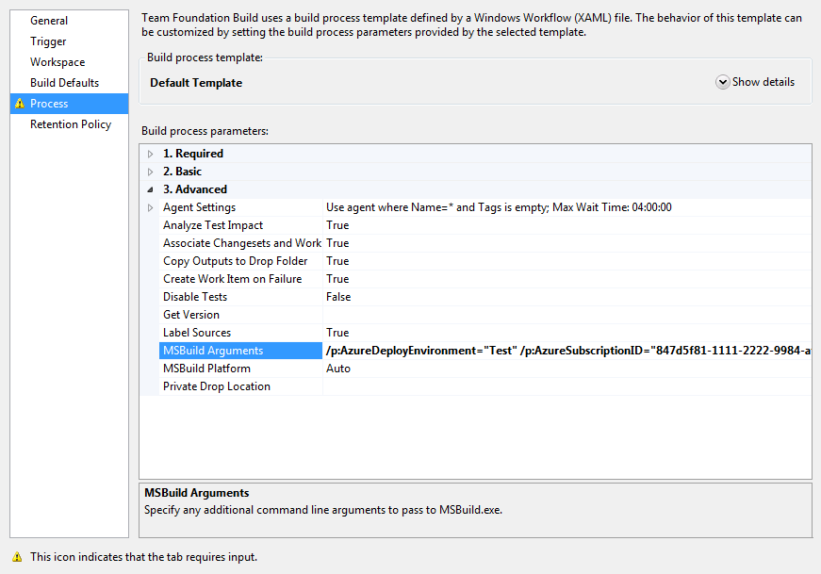
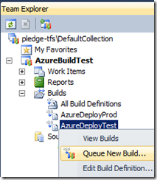
Example: Build Definition
/p:AzureDeployEnvironment="Test" /p:AzureSubscriptionID="847d5f81-1111-2222-9984-af8c008ba1b7" /p:AzureCertificateThumbprint="A38242009E0A1A4DDC0000111122220D943C98E8"
/p:AzureHostedServiceName="myservice" /p:AzureStorageAccountName="mystorage"

Slide 24
Deploy: To the Compute Emulator
Why?
  Can be used for Unit Tests testing more than just classes (integration tests)
  Can be used for Functional Testing on internal servers (but cloud normally makes more sense)
How?
  Package to .csx folder using CSPACK /copyOnly or CorePackageComputeService MSBuild target
  Stop and start the Compute Emulator using CSRUN
  Redirect network ports to allow external access

Slide 25
Deploy: To SQL Azure
Developers should have their own SQL Server sandbox.
Use VSDB (“Data Dude”) to manage scripts for the SQL Server database.
Challenge: VSDB doesn’t support SQL Azure syntax differences / limitations. Solutions:
  Use the new Data Tier Application (DAC) project type
  Generate scripts using SQL Management Studio
  Migrate scripts / data using SQL Azure Migration Wizard from CodePlex
  Tweak SQL Server scripts by hand
Scripts can be executed as a part of deployment
  Use CREATE DATABASE AS COPY for backup

Slide 26
Testing

Slide 27
Functional Test: In the Cloud
Whereas functional testing can be performed on the Compute Emulator, it will also have to be run later in the cloud.
Normally executed as automated User Interface tests, run on local servers accessing the cloud.
A subset of functional tests (“Build Verification Tests”) can be run after deployment to the staging slot before flipping into production.

Slide 28
Load Test: Key Decisions
Where to generate the load?
  In the cloud
    No latency
    Provision and scale on-demand
    Low bandwidth costs
  Outside the cloud
    Realistic latency
    Full control
    Higher Bandwidth costs
What tools to use?
  Custom developed tools
  Traditional load testing products
    e.g. Visual Studio 2010
  SaaS offerings
    e.g. SOASTA

Slide 29
Visual Studio Load Testing from the Cloud
Decisions
  Where to run Visual Studio, Controller, Agents, Database
  VM Role versus Worker Role
Communication between cloud and on-premises environment
  Windows Azure Connect configuration
  Provisioning sequence
  Firewalls
  Latency
Local user accounts and password synchronisation

Slide 30
Visual Studio Load Testing from the Cloud

Slide 31
Load Test: From the Outside
Tests the true scenario.
Best for performance testing, where true response times during load is measured.
Can be tested as any internal server using Visual Studio or similar.
  Can use Azure Connect to access performance counters directly, or Azure Diagnostics to access indirectly.
3rd party test specialist SOASTA a scalable SaaS solution for load testing

Slide 32
Operations

Slide 33
Operations for Cloud Applications
(On-Premises)
Infrastructure
(as a Service)
Platform
(as a Service)
Software
(as a Service)
Applications
Applications
You manage
Applications
Applications
Data
You manage
Data
Data
Data
Runtime
Runtime
Runtime
Runtime
Managed by vendor
Middleware
Middleware
Middleware
Middleware
You manage
Managed by vendor
O/S
O/S
O/S
O/S
Managed by vendor
Virtualization
Virtualization
Virtualization
Virtualization
Servers
Servers
Servers
Servers
Storage
Storage
Storage
Storage
Networking
Networking
Networking
Networking

Slide 34
Monitor
Monitor the Azure Service Dashboard for general availability.
Use System Center Operations Manager Windows Azure Management Pack to monitor instance and app health
  Cerebrata Diagnostics Manager is an alternative.
Develop synthetic transactions to monitor that the whole application is up end-to-end.
Use Dynamic Management Views to monitor SQL Azure.

Slide 35







Monitor: Diagnostics
Visual Studio
Remote Desktop
Scheduled
Transfers
System Center
Operations Manager
Trace Listeners,
Instrumentation
Blob
Role Instance
DiagnosticMonitor
TraceListener
Azure Storage
3rd Party Tools

Slide 36
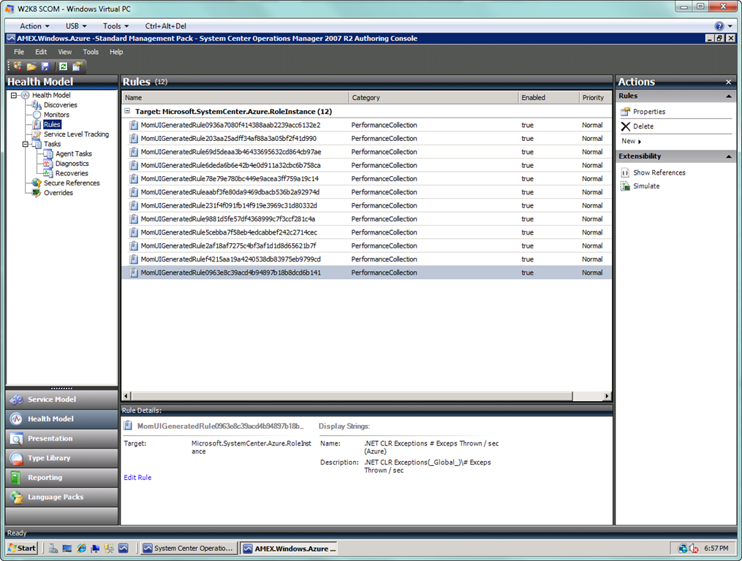
System Center Operations Manager

Slide 37
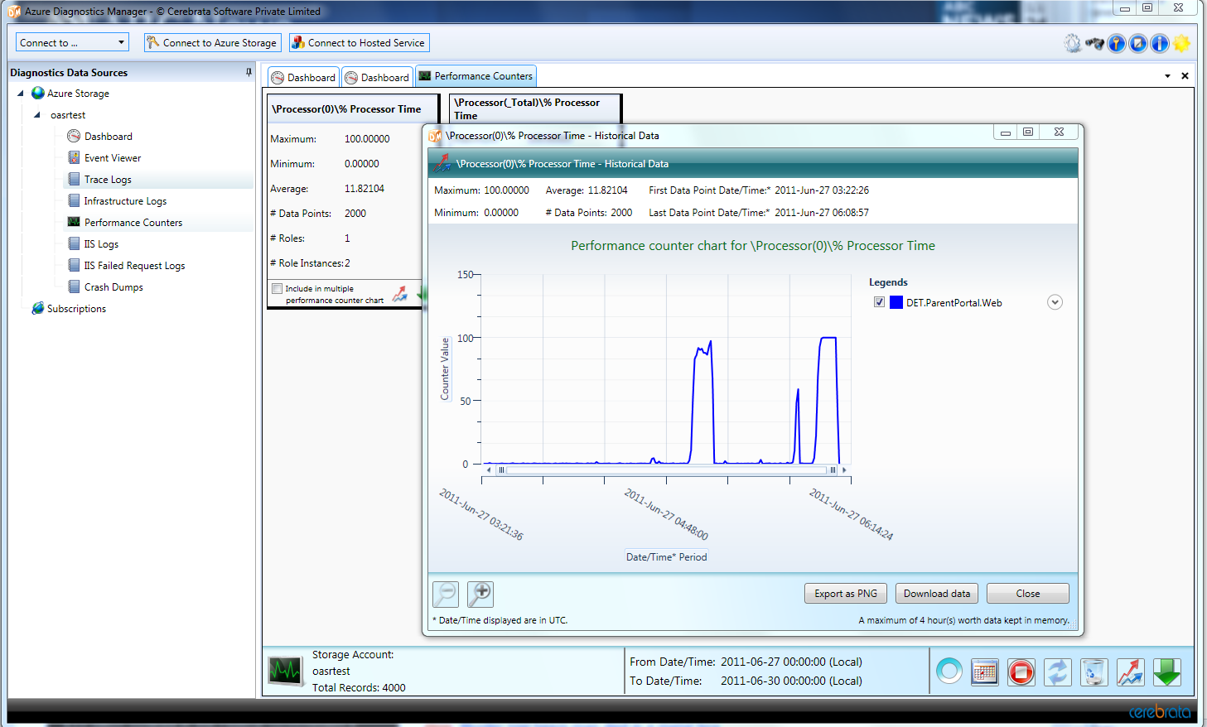
Cerebrata Azure Diagnostics Manager

Slide 38
Manage: Authentication
Implement policies and routines for handling:
  Windows Live ID credentials for Azure management portal
  Management Certificates
Minimise access to Azure management portal
  Use tools based on Management API
  Certificates secured using corporate user accounts
Use different subscriptions for dev/test and production

Slide 39
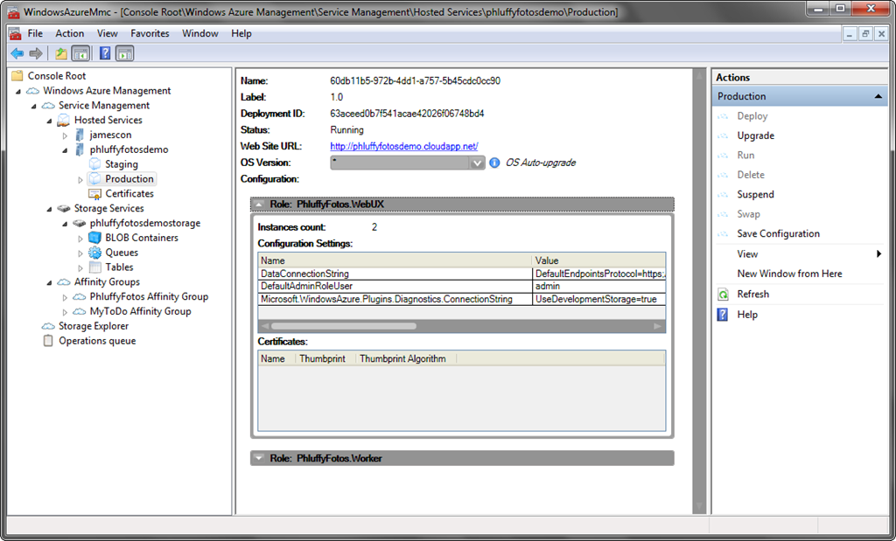
Windows Azure Platform Management Tool

Slide 40
Manage: Scaling
Windows Azure’s “elasticity” allows applications to be scaled up and down based on demand
Platform directly supports manual scaling from portal or APIs
Automated scaling can be built easily on top of APIs
  Time-Based: E.g. console application triggered from Windows Scheduler
  Resource-Based: Worker role that monitors KPIs such as performance counters and adds/removes instances when needed.

Slide 41

Resource-based Autoscaling
Web Role
IN_0
Web Role
IN_1
Scale up/down
Azure Management API
Web Role
IN_2
Analyze
Web Role
IN_3
+1
-1
Sample Period
Autoscaler
Worker Role
Performance Counters
Read
Azure Storage Tables

Slide 42
Summary
Build
Compile
Testing
Configure
Package
Upload
Install
Verify
Monitor
Manage
Support
Deployment
Functional Test
Acceptance Test
Load Test
Operations

Slide 43
Question & Answer Session
tom.hollander@microsoft.com
http://blogs.msdn.com/tomholl

Slide 44
Complete an Evaluation online and enter to WIN these prizes!
<Prizes & Process TBC>

Slide 45

© 2010 Microsoft Corporation. All rights reserved. Microsoft, Windows, Windows Vista and other product names are or may be registered trademarks and/or trademarks in the U.S. and/or other countries.
The information herein is for informational purposes only and represents the current view of Microsoft Corporation as of the date of this presentation. Because Microsoft must respond to changing market conditions, it should not be interpreted to be a commitment on the part of Microsoft, and Microsoft cannot guarantee the accuracy of any information provided after the date of this presentation. MICROSOFT MAKES NO WARRANTIES, EXPRESS, IMPLIED OR STATUTORY, AS TO THE INFORMATION IN THIS PRESENTATION.

Slide 46
PowerPoint Template
Subtitle color
Example of a slide with a subhead
  Set the slide header to “Title Case”
  Set subheads in “sentence case”
  Generally set subhead to 36pt or smaller so it will fit on a single line
  The subhead color is defined for this template but must be selected; In PowerPoint 2010, it is the fifth font color from the left

Slide 47
PowerPoint Guidelines
Font, size, and color for text have been formatted for you in the Slide Master
Use the color palette shown below
Hyperlink color: www.microsoft.com
Sample Fill
Sample Fill
Sample Fill
Sample Fill
Sample Fill
Sample Fill

Slide 48
Slide for Showing Software Code
Use this layout to show software code
  The font is Consolas, a monospace font
  The slide doesn’t use bullets but levels can be indented using the “Increase List Level” icon on the Home menu
  To use straight quotes " instead of
  smart quotes ”, do this:
  Click on the Office Button in the upper left corner
  At the bottom of the menu, choose PowerPoint Options
  From the left pane, select Proofing
  Click on the AutoCorrect Options button
  Select the AutoFormat As You Type tab,
  and deselect “Straight quotes” with “smart
  quotes”. Then Click OK.

Slide 49
Table Format
Table Title
Column 1 | Column 2 | Column 3 | Column 4 | Column 5

Slide 50
Bar Chart Example

Slide 51
Pie Chart Example

Slide 52
Question & Answer Session

Slide 53

Enrol in Microsoft Virtual Academy Today
Why Enroll, other than it being free?
The MVA helps improve your IT skill set and advance your career with a free, easy to access training portal that allows you to learn at your own pace, focusing on Microsoft technologies.
What Do I get for enrolment?
Free training to make you become the Cloud-Hero in my Organization
Help mastering your Training Path and get the recognition
Connect with other IT Pros and discuss The Cloud
Where do I Enrol?
www.microsoftvirtualacademy.com
Then tell us what you think. TellTheDean@microsoft.com

Slide 54




Resources
www.msteched.com/Australia
  Sessions On-Demand & Community
www.microsoft.com/australia/learning
Microsoft Certification & Training Resources
http:// technet.microsoft.com/en-au
  Resources for IT Professionals
http://msdn.microsoft.com/en-au
  Resources for Developers

Slide 55
© 2010 Microsoft Corporation. All rights reserved. Microsoft, Windows, Windows Vista and other product names are or may be registered trademarks and/or trademarks in the U.S. and/or other countries.
The information herein is for informational purposes only and represents the current view of Microsoft Corporation as of the date of this presentation. Because Microsoft must respond to changing market conditions, it should not be interpreted to be a commitment on the part of Microsoft, and Microsoft cannot guarantee the accuracy of any information provided after the date of this presentation. MICROSOFT MAKES NO WARRANTIES, EXPRESS, IMPLIED OR STATUTORY, AS TO THE INFORMATION IN THIS PRESENTATION.

