Slide 2
Crossing the Rubicon Integrating with the Cloud Is Here to Stay
SESSION CODE: COS-MID310
Bill Chesnut
Principal Consultant
Mexia
Dean Robertson
Technical Director
Mexia

Slide 3
Crossing the Rubicon “Let the die be cast…..”

Slide 4
Agenda “Each journey begins with a single step…”
Where are we now?
On-Premise Application Platform
CapEx-based cost model
Where are headed?
Cloud-based Application Platform
OpEx-based cost model
Challenges
What’s My Strategy?
On-premise or Hybrid
Do I need to start now?

Slide 5
Where Are We Now? “The march continues…”
2010 - ?
Cloud
2000s
SOA
1990s
Web
1980s
Client-Server
1970s
Mainframe

Slide 6
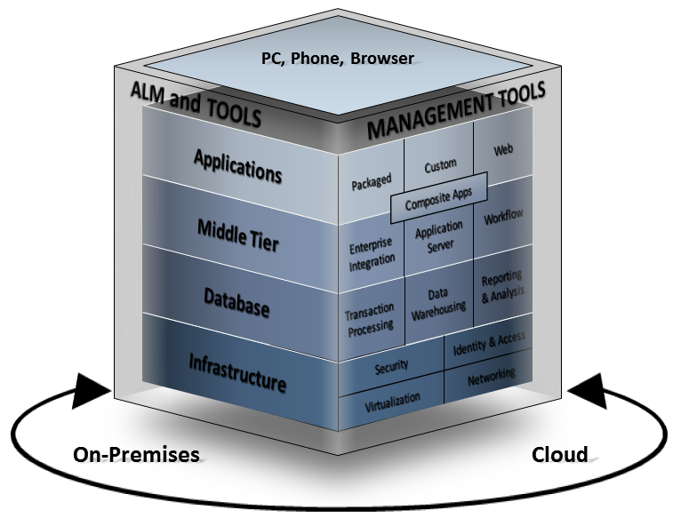
Microsoft Application Platform The Vision

Slide 7
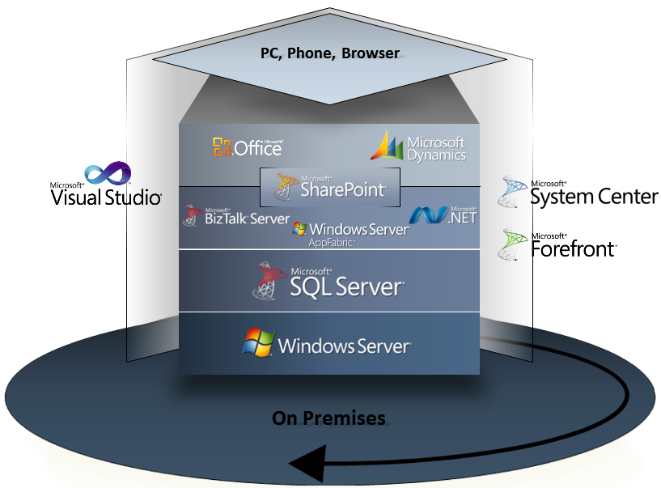
Microsoft Application Platform On Premise

Slide 8
Windows Server AppFabric An Overview
Visual Studio
IIS Manager
Project Deployment
WF & WCF Management Modules
WF & WCF Project Templates
Mgmt PowerShell cmdlets
Configuration Wizard
IIS 7.x/WAS
Hosting
Persistence
Monitoring
Caching
Availability, Deployment, Control
Reliablility,
Scalablity
Application Monitoring
In Memory, Distributed Cache
Server Manager
System Center
AppFabric Role Service of Application Server Role
Management Pack
.NET 4 WCF & WF Frameworks
Web Deploy
Service Discovery
Instance Restart
SQL Persistence Provider
WF ETW Tracking
WCF ETW Tracking
Messaging
AutoStart Service
Workflow Mgmt
Lock Mgmt
Event Collector
Routing Service
Activation
Runtime Databases
Persistence schema
Monitoring schema
Windows 7, Windows Server 2008 & 2008 R2

Slide 9
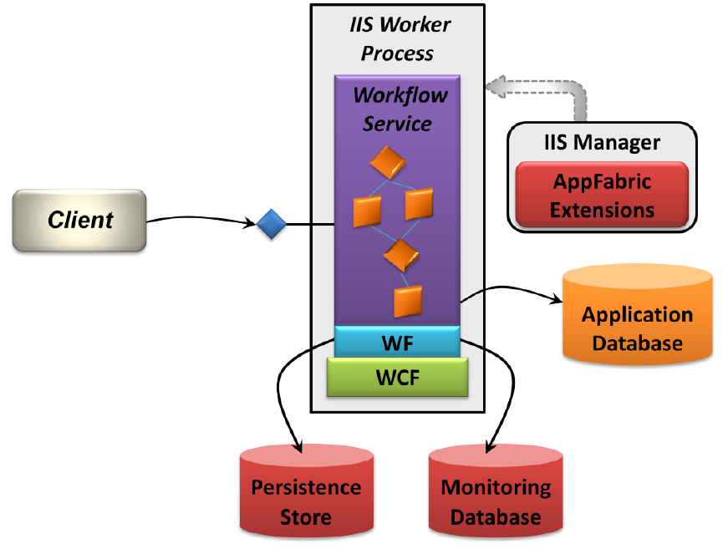
Windows Server AppFabric WCF & WF Hosting
Introducing Windows Server AppFabric, David Chappell, 2010

Slide 10
Windows Server AppFabric Reliability & Availability
Hosting Features
Startup Performance
Message-based activation
Auto-start
Reliability
Restarting Workflow Service instances from failed hosts
Suspending faulted Workflow Services
Improved lock management

Slide 11
Windows Server AppFabric Scalability
Scalability Strategies
Server farms
Custom Routing
Simplified Asynchronous Messaging
Workflow Service Persistence

Slide 12
Demo
Windows Server AppFabric Dashboard

Slide 13
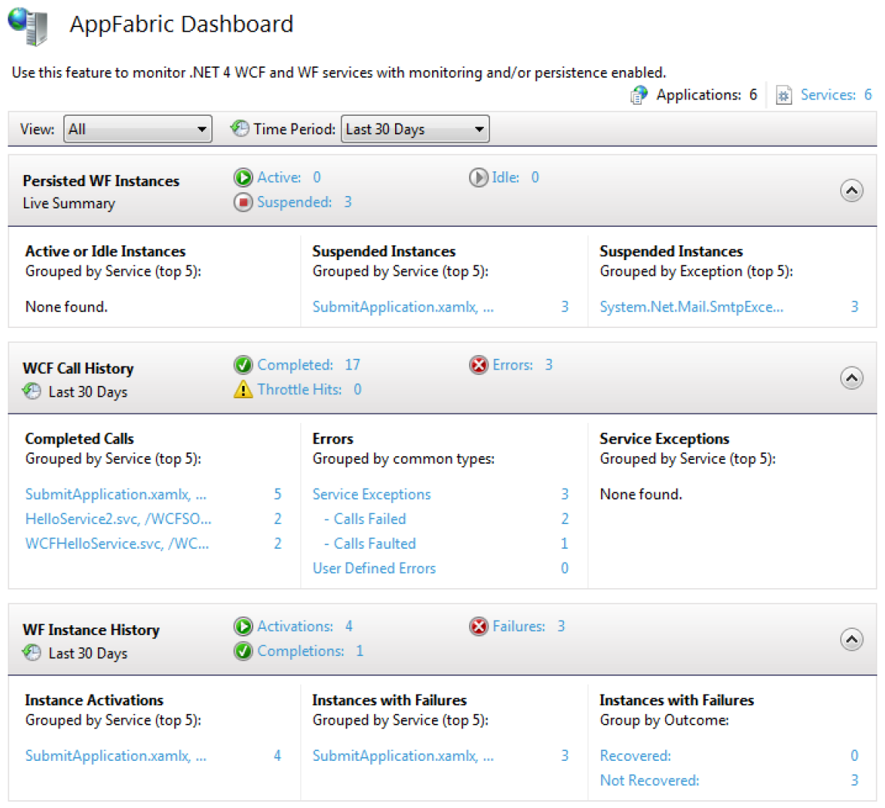
Windows Server AppFabric Management Dashboard

Slide 14
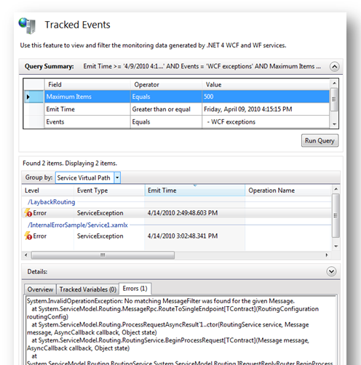
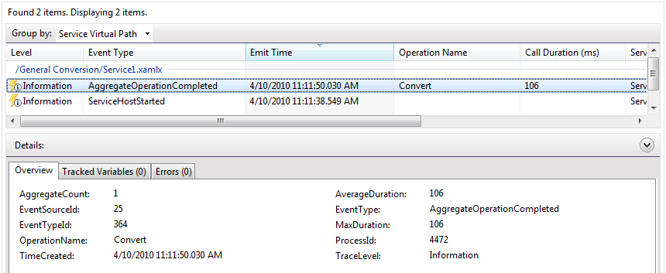
Windows Server AppFabric Execution Tracking

Slide 15
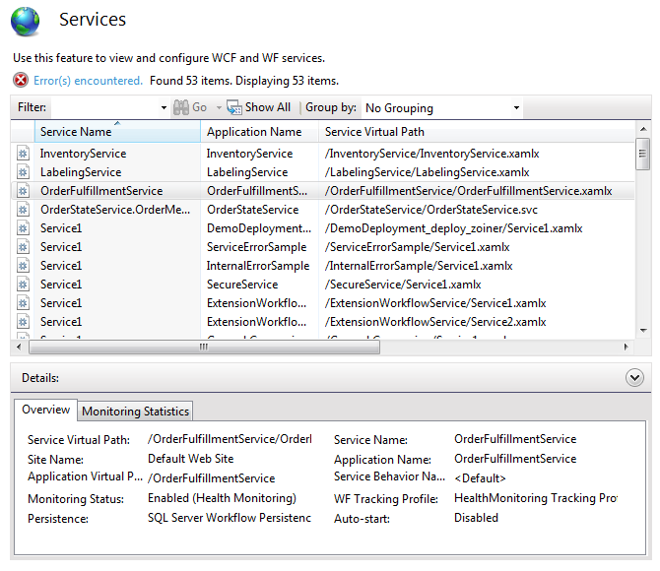
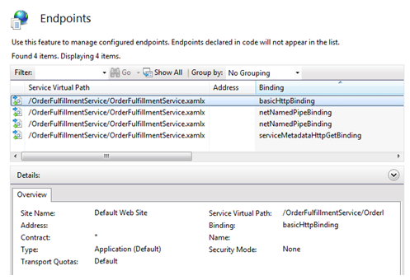
Windows Server AppFabric Service & Endpoint Management

Slide 16
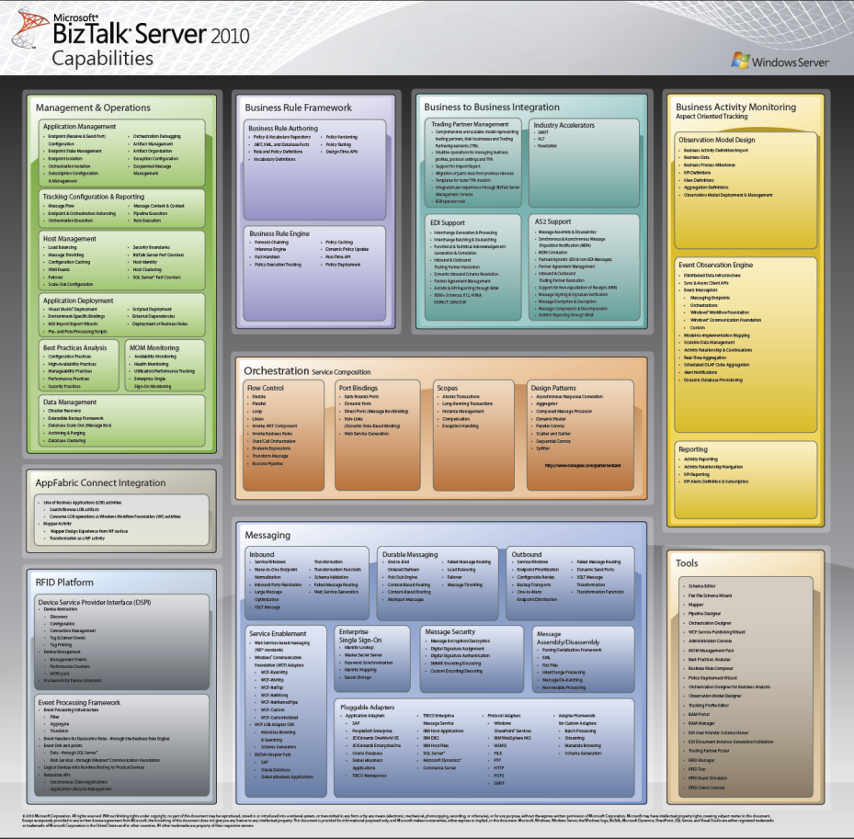
BizTalk Server 2010 An Overview
Messaging
Orchestrations
SOA, B2B, EAI
Rules Engine
Business Activity Monitoring
RFID
Adapter Pack
Dev/Deploy Tools
Management & Operations

Slide 17
BizTalk Server 2010 Runtime Architecture
------------------------------------------------------------------------------------------------------
XML, EDI or
Flat File Message
------------------------------------------------------------------------------------------------------
XML, EDI or
Flat File Message
Host
Host
RECEIVE PORT
HOST
SEND PORT
RECEIVE ADAPTER
1
SEND ADAPTER
8
ORCHESTRATION
2
RECEIVE PIPELINE
SEND PIPELINE
7
--------\----------------------------------
--------
------------------------------------------------------
--------
--------
------------------------------------------------------
5
3
MAPPING
MAPPING
Publish
------------------------------------------------------
------------------------------------------------------
------------------------------------------------------
------------------------------------------------------
MESSAGE BOX
Publish
Subscribe
Subscribe
4
6

Slide 18
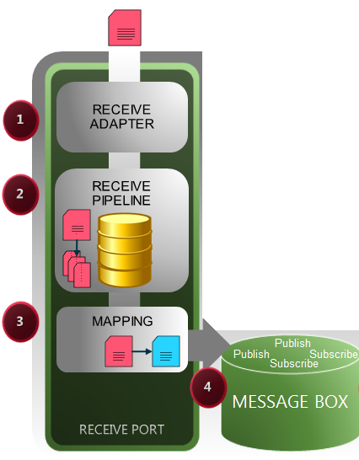
BizTalk Server 2010 Inbound Message Processing
Receive Adapter
Listens (or polls) on endpoint address for message data
Receive Pipeline
Prepares inbound message for processing
Decryption, decompression, security, validation.
Mapping
Inbound XML message transformation
Internal/canonical schema
Publish
XLANGMessages (0..n) written to MessageBox database
Orch/Send Port subscriptions evaluated

Slide 19
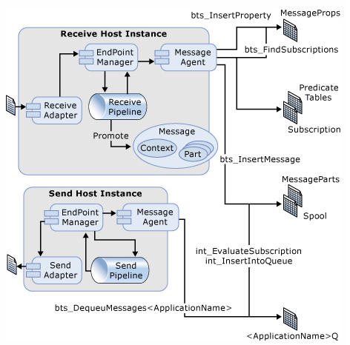
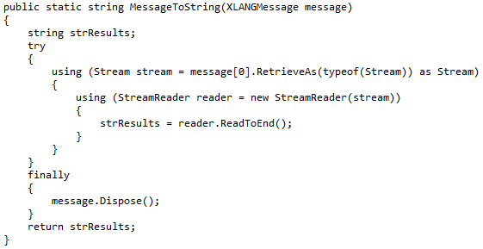
BizTalk Server 2010 Anatomy of a Message
Message Context
Collection of Key-Value Pairs
Used for subscription evaluation
Body Part
Main body of message
Loosely or strongly-typed
Accessed as a Stream
Parts
0..n additional message parts
May contain different data to main Body Part
Accessed as a Stream

Slide 20
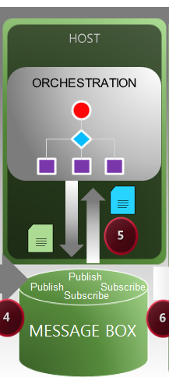
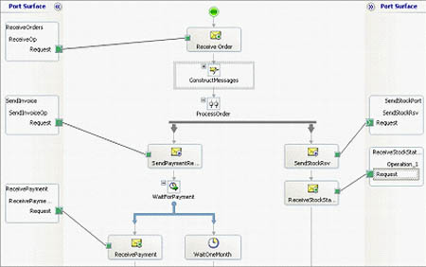
BizTalk Server 2010 Orchestration Processing
Orchestration instantiated based on subscription
Default subscription based on Receive Port message contract
All receive/send shapes go via MessageBox
BizTalk will “dehydrate” an orchestration if waiting too long for async response

Slide 21
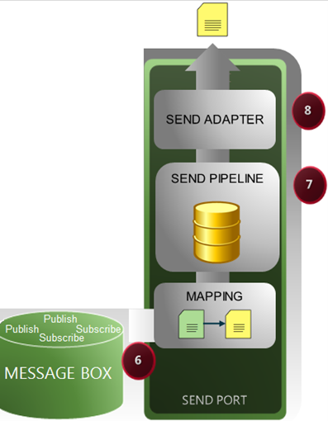
BizTalk Server 2010 Outbound Message Processing
Send Port Instantiated
Subscription ONLY way to send
Complete control over subscription logic
Mapping transforms outbound XML message
Send Pipeline
Prepares outbound message for transmission
Encryption, compression, security, validation …
Send Adapter
Transmits stream to configured endpoint address

Slide 22
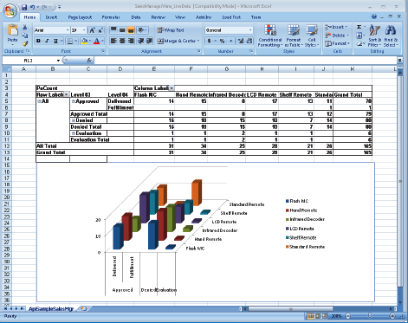
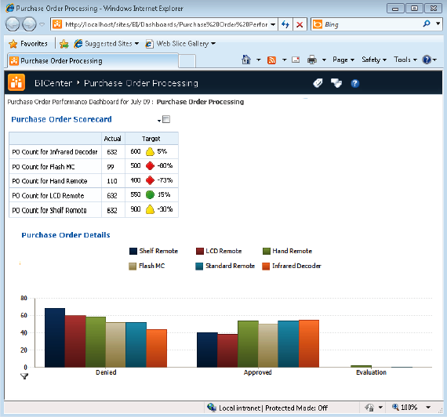
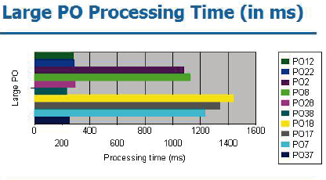
BizTalk Server 2010 Business Activity Monitoring (BAM)

Slide 23
Demo
BizTalk On-Premise - PO Processing

Slide 24
Where are We Now Summary of On-Premise Approach
Pros
Well understood & mature products
Availability of experienced resources
Lots of reference implementations
Cons
High up-front capital expenditure
Requires infrastructure expertise
Requires infrastructure redundancy
Not elastic

Slide 25
Agenda “Each journey begins with a single step…”
Where are we now?
On-Premise Application Platform
CapEx-based cost model
Where are headed?
Cloud-based Application Platform
OpEx-based cost model
Challenges
What’s My Strategy?
On-premise or Hybrid
Do I need to start now?

Slide 26
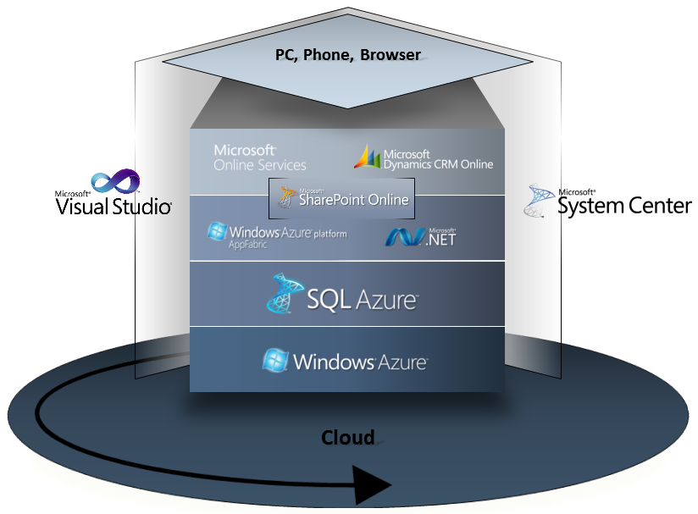
Microsoft Application Platform Goal is Platform Equivalence

Slide 27
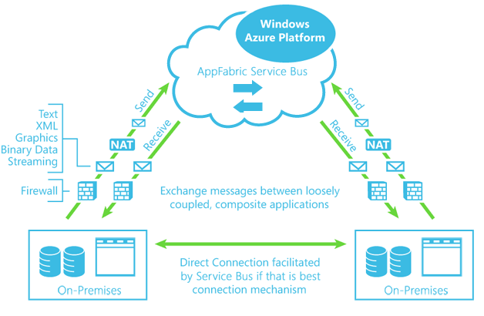
Windows Azure Service Bus An Overview
Messaging
One-way
Unicast & multicast
Full-duplex
Peer-to-peer
Pub-Sub
Secure
Network boundary traversal
Federated security with ACS
Open
Internet-scoped addresses
Publically discoverable
Supports REST & HTTP from non-Microsoft clients

Slide 28
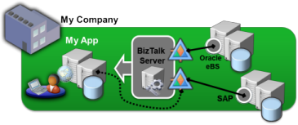
AppFabric Connect Extending your on-premise investments

Slide 29
Demo
Extending BizTalk to the Cloud

Slide 30
Agenda “Each journey begins with a single step…”
Where are we now?
On-Premise Application Platform
CapEx-based cost model
Where are headed?
Cloud-based Application Platform
OpEx-based cost model
Challenges
What’s My Strategy?
On-premise or Hybrid
Do I need to start now?

Slide 31
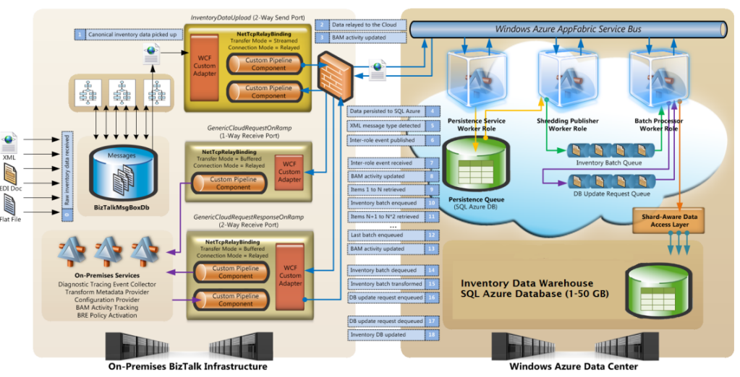
What’s My Strategy? Hybrid Integration Platform
http://code.msdn.microsoft.com/Hybrid-Reference-ef46d563

Slide 32
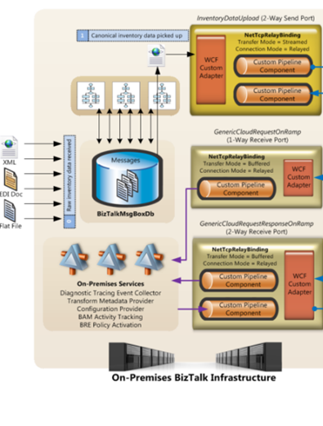
What’s My Strategy? Hybrid Integration Platform
On-Premise
BizTalk Server
Adapters (FILE, FTP, EDI etc)
Orchestrations
Rules Engine
Message Transformations
Business Activity Monitoring

Slide 33
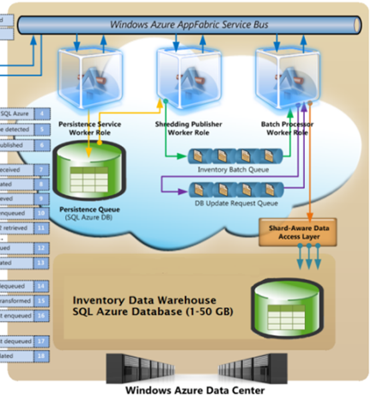
What’s My Strategy? Hybrid Integration Platform
Cloud
Azure ServiceBus
Message Relay
Inter-role messaging
Queues & Topics
Azure Worker Roles
Queue processing
Workload sharding
SQL Azure
Processing state persistence

Slide 34
Azure Integration
(what can we say here?)

Slide 35
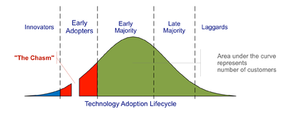
Why Should We Migrate? The Azure Adoption Chasm
Innovators
Are technology enthusiasts
Are forgiving of bugs & missing features
Not always focussed on business benefits
Early Adopters
Are technology visionaries
Focussed on strategic opportunities
Focussed on transformative business models
Early Majority
Pragmatists
Focussed on “proven business value”
Don’t want to be the visionaries
Represent the vast majority of market

Slide 36
Summary Closing Thoughts
Cloud is here and will keep improving
But it’s immature & new
BizTalk is mature & solving problems today!
However the die is cast…..

Slide 37
Enrol in Microsoft Virtual Academy Today
Why Enroll, other than it being free?
The MVA helps improve your IT skill set and advance your career with a free, easy to access training portal that allows you to learn at your own pace, focusing on Microsoft technologies.
What Do I get for enrolment?
Free training to make you become the Cloud-Hero in my Organization
Help mastering your Training Path and get the recognition
Connect with other IT Pros and discuss The Cloud
Where do I Enrol?
www.microsoftvirtualacademy.com
Then tell us what you think. TellTheDean@microsoft.com

Slide 38
© 2010 Microsoft Corporation. All rights reserved. Microsoft, Windows, Windows Vista and other product names are or may be registered trademarks and/or trademarks in the U.S. and/or other countries.
The information herein is for informational purposes only and represents the current view of Microsoft Corporation as of the date of this presentation. Because Microsoft must respond to changing market conditions, it should not be interpreted to be a commitment on the part of Microsoft, and Microsoft cannot guarantee the accuracy of any information provided after the date of this presentation. MICROSOFT MAKES NO WARRANTIES, EXPRESS, IMPLIED OR STATUTORY, AS TO THE INFORMATION IN THIS PRESENTATION.

