Slide 2
Automating Daas Desktops with Citrix cortex
SESSION CODE: CLI415
Tony Sanchez
WW Alliances Solutions Architecture
Citrix Systems Inc

Slide 3
Agenda
Citrix Service Provider Program
Citrix Cortex Cloud Control Panel Overview
Challenges for DaaS Providers
How Cortex solves them
Live Demonstration
Q&A

Slide 4
Deliver Windows Apps & Desktops as a Cloud Service
Scalable I Self-service I Secure
WAN optimization
User Experience
Cloud App Delivery Infrastructure
Secure access
Receiver
INSTANT ENTERPRISE POWER FOR EVERYONE
Notes:
4

Slide 5
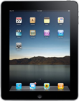
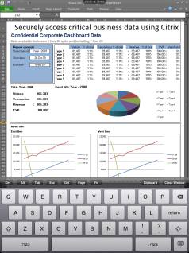
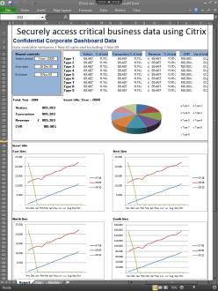
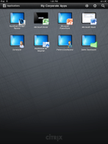
On-demand Windows desktops and apps from any device
Corporate Data Center
Network
The network acts like a combo VGA/computer monitor cable and control channel
Citrix Receiver
Citrix XenApp
The Citrix Receiver sends input from the devices keyboard, mouse and touch screen to the connected XenApp server.
XenApp sends the keyboard and mouse data to the running application to be processed.
The app looks like it’s running on the device, but it’s really running securely in the data center.

Slide 6
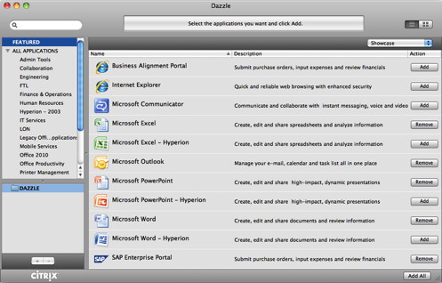
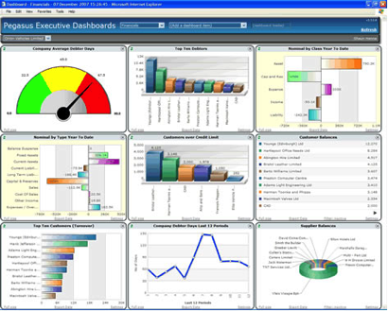
Meeting the Needs of Providers and Subscribers
Self-Service, Performance
Dashboards, Provisioning
Simple, Autonomic & Scalable Management
Subscriber
Tenant
Service Provider

Slide 7
Cloud DaaS Architects Challenges
Subscribers
Technology
Business
Multiple, hard to use portals
Too many interfaces
Billing/reporting difficult
Dependent on helpdesk
Expensive single-tenant environments
Can’t scale without multiplying staff
Insufficient identity management

Slide 8
Cortex Cloud Control Panel
Simplify cloud services management

Slide 9
Introduction to Cortex
Cortex Cloud Control Panel is used by service providers to manage the provisioning and delegated administration of hosted business applications
100+ active service providers
~1/3 in the Citrix Service Provider Program
Microsoft Gold Certified Partner

Slide 10
Simplifying Cloud Services Management
Cortex Cloud Control Panel from Citrix
Single, self-service interface for provisioning apps, desktops and services from the cloud
Automation
User Account
Management
Delegation
Messaging & Collaboration
Web & Data Hosting
Application Delivery
Virtualization
SDK

Slide 11
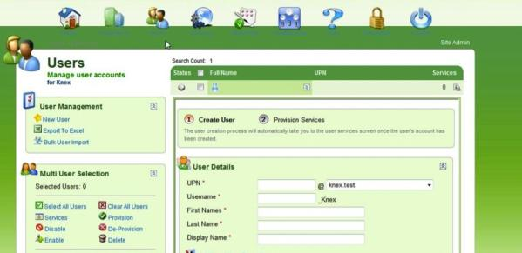
Support for Many Microsoft Technologies
Automation
User Account
Management
Delegation
Exchange, Sharepoint, RDS, SQL Server, Dynamics CRM
OCS
Web Data Hosting
Hyper-V
SDK

Slide 12
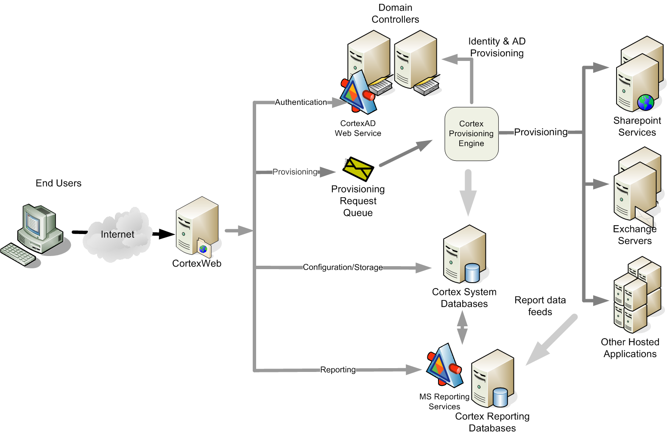
Architecture
Authentication
Provisioning
Provisioning
Configuration/Storage
Reporting
end-user web-site provisioning application servers

Slide 13
Customer Management Demo with Cortex Cloud Control Panel
Service provider (reseller)
Productize your offerings
Assign service to reseller/tenant
Create tenant and first admin user
Tenant administrator
Create users
Assign service to users
Manage Services, Application Groups, Distribution groups etc.
User
Change password
Single sign on tool, Outlook configuration

Slide 14
Live Demonstration

Slide 15
Packaging and Reporting

Slide 16
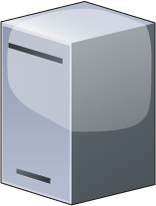
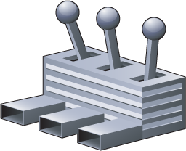
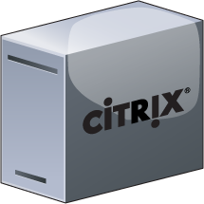
Active Directory #1
Cortex Provisioning Engine
Cortex Databases
Cortex API
Cortex Agent
Active Directory #X
Cortex Cloud Control Panel
Cortex Agent
Web enabled
Anywhere access
Application Servers
Service Providers
XenApp
Mail
SharePoint
Messaging
XYZ…
Subscribers

Slide 17
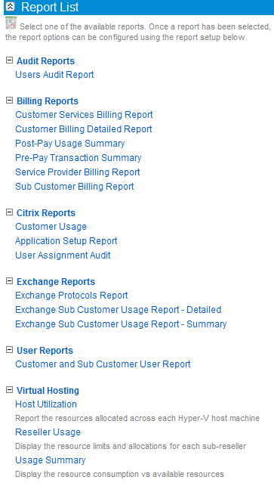
Reporting
Based on Microsoft SQL Server Reporting Services
Standard set of reports for each managed service (Exchange, SharePoint, etc.)
Billing reports with usage information – ready for import into variety of billing systems
Available in PDF, CSV, SLK, HTML and XML formats
Can be configured to deliver reports automatically via subscription mechanism

Slide 18
Reduce Costs and Risk
Automate
Reduce support costs by up to 70%
Delegate
Reduce time to resolve by 99%
SCALE!
Grow business and profitability
Minimize mistakes
Improve customer satisfaction and service
New user setup, from weeks to minutes!
Add new services with minimal incremental cost
Extend and customize for your needs

Slide 19
Summary
To compete in this market you must have automation and delegated administration
Cortex Cloud Control Panel from Citrix:
Platform capability for delivering from the Cloud
Range of horizontal apps supported out-of-the-box
Supports direct and partner sales models
Reduces your costs
Better IT solutions for the enterprise

Slide 20
Enrol in Microsoft Virtual Academy Today
Why Enroll, other than it being free?
The MVA helps improve your IT skill set and advance your career with a free, easy to access training portal that allows you to learn at your own pace, focusing on Microsoft technologies.
What Do I get for enrolment?
Free training to make you become the Cloud-Hero in my Organization
Help mastering your Training Path and get the recognition
Connect with other IT Pros and discuss The Cloud
Where do I Enrol?
www.microsoftvirtualacademy.com
Then tell us what you think. TellTheDean@microsoft.com

Slide 21
© 2010 Microsoft Corporation. All rights reserved. Microsoft, Windows, Windows Vista and other product names are or may be registered trademarks and/or trademarks in the U.S. and/or other countries.
The information herein is for informational purposes only and represents the current view of Microsoft Corporation as of the date of this presentation. Because Microsoft must respond to changing market conditions, it should not be interpreted to be a commitment on the part of Microsoft, and Microsoft cannot guarantee the accuracy of any information provided after the date of this presentation. MICROSOFT MAKES NO WARRANTIES, EXPRESS, IMPLIED OR STATUTORY, AS TO THE INFORMATION IN THIS PRESENTATION.

