Slide 2
Creating Custom WinPE 3.0 boot images
SESSION CODE: CLI303
Johan Arwidmark
Chief Technical Architect
Knowledge Factory

Slide 3
I live here...

Slide 4
Agenda
WinPE Drives the Deployment
WinPE Tools and Features
Deployment Solutions
How MDT 2010 and ConfigMgr 2007 is using WinPE
Create Custom WinPE Image
Offline Servicing – Drivers, Updates, other components
Authoring WinPE plugins
Troubleshooting
Device Driver Ranking, Logfiles

Slide 5
Deployment Challenges
Static Deployments are so 2001
Support for new hardware
Quicker turnarounds - Effective troubleshooting is key

Slide 6
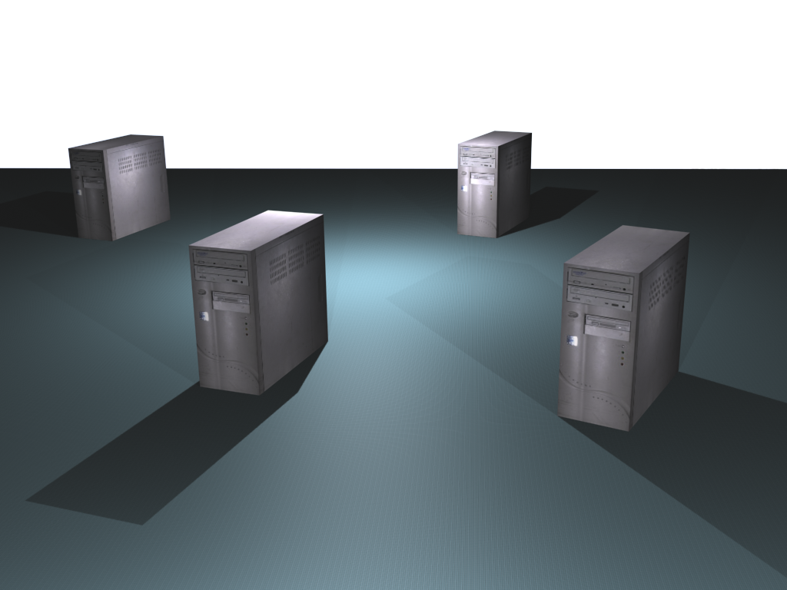
Demo Environment
Hyper-V R2, 16 GB RAM, 2 x 256 SSD
DC01
DC and DNS
DC02
DC and DNS
MDT01
MDT 2010
WDS, WSUS and DHCP
SQL 2008 Express SP1
CM01
MDT 2010
SQL 2008 SP1
WDS, WSUS and DHCP
ConfigMgr 2007 SP2

Slide 7
Windows 7 Setup
WinPE 3.x drives the Deployment
Using Setup or Imaging Utility
Setup is exclusively image-based
32- or 64-bit executable
Automated via unattend.xml
New boot from VHD option

Slide 8
Windows PE 3.1
New Features in WinPE 3.1
802.1x
Advanced Format Hard Drives (4k/512e)
Windows 7 SP1 bug fixes
“Old” tools
Drvload, DISM, BCDEdit, BootSect, WPEUtil
Still Default 32 MB Scratch Space

Slide 9
Following a Windows 7 setup…
Johan Arwidmark
Chief Technical Architect
Knowledge Factory
demo

Slide 10
Deployment Solutions
MDT 2010 Lite Touch
Adds custom shell and components
ConfigMgr 2007
Understanding the ConfigMgr boot media

Slide 11
MDT 2010 and ConfigMgr boot media internals
Johan Arwidmark
Chief Technical Architect
Knowledge Factory
demo

Slide 12
Creating Custom Boot Images #1
Using WAIK 2.0
The CopyPE command
Offline Servicing - DISM
Add Packages and Updates
Add Drivers

Slide 13
Creating Custom WinPE Images #1
Johan Arwidmark
Chief Technical Architect
Knowledge Factory
demo

Slide 14
Creating Custom Boot Images #2
Add other components
Authoring plugins
Adding Frontends
Using Web Services

Slide 15
Creating Custom WinPE Images #2
Johan Arwidmark
Chief Technical Architect
Knowledge Factory
demo

Slide 16
Troubleshooting WinPE
Components
Log Files

Slide 17
Troubleshooting WinPE
Johan Arwidmark
Chief Technical Architect
Knowledge Factory
demo

Slide 18
Summary
Understanding WinPE
Effective Troubleshooting
Quickly adopt for new hardware
Dynamic Deployments

Slide 19
Session resources
www.deploymentresearch.com
www.deploymentbunny.com
blogs.technet.com/deploymentguys
blogs.technet.com/mniehaus

Slide 20
Enrol in Microsoft Virtual Academy Today
Why Enroll, other than it being free?
The MVA helps improve your IT skill set and advance your career with a free, easy to access training portal that allows you to learn at your own pace, focusing on Microsoft technologies.
What Do I get for enrolment?
Free training to make you become the Cloud-Hero in my Organization
Help mastering your Training Path and get the recognition
Connect with other IT Pros and discuss The Cloud
Where do I Enrol?
www.microsoftvirtualacademy.com
Then tell us what you think. TellTheDean@microsoft.com

Slide 21
© 2010 Microsoft Corporation. All rights reserved. Microsoft, Windows, Windows Vista and other product names are or may be registered trademarks and/or trademarks in the U.S. and/or other countries.
The information herein is for informational purposes only and represents the current view of Microsoft Corporation as of the date of this presentation. Because Microsoft must respond to changing market conditions, it should not be interpreted to be a commitment on the part of Microsoft, and Microsoft cannot guarantee the accuracy of any information provided after the date of this presentation. MICROSOFT MAKES NO WARRANTIES, EXPRESS, IMPLIED OR STATUTORY, AS TO THE INFORMATION IN THIS PRESENTATION.

