Slide 2
CLI302 Application Readiness for Windows 7 and Server 2008 R2
SESSION CODE: CLI302
Paul Schnell
CTO
App-DNA

Slide 3
Agenda Application Readiness for Windows 7 and Server 2008 R2
Intro’s
Application challenges
The ‘old way’
The ‘new way’
Demos
Closing
75min

Slide 4
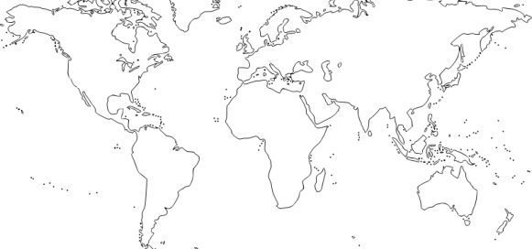
Intro’s Who are App-DNA?
Worldwide ISV
Locations: London, Paris, Sydney & Chicago
Opening: New York, Munich
Software: AppTitude (5.1) 8 years mature
Technology Partners
Channel
(GSIP & SIP programme)
Customers
(over 200 enterprises)
Industry Leadership
(Awards, Thought Leadership, Innovation)

Slide 5
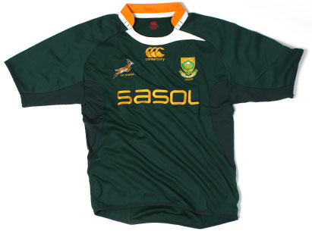
Intro’s Who am I?

Slide 6
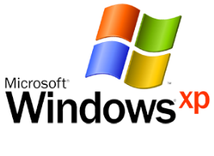
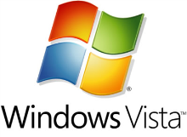
Intro’s Who are you?
Developer
IT Pro
Project Manager / Architect
CXO

Slide 7
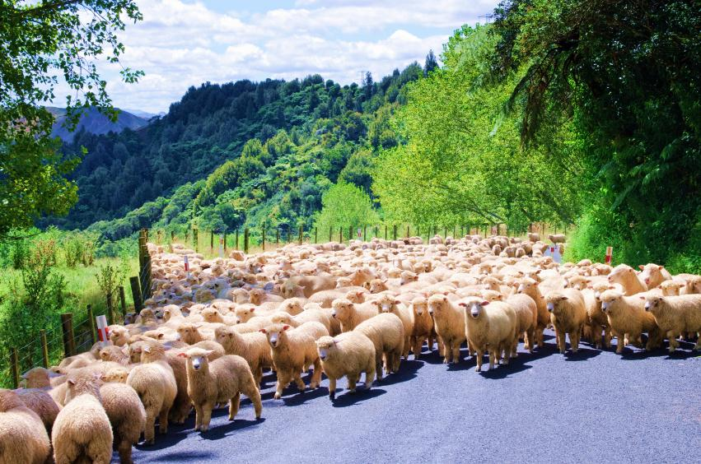
Application readiness How does the road ahead look?

Slide 8
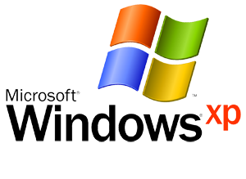
Application Challenges Application Readiness for Windows
Old World
New World

Slide 9
What’s happening here?
Manageability
Portability / Agility
Security
Green
Accessibility
New technologies
Complexity
Uncertainty
Risk
Cost
Time
?
Applications

Slide 10
Why do the apps complicate things?
App Format
Physical
Virtual
Delivery Method
Hosted
Streamed
?
Win 7
OS Compatibility
Server 2008
Virtualization
App-V
XenApp
Application profile
Volume
Data Perf Deps

Slide 11
The ‘old way’ Manual effort
?
Time
Cost
Risk

Slide 12
The ‘new way’ Automation
Time
Application
“DNA”
Cost
Risk

Slide 13
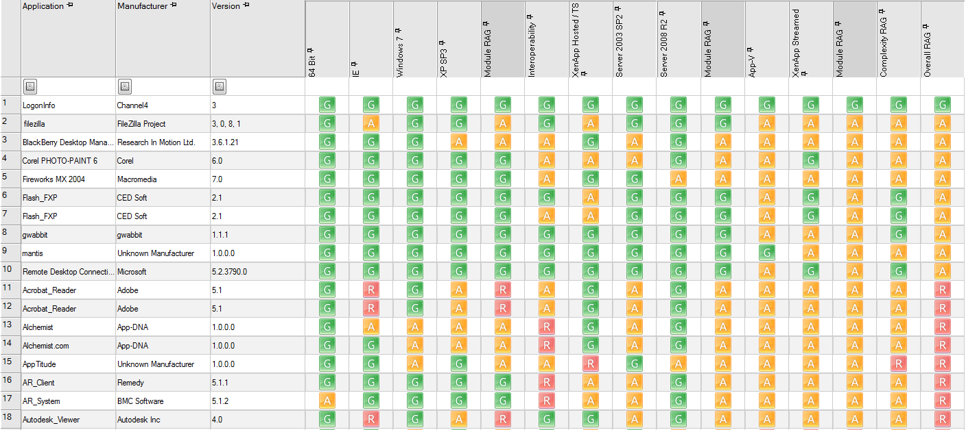
Readiness Matrix All apps, all technologies
Windows Desktop
Server Based Computing
Virtualisation
Complexity

Slide 14
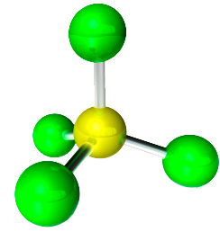
Leveraging Automation How do we get there?
Discover
Model
Automate
Manage

Slide 15
Leveraging Automation How do we get there?
Discover
Model
Automate
Manage

Slide 16
Discover Building Application Intelligence
Import
Analyse
Report
Application
“DNA”
All Applications

Slide 17
Import Application and OS DNA
68,000+ data points per app
Application DNA
Windows 7 DNA
Windows XP DNA
DNA Database

Slide 18
Analyse Heuristic algorithms
Algorithms
Apps
Internal State
Dependencies
App -> App
App -> OS
External data
OS
DNA Database

Slide 19
Anatomy of an Algorithm
OBS7_WINXP_001
Obsolete Files Provided by Windows XP
Application DNA
Assess External References
Check References
Windows 7 DNA
Windows XP DNA
Check References
DNA Database

Slide 20
Anatomy of an Algorithm
W7_UAC_015
Un-elevated Administrative Applications
Application DNA
Find Elevated APIs
Assess Elevated References
Windows 7 DNA
Windows XP DNA
Check Manifests
DNA Database

Slide 21
Anatomy of an Algorithm
IE_SCRIPT_CLASS_001
‘classname’ attribute syntax no longer supported
Application DNA
Determine Rendering Mode
Find classname usage
Windows 7 DNA
Windows XP DNA
DNA Database

Slide 22
Most Frequent Issues
Description | % | RAG | Fix? | Effort
Missing dependencies or middleware | 17%
Session 0 Isolation Issues | 15%
UAC Issues with setups | 6%
UAC Issues with applications | 6%
Missing dependencies or middleware provided by Windows XP | 5%
Launch Conditions preventing installation | 2%
Restricted access to registry keys | 2%
Services requiring SYSTEM credentials | 2%

Slide 23
Discover
DEMO

Slide 24
Leveraging Automation How do we get there?
Discover
Model
Automate
Manage

Slide 25
A Key project challenge Estimation
Effort
Resources
Time
Cost
?

Slide 26
Effort Calculator Automated results
Apps
Issues
Actions
Action
Effort
App
Complexity
Project Variables
Project Effort
Getting from current state to remediated state

Slide 27
Model
Model
DEMO

Slide 28
Leveraging Automation How do we get there?
Discover
Model
Automate
Manage

Slide 29
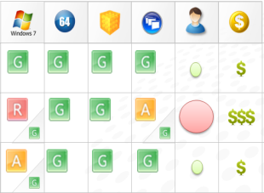
Forward Path Driving conditional delivery
Conditional Delivery
IT Consumerisation
Browser
User Persona
AppTitude Forward Path
VDI
Laptop
Presentation Virtualisation (XenApp / TS)
PC
App-V
Streamed Local
Smart

Slide 30
Forward Path Managing multiple technologies
Organisational Objectives
Model, action
Automate App-V package creation
Critical App, Complex email app owner
Requires Win 7 testing
AppTitude Forward Path

Slide 31
Automate
Automate
DEMO

Slide 32
Leveraging Automation How do we get there?
Discover
Model
Automate
Manage

Slide 33
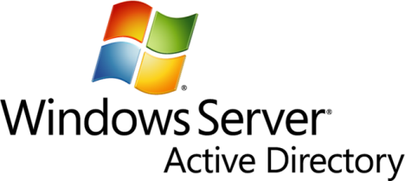
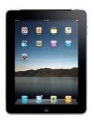
Manage
Apps + Users + Devices

Slide 34
Question & Answer Session

Slide 35
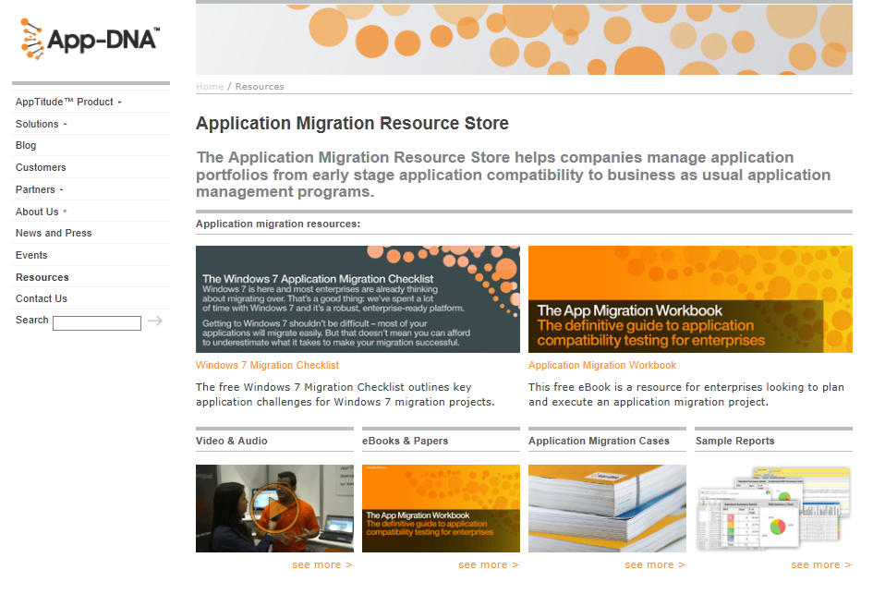
Closing App-DNA resources: www.app-dna.com

Slide 36
Closing Windows Migration Checklist
1. Audit your App Estate
2. Rationalize aggressively
3. Scale the project
4. Plan your resourcing
5. Scope out the migration project
6. Start with pre-migration app-compat assessment
7. Test against your own flavor of Windows 7
8. Create the migration plan
9. Develop an optimized migration process
10. Implement ‘Targeted Testing’
11. Packaging Remediation: give your Packagers/Developers the insight they need
12. More efficient BAU when migration is complete

Slide 37
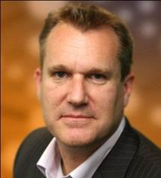
Complete an Evaluation online and SEE WHO WINS…
Chris Jackson
“Appcompat guy”
Paul Schnell
“The underdog”

Slide 38
Next Steps: Get Started!
Free resources on www.app-dna.com
Jumpstart Program licenses at www.app-dna.com/jumpstart
AppTitude 20 minute demo
App Migration Workbook (ebook)
Windows 7 Migration Checklist
Sample reports and more…
Demo? Pricing? Contact info@app-dna.com
App-DNA technical blog fishbowl.app-dna.com
Follow @appdna on

Slide 39
Enrol in Microsoft Virtual Academy Today
Why Enroll, other than it being free?
The MVA helps improve your IT skill set and advance your career with a free, easy to access training portal that allows you to learn at your own pace, focusing on Microsoft technologies.
What Do I get for enrolment?
Free training to make you become the Cloud-Hero in my Organization
Help mastering your Training Path and get the recognition
Connect with other IT Pros and discuss The Cloud
Where do I Enrol?
www.microsoftvirtualacademy.com
Then tell us what you think. TellTheDean@microsoft.com

Slide 40
© 2010 Microsoft Corporation. All rights reserved. Microsoft, Windows, Windows Vista and other product names are or may be registered trademarks and/or trademarks in the U.S. and/or other countries.
The information herein is for informational purposes only and represents the current view of Microsoft Corporation as of the date of this presentation. Because Microsoft must respond to changing market conditions, it should not be interpreted to be a commitment on the part of Microsoft, and Microsoft cannot guarantee the accuracy of any information provided after the date of this presentation. MICROSOFT MAKES NO WARRANTIES, EXPRESS, IMPLIED OR STATUTORY, AS TO THE INFORMATION IN THIS PRESENTATION.

