Slide 2
Provisioning in System Center: Users, Groups, Virtual Servers, Software and More!
Cameron Fuller
Chris Ross
Jason Sandys
Catapult Systems
IM-B317

Slide 3





Ultimate Provisioning Championship: Tale of the Tape
  Years in IT
  MVP Years
  MMS Years
  Specialization
  Twitter
Cameron Fuller
  20
  7
  9
  Operations Manager
  @CFullerMVP
Jason Sandys
  19
  4
  7
  Config Manager
  @JasonSandys
Chris Ross
  18
  1
  2
  Service Manager
  @SCSMUS
CARL
  5
  -
  Debut
  Helpdesk
  @SCUCARL

Slide 4
Agenda
Integration Points in System Center
  Service Manager
  Orchestrator
  Operations Manager
  Configuration Manager
Provisioning Scenarios & Demos in Three Rounds
  Users and Groups
  Virtuals
  Software
  Other scenarios

Slide 5
Operations Manager
Service Manager
Integration Points
Configuration Manager
Orchestrator
Management Pack
Management Pack
Management Pack
Operations Manager
Active Directory
Management Pack
Management Pack
Exchange
Data Protection Manager
Management Pack
Management Pack
Virtual Machine Manager
Management Pack
App Controller

Slide 6
Orchestrator
Operations Manager
Integration Points
Configuration Manager
Service Manager
Integration Pack
Integration Pack
Integration Pack
Orchestrator
Active Directory
Integration Pack
Integration Pack
Exchange
Data Protection Manager
Integration Pack
Integration Pack
Virtual Machine Manager
Integration Pack
App Controller

Slide 7
Configuration Manager
Operations Manager
Integration Points
Service Manager
Orchestrator
Console & Agent Deployment
Console Deployment
Configuration Manager
Console Deployment
Active Directory
Exchange
Data Protection Manager
Virtual Machine Manager
Console & Agent Deployment
App Controller

Slide 8
Service Manager
Operations Manager
Integration Points
Configuration Manager
Orchestrator
Alerts
Configuration Items
Service Manager
Configuration Items
Runbooks
Active Directory
Configuration Items
Configuration Items
Exchange
Data Protection Manager
Virtual Machine Manager
Configuration Items
App Controller

Slide 9
Provisioning Scenarios
Lots of options are available
  Some are automated, some are manual
The right option will vary depending on
  What components of System Center you use
  Your business requirements

Slide 10

Round 1: Users & Groups
1

Slide 11

Provisioning Scenarios: Users & Groups
Approach
  Manual user creation from a ticket or email source
  Requests can be submitted through a portal or email
  The request in the ticket is executed by the helpdesk person and the ticket is closed after the action is completed
Benefits
  Minimal complexity and minimal training required
  Works well for organizations which do not create large numbers of user or groups regularly
Negatives to Automating
  Account creation may need to go through different chains of command. For an example full time employees versus contractors.

Slide 12
Provisioning Scenarios: Users
Orchestrator only
  Approach:
  Daily data file from your payroll company
  Processed through an Orchestrator workflow
  Good for large organizations with lots of personnel churn
  Benefits: Fully automated user provisioning for large-scale organizations
  Negatives: Requires a data file from your payroll provider and time to create the integration
Service Manager + Orchestrator
  Approach:
  Employee requests user creation through a portal
  Processed through an Orchestrator workflow
  Benefits: Good for smaller organizations who want to automate currently manual processes
  Negatives: Complexity required to install the two components, configure integration and monitor the integration.

Slide 13
User Provisioning
Provisioning user creation from Service Manager and creating the user through an Orchestrator workflow.
Active Directory
Service Manager
Orchestrator
Integration Pack
Runbook Execution
Integration Pack
Exchange

Slide 14
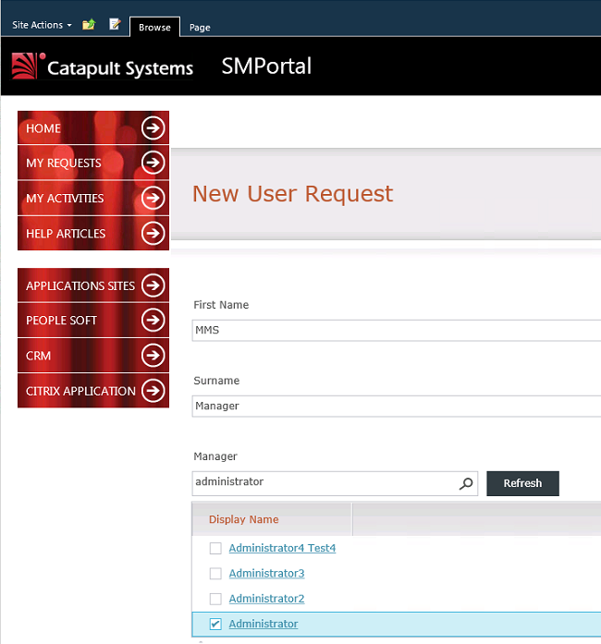
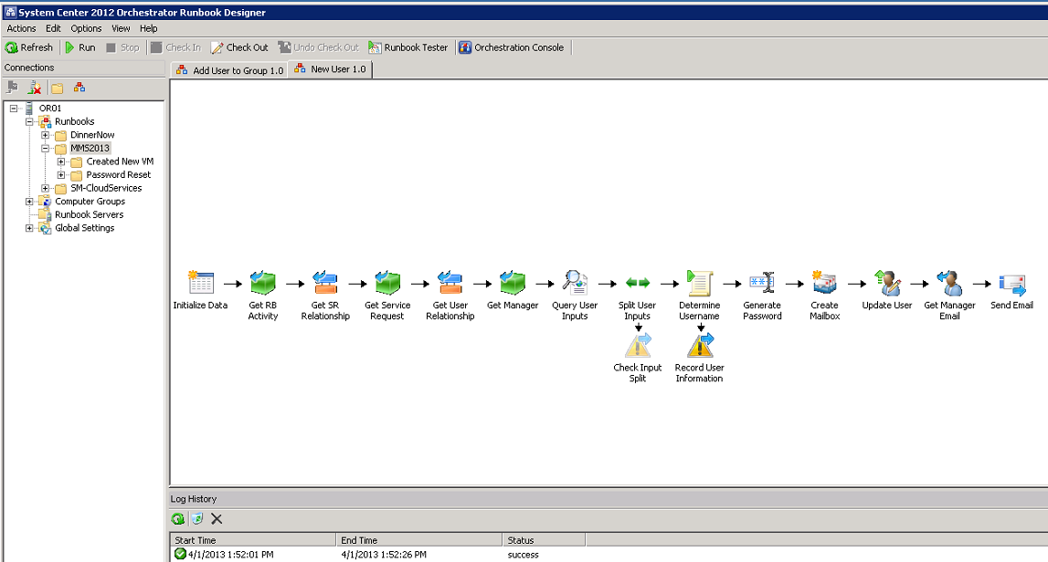
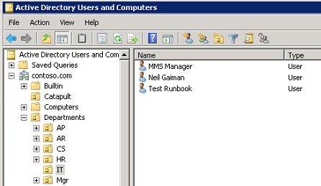
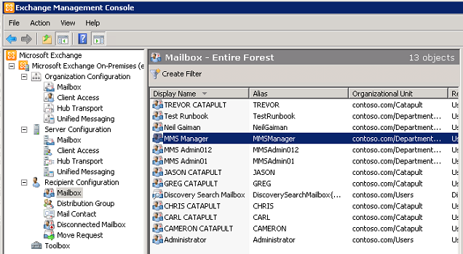
User Provisioning
Service Manager
Orchestrator
Active Directory
Exchange

Slide 15
Group Provisioning
Request on the service manager portal, opens a ticket, service request, approved, Orchestrator to add a user to a group.
Service Manager
Orchestrator
Runbook Execution
Integration Pack
Active Directory

Slide 16
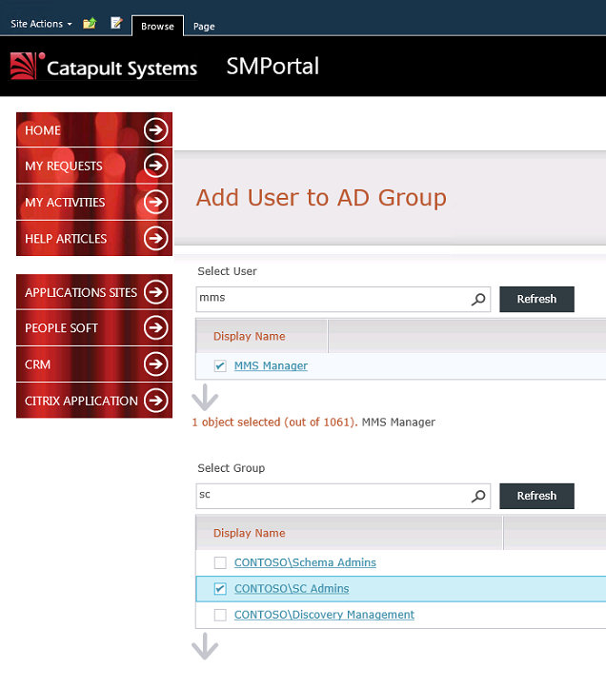
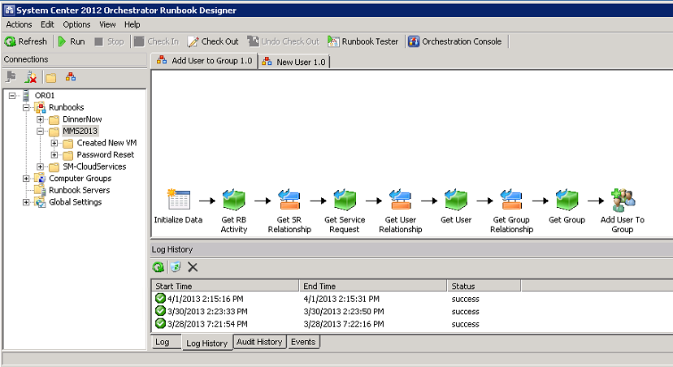
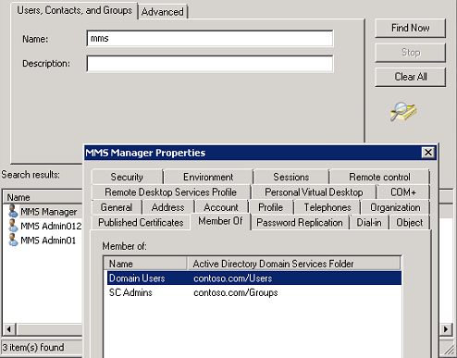
Group Provisioning
Service Manager
Orchestrator
Active Directory

Slide 17
Demo: User Provisioning using Service Manager + Orchestrator
1
Users
Groups
Cameron Fuller, Chris Ross

Slide 18


Round 1: Who Won?
Tweet to #SysCtrMVP - #MMS2013 #MMSB317 if System Center won this round!
Tweet to #SCUCarl - #MMS2013 #MMSB317 if CARL won this round!

Slide 19
Round 2: Virtuals
2

Slide 20
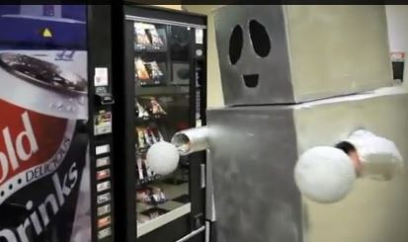
Provisioning Scenarios: Virtuals
Approach
  Same approach as user and group provisioning
Benefits
  Minimal complexity
  Minimal training required
  Works well for organizations which do not create large numbers of virtual servers
Negatives to Automating
  Chargeback needs to occur for virtual server resources
  How do you handle resources requested such as SQL servers which need to have their memory fine-tuned?

Slide 21
Provisioning Scenarios: Virtuals
Hyper-V only
  Benefits: Installed with the first Hyper-V server
  Negatives: No templates, or advanced functionality available in VMM
Virtual Machine Manager only
  Benefits: Provides all of the functionality from Hyper-V manager and more including templates
  Negatives: No workflow approval for users requesting virtuals
Service Manager + Orchestrator + Virtual Machine Manager
  Benefits: Fully automated including workflow and approval
  Negatives: Complexity required to install multiple components, configure integration and monitor the integration.
Cloud Process Pack + Service Manager + Orchestrator + Virtual Machine Manager
  Benefits: Fully automated including workflow and approval with pre-built Orchestrator and Service Manager items
  Negatives: Complexity required to install multiple components, configure integration and monitor the integration.

Slide 22
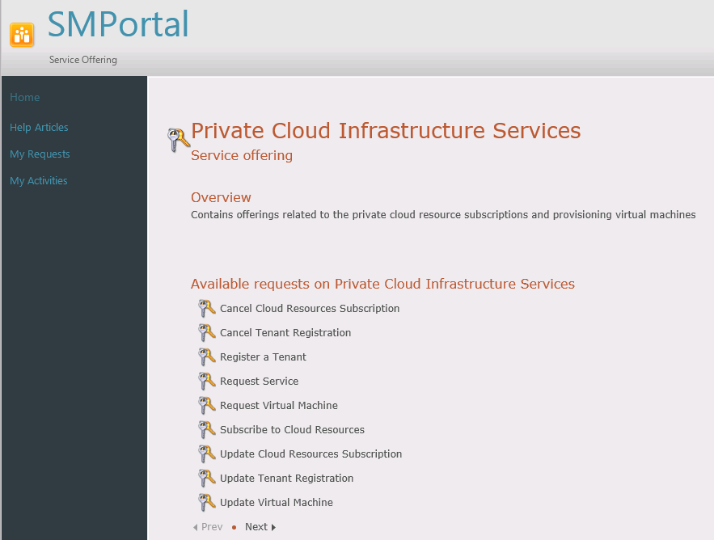
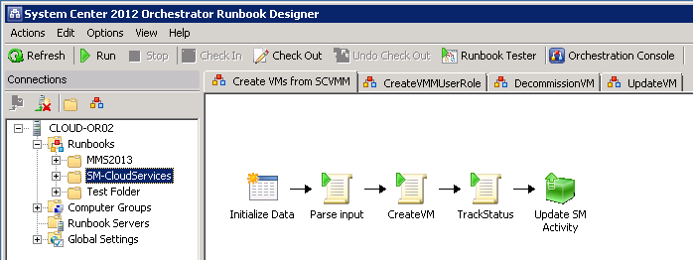
Virtual Provisioning: Cloud Process Pack
Service Manager
Orchestrator

Slide 23
Virtual Provisioning
Provisioning a virtual via a request form in Service Manager and creation of the virtual in VMM instrumented through Orchestrator.
Service Manager
Orchestrator
Virtual Machine Manager
Runbook Execution
Integration Pack

Slide 24
Demo: Virtual Provisioning using Service Manager, Orchestrator + Virtual Machine Manager
2
Virtuals
Chris Ross, Cameron Fuller

Slide 25
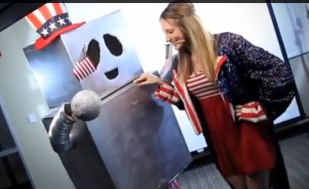
Round 2: Who Won?
Tweet to #SysCtrMVP - #MMS2013 #MMSB317 if System Center won this round!
Tweet to #SCUCarl - #MMS2013 #MMSB317 if CARL won this round!

Slide 26
Round 3: Software
3

Slide 27
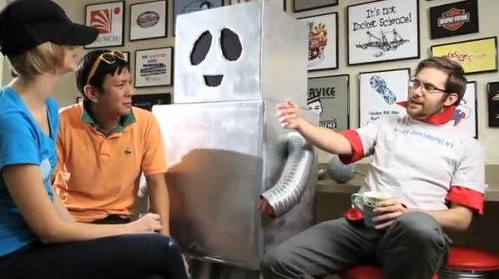
Provisioning Scenarios: Software
Approach
  Same approach as user and group provisioning
  Sneakernet for one-off applications
Benefits
  Minimal complexity
  Minimal training required
  Works well for organizations which do not deploy a lot of software
Negatives to Automating
  My vendor will not support packaging the application
  Certain software configurations only go to certain machines due to known incompatibilities

Slide 28
Provisioning Scenarios: Software
Configuration Manager
  Benefits: Portal available directly through ConfigMgr
  Negatives: No advanced workflow capabilities
Orchestrator + Configuration Manager
  Benefits: Delegation of permissions
  Negatives: Complexity of integrating the two components
Application Approval Workflow = Service Manager + Orchestrator + Configuration Manager
  Benefits: Advanced workflow capabilities like approval
  Negatives: Complexity of integrating the three components

Slide 29
Software Provisioning
Integrating Service Manager with ConfigMgr for self-service package requests and automated approval.
Service Manager
Configuration Manager
Orchestrator

Slide 30
Demo: Software Provisioning using AAW + Orchestrator + Service Manager + Configuration Manager
3
Software
Chris Ross, Jason Sandys

Slide 31

Round 3: Who Won?
Tweet to #SysCtrMVP - #MMS2013 #MMSB317 if System Center won this round!
Tweet to #SCUCarl - #MMS2013 #MMSB317 if CARL won this round!

Slide 32
Provisioning Scenarios – Lessons Learned
Orchestrator
  Build the runbook first, and use the runbook tester
  Orchestrator runbooks not working? Make sure they are checked in!
  Integrate runbooks through the runbook ID number
Operations Manager
  Monitor everything including System Center
  Monitor runbooks
  Monitor critical services and auto-restart in lab environments
  Alert on conditions from runbooks
Configuration Manager
  Shared content in App-V: “Import-module AppVClient
  Set-AppvclientConfiguration -SharedContentStoreMode 1”
Service Manager
  Need to publish Service Offerings so they appear in the Service Manager Portal
  Orchestrator workflows not synching? Try http://tinyurl.com/NoRunBook4U (TRUNCATE TABLE [Microsoft.SystemCenter.Orchestrator.Internal].AuthorizationCache)
System Center
  Integrated solution with best of breed components
  Manages both physical and virtual environments

Slide 33
Round 4: Sudden Victory
4?

Slide 34
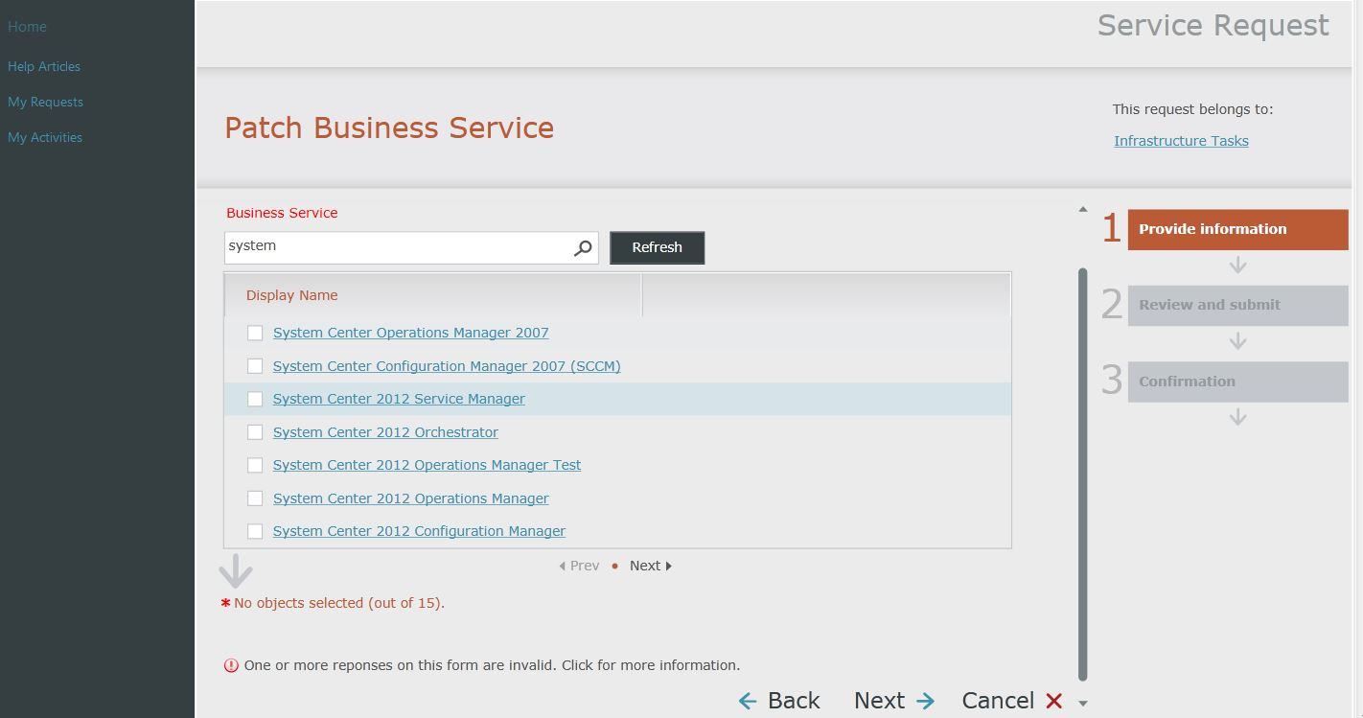
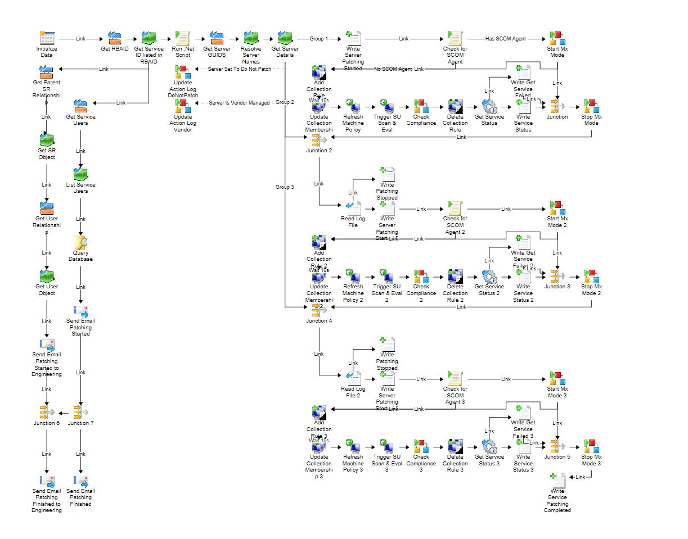
Other Integration Scenarios
Application owner self service patching
  Service Manager plus Orchestrator to patch business services
Service Manager
Orchestrator

Slide 35
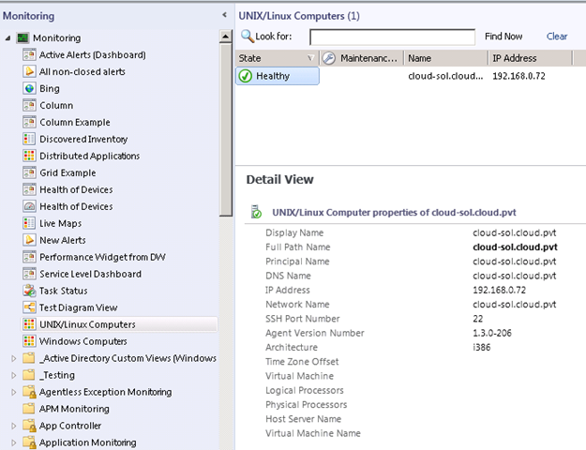
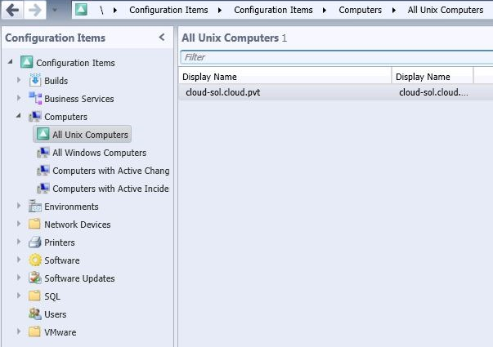
Other Integration Scenarios
Operations Manager and Network Monitoring with Service Manager
  Operations Manager network monitoring (http://tinyurl.com/ccohkao )
  Integration with Service Manager to include the network devices as CI’s
Operations Manager
Service Manager

Slide 36
Who won?
OR

Slide 37
Take-A-Ways
System Center is more powerful when using multiple components
  Use the existing integration points
What is important to automate in your environment?
  Users and groups?
  Virtuals?
  Software deployment?
Automation is not for every situation
  Choose to automate processes which need to be more consistent or occur frequently

Slide 38
Resources
Access MMS Online to view session recordings after the event.
http://channel9.msdn.com/Events

Slide 39
Evaluation
We want to hear from you!
Complete your session evaluations today and enter to win prizes daily.
Provide your feedback at a CommNet kiosk or log on at www.2013mms.com.
Upon submission you will receive instant notification if you have won a prize.
Prize pickup is at the Information Desk located in Attendee Services in the Mandalay Bay Foyer.
Entry details can be found on the MMS website.

